Slide 1
EID and Viral Load Product and Site Selection Tool
May 2015

Slide 2
Background: Why is a product selection process necessary?
Comprehensive product information
Historically, in the diagnostics sector, decision-makers have lacked sufficient information to make informed product selection decisions
Suppliers provide Ministries of Health (MOHs) with extensive marketing materials, but they lack comprehensive and unbiased information to pick the products that are most appropriate for their countries
Public procurement principles
Public funding requires that public procurement principles be observed in the procurement of commodities. MOHs have an obligation to demonstrate that a rational and transparent process has been followed to select products for procurement.
There is a role to play for neutral 3rd parties to facilitate the development of a rational and transparent product selection process.

Slide 3
Key Principles of Product and Site Selection
It should be MOH-led and involve all key stakeholders to drive consensus
It should be rational, transparent, and well-documented
It should be driven by the country’s unique diagnostic testing priorities, including such factors as:
Patient volumes
Clinical need (i.e., potential need for emergency EID testing in hospitals)
Access challenges (low-volume sites with long turnaround times and/or sites that are located far from centralized testing labs)
Cost efficiency
4. It should be an iterative process

Slide 4
Product and site selection tool are just part of a broader process
Select products for evaluation
Convene TWG
Review product information
Product selection
Conduct evaluations
Select products for
Pilot/scale-up
Note: Countries are increasingly working to harmonize and share evaluation results to minimize duplication.
Convene TWG
Review evaluation results
Product selection
Site selection tool
Pilot/Scale-up

Slide 5
The product and site selection tool and accompanying guidance can be used to facilitate stakeholder discussions
Understand current testing landscape
Understand the current gaps in testing coverage in the country:
What segments have the poorest access to testing?
At what level of the health system do most patients seek care?
Which segments of the health system would be best served by POC?
Determine key criteria
Determine the most important ~5 – 10 criteria when selecting POC products
Discuss how these criteria should be weighted against each other in each segment
Determine balance between patient numbers, access, and price to be used in site selection
Review product pipeline and assign scores to products
Review all available information for each product
Assign scores for each of the products for the criteria determined in step 2
Select POC products and sites
Review scores for each product in the various segments
Hold discussions across all stakeholders to consider scores and other relevant factors
Select products for evaluation and/or scale-up and match to appropriate sites
Repeat process periodically to include new products and new information

Slide 6
EID and VL Site and Product Selection Tool Overview (1 of 5)
Goal: Help countries determine optimal deployment of POC and conventional equipment at a site level to maximize patient impact while maintaining cost efficiency
1
Define country and site-level information
Enter details regarding country guidelines, existing equipment, lab operations, sample transportation, costs, and site-level patient data, including but not limited to:
ART patients
PMTCT patients OR historical EID test numbers
Existing access to testing (EID or VL)
Distance from lab or turnaround time in days
Presence of pediatric or nutrition ward
2
Assign site selection criteria
Weight most important criteria for site selection, including minimizing cost, improving on-site access to testing, or maximizing patient coverage
Choose maximum number of devices to be deployed per site

Slide 7
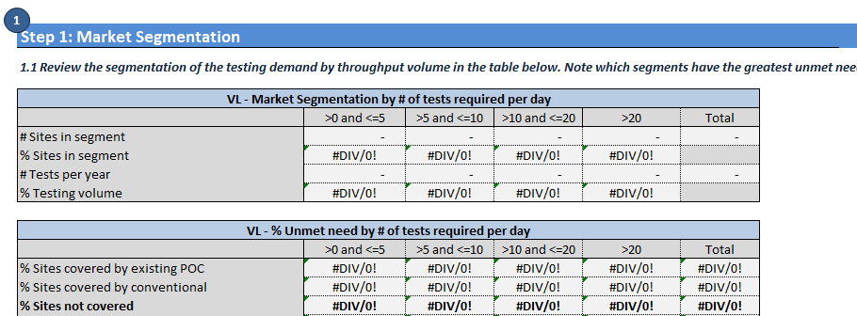
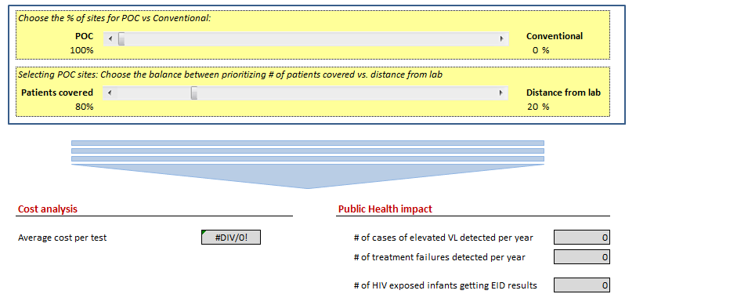
EID and VL Site and Product Selection Tool Overview (2 of 5)
3
Assess existing coverage through conventional systems and role of POC
Outputs of site-level data used to define access to on-site testing
User can test various scenarios shifting balance from conventional to POC at national level to determine potential patient and cost impact
This will help inform the overall balance between POC and conventional testing in country

Slide 8
EID and VL Site and Product Selection Tool Overview (3 of 5)
4
Determine key criteria for new product selection
Identify all the factors that should be considered when selecting new product
Identify percentage weights to be given to each criteria
Performance Criteria | >0 and <=5 | >5 and <=10 | >10 and <=20 | >20
Tests Offered (EID or VL) |  |  | 5% | 10%
Quantitative/Semi-Quantitative |  |  |  | 5%
Device/Device-Free | 5% | 5%
Throughput |  |  | 15% | 25%
Power Source | 20% | 20% | 10% | 10%
Connectivity | 10% | 10% | 20% | 15%
Device Cost | 20% | 20% | 10% | 5%
Reagent Cost | 10% | 10% | 10% | 10%
Ease of Use | 15% | 15% | 15% | 5%
After-Sale Support | 20% | 20% | 15% | 15%
5
Review product pipeline and assign scores to products
6
Select new products to deploy

Slide 9
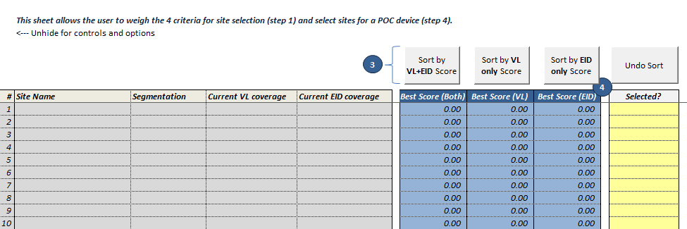
EID and VL Site and Product Selection Tool Overview (4 of 5)
7
Score and select sites and assign products
Sort sites to rank from highest to lowest based on EID, VL, or both
Select which sites will be chosen for new product deployment
Designate product for all chosen sites

Slide 10
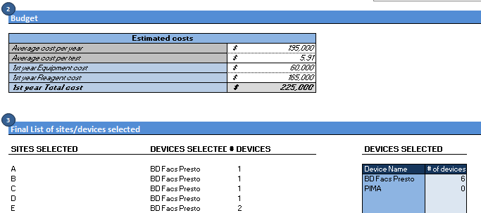
EID and VL Site and Product Selection Tool Overview (5 of 5)
8
Review outputs and adjust as necessary
Review model outputs, including:
Distribution of on-site access to testing by facility size
List of sites and devices selected
Required budget
Average cost per test
Public health impact
Adjust model outputs based on findings

Slide 11
Introducing New POC Devices in Zimbabwe:
Focus on Early Infant Diagnosis
May 2016

Slide 12
Agenda
Zimbabwe POC Implementation Guidelines
Case Study: POC Product Selection
Case Study: POC Site Selection

Slide 13
Implementation guidelines: Driven by country’s overall plan
The POC Guidelines Development Task Force was formed by Ministry of Health and Child Care Department of Laboratory Services (MOHCC-DLS) to draft POC Testing Guidelines;
Actively participated by key partners: MLSCZ, ZINQAP, CHAI, UNICEF, EGPAF, JSI ,MSF, ZNA, AFZ, NBTS
In 2015, the National POC Testing Guidelines was approved by the MOHCC Permanent Secretary
The POC Testing Guidelines :
Define the strategy for POC, including guidelines and criteria for selecting products and sites for deployment;
Include a roadmap for product-agnostic systems for training, quality assurance, supply chain and distribution, service and maintenance, data management, and M&E;
Per the POC Testing Guidelines
Facilitation of the product selection process has included both quantitative scoring and qualitative discussion among MOHCC-led TWGs and specific programs such as PMTCT and HIV/TB.
Notes:
Please note that the POC guidelines apply to all POC and near POC testing ( HIV screening, CD4, EID, VL, HCV, etc)

Slide 14
Agenda
Zimbabwe POC Implementation Guidelines
Case Study: POC Product Selection
Case Study: POC Site Selection

Slide 15
Key Principles of Product Selection per POC Testing Guidelines
It must be led by the MOHCC-DLS
The process should involve all key stakeholders to drive consensus
Rational and transparent criteria will be used to identify the most suitable products
The process should be well documented demonstrating the rationale for the selection of suitable products
The tools should be flexible so that Zimbabwe can customize the process according to its needs
The process must be iterative as the laboratory network and available technologies evolve
Notes:
Add comment on how the tool help improve product selection process in the past and how similar tool will help improve unbiased product selection for EID and VL

Slide 16
Product Selection Case Study: Zimbabwe POC EID
Attendance: National Microbiology Reference laboratory (NMRL/MOHCC), EGPAF, MSF, UNICEF, CHAI
Understand current testing landscape for EID
1
CHAI presented on the current access to on-site testing in Zimbabwe
The group focused on:
Largest segments where pediatric patients seek HIV care and treatment;
Segments with poor access to on-site testing and where there is availability to off-site testing;
2
Determine key criteria for POC EID selection
The group identified all the factors that should be considered when selecting POC EID Devices
The top 11 criteria were determined
The group discussed the percentage weights to be given to each criteria:

Slide 17
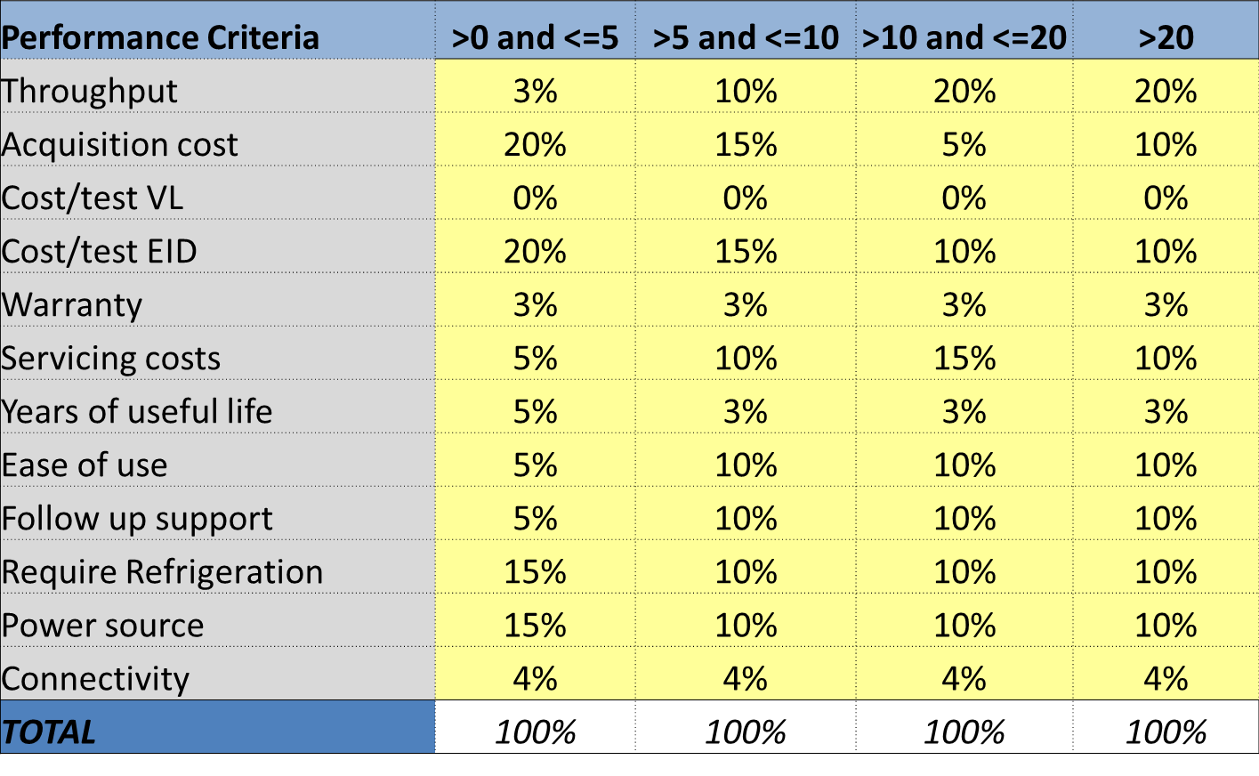
Product Selection Case Study: Zimbabwe POC EID
Notes:
Explain briefly why some of the criteria where weighted as they are. Please note that the higher the percentage, the more important it is.

Slide 18
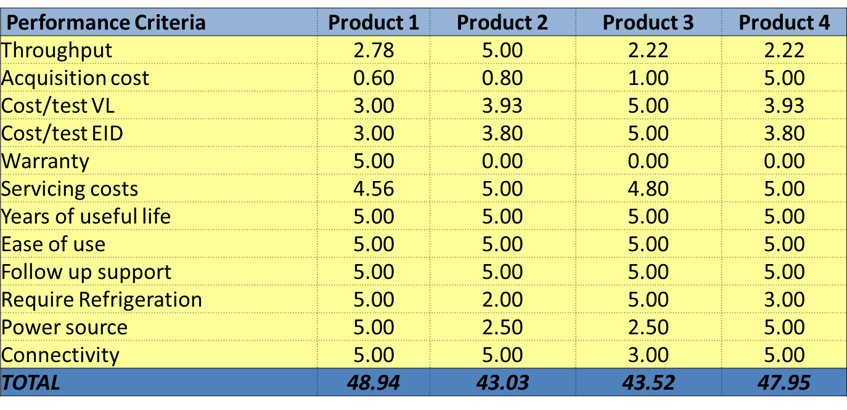
Product Selection Case Study: Zimbabwe POC EID
3
Review product pipeline and assign scores to products for POC EID
CHAI presented the available information on each of the products
The group discussed features and advantages of each of the products
The group determined scores for each of the products against each of the 11 criteria
*Performance Criteria scored from a low of 1 to a high of 5
Notes:
Please note that the higher the score, the better the product performs. The score are as objective as possible based on experience with the device and information shared by the manufacturers.

Slide 19
Product Selection Case Study: Zimbabwe POC EID
4
Select POC EID products
The tool provides scores for each product in each segment
The group discussed the resulting scores:
Which products scored best in each segment?
Were the results expected? If not, what was missed?
What additional data is required to improve the accuracy of the scores?
Are the differences between various top scoring products significant?
How many products are needed in the country?
The group, led by MOHCC, documented its selections with formal meeting minutes
The group made plans to repeat this process in the future
Notes:
When presenting, briefly elaborate what the group discussed regarding resulting scores of product selection.
Product 1- Alere q; Product 2 –Cepheid GeneXpert; Product 3- Samba II; Product 4- Omni

Slide 20
Agenda
Zimbabwe POC Implementation Guidelines
Case Study: POC Product Selection
Case Study: POC Site Selection

Slide 21
Key Principles of Site Selection per POC Testing Guidelines
It must be led by the MOHCC-DLS
The process should involve all key stakeholders to drive consensus
Should be driven by the country’s unique diagnostic testing priorities, including such factors as:
Patient volumes
Access challenges (low-volume sites with long turnaround times and/or sites that are located far from centralized testing labs)
Alternative entry points for testing (i.e., pediatric wards & nutrition rehabilitation unit for EID)
The process should be well documented demonstrating the rationale for the selection of suitable sites

Slide 22
Site Selection: Zimbabwe mapped all sites by key criteria and selected sites most appropriate for POC diagnostics deployment based priorities
Key criteria
Patient volumes at each site: shall consider actual/expected volume based on number patients requiring the tests
Distance from a regional lab: accessibility of the testing site to the nearest conventional lab for back up, monitoring and quality assurance
ART coverage rate : high number of ART patients at the facility requiring VL testing for care monitoring
HIV prevalence: intend to consider sites or entry and testing points with high HIV burden for high patient impact
Road quality: will consider hard to reach sites due to difficult terrain/ impassable road to provide onsite access to testing
Country Priorities
Prioritizing more remote facility within each province
Patient volumes: moderate/low volume sites with long turnaround time
Access to labs: sites that are located far from centralized testing labs and no reliable sample transport mechanism

Slide 23
There is a sweet spot for sites where laboratory based and POC testing make economic sense based on throughput, cost and complexity
Highest volume sites
Lowest volume sites
Suited to laboratory based
Suited to POC
Actual share of the market will depend on:
Country preference
Leverage current laboratory based platforms?
Price points for device/reagents
Cost of POC test vs laboratory based + sample transport
Throughput of POC/near-POC
# of machines required to meet patient need vs. burden on health workers
Guidelines on DBS
Without DBS, laboratory based may not be able to reach peripheral sites

Slide 24
Site-level data can be used to identify gaps in testing coverage and target opportunities to use POC to maximize linkage to treatment
Market Segmentation by facility level and EID sample volumes
Test Need/day | Provincial Hospitals | District Hospitals | Health Centers | TOTAL
>10 Tests per Day | 0% | 5% | 0% | 5%
5-10 Tests per Day | 0% | 5% | 0% | 5%
2-5 Tests per Day | 1% | 8% | 5% | 14%
1-2 Tests per Day | 0.5% | 13% | 8% | 21%
0-1 Tests per Day | 0% | 15% | 40% | 55%
TOTAL | 1.5% | 46% | 53% | 100%
Most sites test only 0-1 patients per day. Some combination of district hospitals and health centers with greatest unmet need and poor access may be the best use cases for EID POC.
Note: This is sample data from an analysis of 2015 Zimbabwe EID Market Segmentation Analysis

Slide 25
Next Steps
Present the outcome of the product and site selection to the TWGs
Evaluate/Review the impact of site selection on testing coverage
Review the final list of sites and devices selected for POC pilot deployment and eventual scale up
Develop the deployment plan and execute product deployment to selected sites
Notes:
Final note, once product and sites were selected the next steps would be to review the budget, evaluate the impact of site selection on testing coverage and review the final list of sites and devices selected for POC deployment

