Slide 1





9th International Pediatric HIV Workshop
and ^{9th} IAS Conference on HIV
Pathogenesis Treatment & Prevention
Selected Pediatric, PMTCT,
and Maternal/Adult
Abstracts
Lynne Mofenson MD 08/07/17

Slide 2

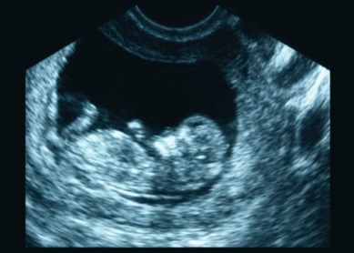
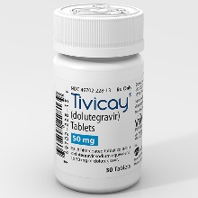
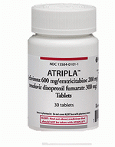

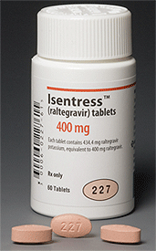

Pregnancy
Drugs

Slide 3
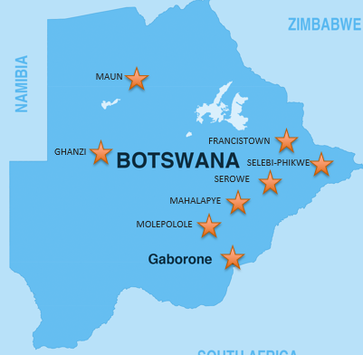
Safety of Dolutegravir in Pregnancy
Tsepamo Study, Botswana
Zash R et al. 9th IAS Conference, Paris, 2017 Abs. MOAX0202LB
Abstracted data from all consecutive births >24 wk GA at 8 maternity wards Botswana
Compared 4,593 HIV+ women starting EFV/TDF/FTC in pregnancy and delivered Aug 2014-Aug 2016 with 845 HIV+ women starting DTG/TDF/FTC in pregnancy and delivered Nov 2016-Ap 2017
  ART started >4 wk after conception and not switched or stopped during pregnancy
Smaller number 1st trimester exposures (116 DTG/TDF/FTC and 396 EFV/TDF/FTC)
  One birth defect – skeletal dysplasia (EFV/TDF/FTC)

Slide 4
No Difference Pregnancy Outcomes
EFV vs DTG-Based ART
Zash R et al. 9th IAS Conference, Paris, 2017 Abs. MOAX0202LB

Slide 5
No Increase Birth Defects with 1st Trimester DTG or RAL Exposure
Vannappagari V et al. 9th IAS Conference, Paris, 2017 Abs. MOPEB0283
Thorne C et al. 9th IAS Conference, Paris, 2017 Abs. MOPEC0609
Sibiude J et al. 9th IAS Conference, Paris, 2017 Abs.MOAB0204
Vannappagari: APR, 133 live births with DTG exposure
  Birth defects 2/77 (2.6%) 1st trimester vs 3.6% (2/56) 2nd-3rd trimester
Thorne: 8 countries Europe, 81 live births with DTG exposure
  Birth defects 4/81 (4.9%) (only 2 EUROCAT defects)
DTG exposure, including Botswana data: 4 defects/247 1st trimester exposures: 1.6% rate defects
Sibiude: 479 women receiving RAL in pregnancy in France
  Birth defects not significantly different 1st vs 2nd-3rd trimester (5.7% vs 3.5%, p=0.29)

Slide 6
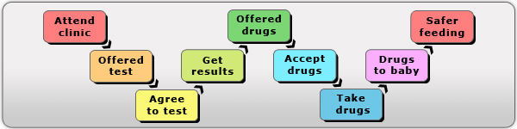
Pregnancy
HIV Care and Retention

Slide 7
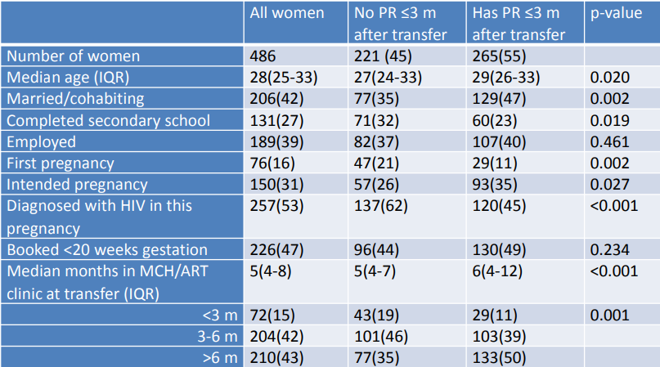
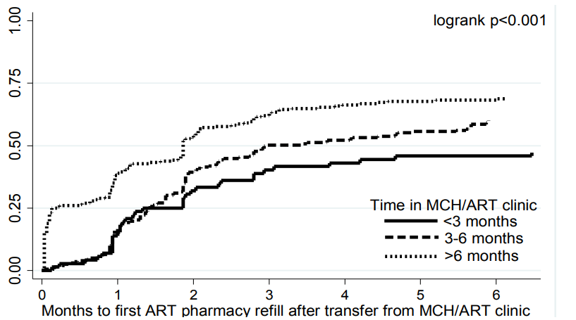
Postpartum Transfer of Women Starting ART During Pregnancy in Integrated ANC/ART Service
Phillips TK et al. 9th IAS Conference, Paris, 2017 Abs.TUPED1309
Enrolled 486 women initiating ART in MCH/ART service and followed through 18 months PP; transfer from MCH/ART service to general ART clinic occurred 0-12 mo PP.
Only 55% of women successfully transferred to ART clinic (evidenced by post-transfer pharmacy refill [PR]).
Factors Associated with Successful Post-Transfer PR
Time to successful transfer by total months
(pregnant & PP) in the MCH/ART clinic
Successful transfer: Older age, married, multiparous, intended pregnancy, knew HIV status before pregnancy, had more time in integrated MCH/ART clinic

Slide 8

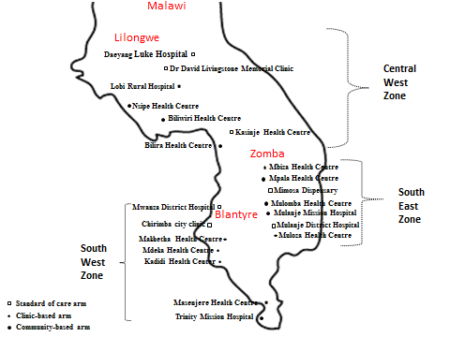
Peer Support in Malawi Option B+
Hosseinipour M et al. 9th IAS Conference, Paris, 2017 Abs. MOSA0804.
3-arm, 21 cluster randomized trial evaluating if facility- & community-based peer support by women who had recently gone through the PMTCT program would improve uptake & retention of mothers/infants in Malawi’s Option B+ program.
Standard of care (N=447, 90% pregnant, 10% BF): MOH guidelines care, use of MOH master card/logs
Facility support (N=428, 84% pregnant, 16% BF): peer one-one support at each clinic visit; lead weekly clinic-based support groups, contacted women within a week of missed visit
Community support (N=394, 85% pregnant, 15% BF): peer conducted routine home visits to provide HIV education, support and clinic visit reminders; lead monthly community-based support groups; contacted women within a week of missed visit

Slide 9
ART Uptake & 24 Month Retention Improved with
Peer Support Facility or Community Interventions
Hosseinipour M et al. 9th IAS Conference, Paris, 2017 Abs. MOSA0804.
Community
Facility
SOC
Better ART uptake &
24-month retention with facility or community peer support
Better retention and lower default rates with facility or community peer support; mortality low all groups
VL collected more frequently but viral suppression similar (94%, 96%, 94%) (not shown)

Slide 10
INSPIRE: MoMent (Mother Mentor) Nigeria Study
Sam-Agudu N et al. 9th IAS Conference, Paris, 2017 Abs.MOSA0805
Compared 2 cohorts of mother-infant pairs at facility level comparing Mentor Mothers to routine Peer Support
Outcome Measures | Adjusted Odds Ratios (MM vs routine PS) | Absolute difference (MM vs routine PS)
EID presentation among infants by 2 months of age | 3.7x higher odds | 28.9% (63.9% vs 35.0%)
Maternal retention in care over first 6 months postpartum (≥ 3 of 6 visits) | 5.9x higher odds | 37.0% (61.9% vs 24.9%)
Maternal viral suppression at 6 months postpartum (<20 copies/ml) | 4.9x higher odds | 32.2% (41.5% vs 9.3%)
*Regardless of study arm, retained vs not-retained women
  →2.1x more likely to be virally suppressed
  → 39.5% vs 15.5%; absolute difference 24.0%

Slide 11

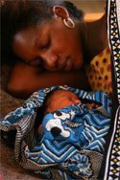
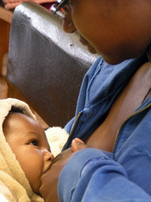
Prevention of
Mother to Child
HIV Transmission

Slide 12
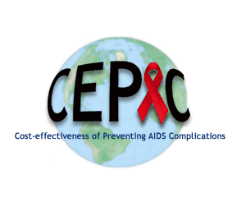
Cost-Effectiveness of Integrating Maternal ART into Maternal-Child Health Services
Dugdale C et al. 9th IAS Conference, Paris, 2017 Abs. WEAD0106LB
Analysis in context of RCT: HIV+ mothers randomized to either:
  Routine care (separate maternal ART and infant care)
  Integrated care (co-located maternal ART/infant care in MCH services until end of BF)
RCT results: Integrated care improved retention & viral suppression at 12 mos; longer BF duration; similar low 1 yr MTCT (1.7%) both arms
Maternal parameters | Routine care | Integrated care
Age (mean, in years) | 28.6
CD4 count <350 cells/µL before ART | 49%
Time on ART at delivery (median, in mo.) | 4.3
Retention in care at 1 year | 71% | 81%
HIV viral load <50 copies/mL at 1 year | 49% | 66%
Pediatric parameters | Routine care | Integrated care
Breastfeeding duration (mean, in mo.) | 6 | 8
Economic parameters | Routine care | Integrated care
Additional integrated care intervention cost for mother-infant pair | ----- | $200

Slide 13
Cost-Effectiveness of Integrating Maternal ART into Maternal-Child Health Services
Dugdale C et al. 9th IAS Conference, Paris, 2017 Abs. WEAD0106LB
Lifetime projections (undiscounted)
 | Pediatric (HIV-infected and uninfected) |  |  | Maternal
 | MTCT (%) | Life expectancy (LE) (years) | HIV-related costs/person ($) | LE from delivery (years) | HIV-related costs/ person from delivery ($)
Routine care | 1.7 | 62.4 | 290 | 26.5 | 21,920
Integrated care |  |  |  | 27.3 | 22,570
Additional resource use
$
Incremental cost-effectiveness ratio (ICER):
in
Additional health benefit
Year life saved (YLS)
The ICER of integrated care compared to routine care was $1,050/Year Life Saved (YLS)*:
  This is <20% South Africa per-capita GDP ($5,260), thus considered cost-effective *Costs and LE discounted at 3%.

Slide 14
Cost-Effectiveness of Integrating Maternal ART into Maternal-Child Health Services: Sensitivity Analysis
Dugdale C et al. 9th IAS Conference, Paris, 2017 Abs. WEAD0106LB
Breastfeeding:
  Integrated care was increasingly cost-effective with longer duration BF (12 mo BF – ICER $990/YLS)
Varying cost
  Integrated care was cost-effective unless the intervention cost was >$2,360/mother-infant pair
    This is unlikely as is ~12x estimated cost
Varying effectiveness
  Integrated care remained cost-effective even if intervention impact on maternal retention and viral suppression reduced by 50% from observed
    50% effectiveness: ICER $1,310/YLS

Slide 15
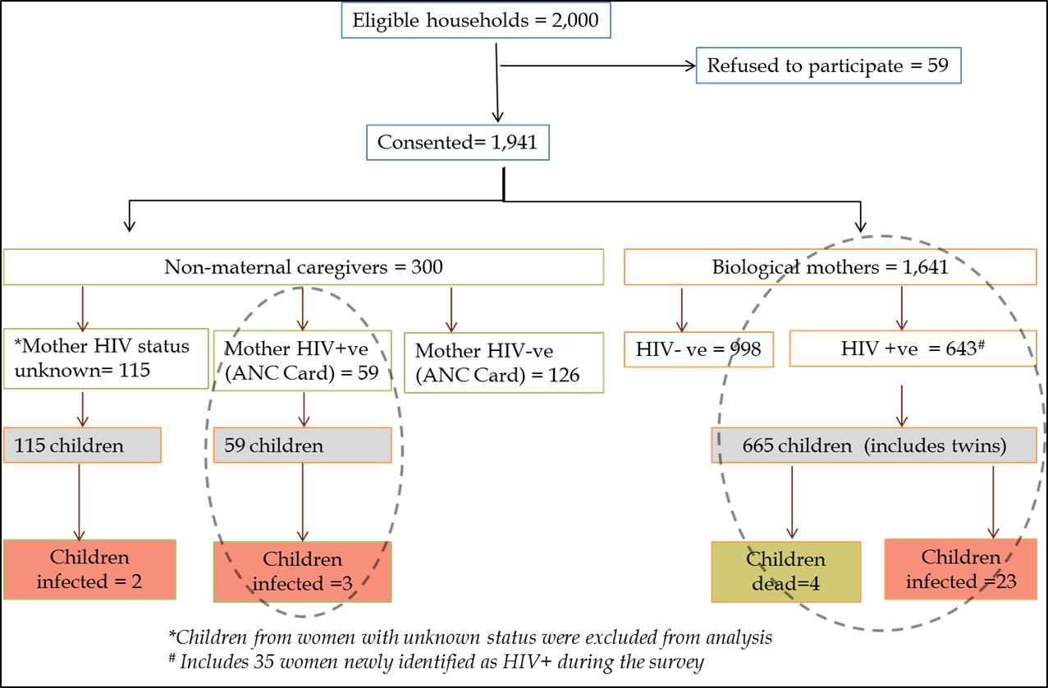
Swaziland Household Survey: 18-24 Mo HIV-Free Survival
Chouraya C et al. 9th IAS Conference, Paris, 2017 Abs. WEAC0205
Household survey of all households with births Ap-Oct 2013 (Option A) to determine 18-24 mo infant HIV-free survival in Swaziland
702/1826 (38%)
mothers HIV+
35 newly dx as
HIV+ during
Survey
99.7% attended
ANC
91.6% (excluding
new dx)
received AZT
or ART (56%)
26/724 (3.6%)
MTCT at 18 Mos

Slide 16
Swaziland Household Survey HIV-Free Survival – Option A
Chouraya C et al. 9th IAS Conference, Paris, 2017 Abs. WEAC0205
Outcome | N | HIV-negative and alive (n) | HIV-infected (n) | Estimate (95% CI)
HIV-free survival at 18-24 mos | 724 | 694 |  | 95.9% (94.1-97.2)
MTCT rate in known HIV-exposed children | 720ª |  | 26 | 3.6% (2.4-5.2)
MTCT rate assuming all dead children were infected | 724 |  | 30 | 4.1% (2.7-5.5)
Risk of child HIV infection or death was significantly associated with:
  Maternal age: every 10-year ↑ in the mother’s age, reduced odds of child HIV infection or death by 58% (aOR=0.42; 95% CI [0.17-1.00]).
  No PMTCT drugs: receipt of AZT only (aOR=0.15; 95% CI=[0.04-0.62]), ART initiation during pregnancy (aOR=0.14; 95% CI=[0.03-0.58]), and being ART experienced (aOR=0.08; 95% CI=[0.01-078]) were protective vs no drugs.
  Delivery in a health facility: Reduced the odds of infant infection or death (aOR=0.33; 95% CI [0.12-0.92]).

Slide 17
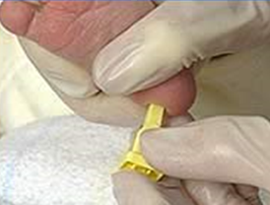
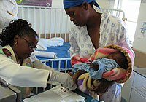
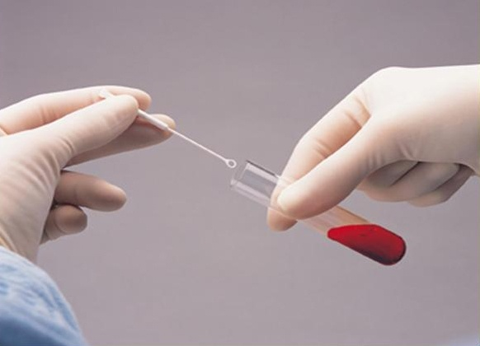
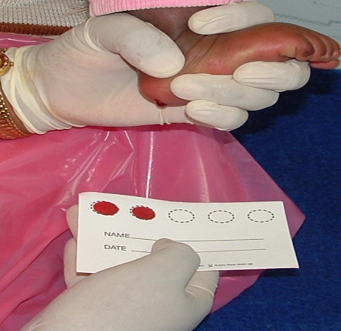
Infant HIV Diagnosis and HIV Testing Older Children

Slide 18


EGPAF UNITAID Project: POC EID Implementation
Cohn J et al. 9th Pediatric HIV Workshop, Paris, 2017
Sites selected for programmatic purposes - Site selection based on criteria agreed by MOH and EGPAF(Sites with ART access, consideration of access to conventional EID, platform placement at sites with EID demand >0.5/day)
  Hub-and-spoke model adopted or planned for 8 countries
  Platform (either AlereQ or Cepheid Xpert) matched to site
Phased and monitored implementation: Initial phase of 6 months
Interim POC EID data from 6 countries: Cameroon, Côte d’Ivoire, Lesotho, Rwanda, Swaziland, Zimbabwe.
Pre-intervention data (conventional EID) were retrospectively collected from facility registers from a sub-set of intervention sites
  Purposive sampling of sites selected for intervention
  10-20 sites per country
  In each site, data retrospectively extracted from registers for 30 consecutive HEI who had a sample collected for EID
Intervention data (POC EID) were collected prospectively in all POC EID sites using a newly introduced POC EID Testing Form.
Notes:
Sites selected
ONLY 6 COUNTRIES HAVE DATA CLEANED AND AVAILABLE TO SHARE AS OF JUNE 2017.
Countries: CDI, Cameroon, Rwanda, Zim, Lesotho, Swazi
Not included: Zambia, Moz, Kenya

Slide 19
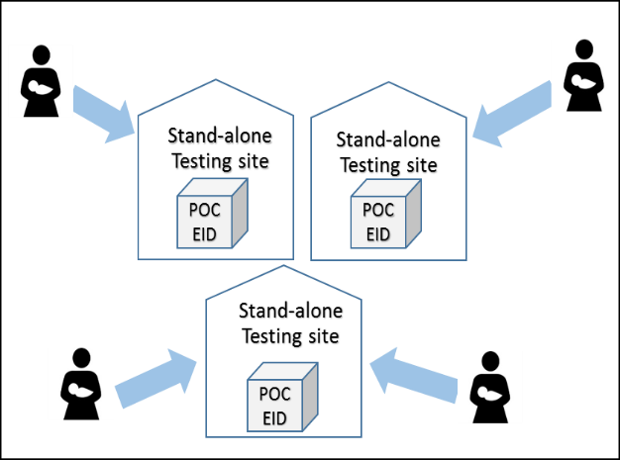
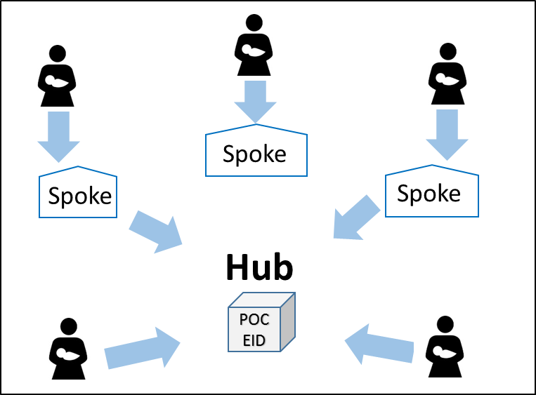
POC EID Placement Models and Results
Cohn J et al. 9th Pediatric HIV Workshop, Paris, 2017
Stand-Alone Model
Hub-and-Spoke Model
Stand-alone testing sites (without spokes): Receive samples directly from clients and perform POC EID tests on site
Hub testing sites: provide testing for patients
at that site and for spoke sites
Spoke sites: regularly send samples to the hub
sites for POC EID testing
Indicator | Testing Sites (n = 28 sites) | Spoke Sites (n = 67 sites)
% of results returned to caregiver | 99.5% | 99.9%
Median turnaround time from blood sampling to caregiver receipt of results | 0 days (range: 0-33 days) | 2 days (range: 0-38 days)
Median turnaround time from receipt of results to initiation on treatment | 0 days (range: 0-28 days) | 0 days (range: 0-7 days)
% HIV-Infected children initiated on ART | 88.5% | 80.6%
Notes:
Why were these two models developed: In order to ensure a minimum testing throughput to maintain instrument operator proficiency and to increase value for money (or return on investment) for POC instruments. Sites with more than 0.5 tests per day could qualify as a stand-alone site. Sites with less than 0.5 tests per day that could be networked with other sites within 1 hour transportation were considered for the hub-and-spoke model.

Slide 20
Comparing Conventional to POC EID
Cohn J et al. 9th Pediatric HIV Workshop, Paris, 2017
Indicator | Conventional | Point-of-Care
% Reaching Caregiver: | 72% | 99.7%
TAT: Blood sample to receipt of results | 53 days [2-438] | 0 days [0 – 38]
TAT: Receipt of results to initiation | 0 [0-75] | 0 days [0 – 28]
% initiation on treatment | 72.4% | 86.8%
Cost per test result returned to caregiver* | $19.00 -39.00 USD | $21.21-32.83 USD
*Based on The Global Fund’s total cost of ownership estimates reported in the April 2017 HIV Viral Load and EID Selection and Procurement Information Tool, and adjusted for a 77.4% return rate for conventional and a 99.6% return rate for point-of-care
Conventional EID: Median days between blood sample collection and initiation on treatment for HIV-infected kids: 51.5 [range 17 – 156]
POC EID: Median days between blood sample collection and initiation on treatment for HIV-infected kids: 0 [range 0 - 38]
Notes:
Why were these two models developed: In order to ensure a minimum testing throughput to maintain instrument operator proficiency and to increase value for money (or return on investment) for POC instruments. Sites with more than 0.5 tests per day could qualify as a stand-alone site. Sites with less than 0.5 tests per day that could be networked with other sites within 1 hour transportation were considered for the hub-and-spoke model.

Slide 21

Clinical Impact and Cost-Effectiveness of
Incorporating POC Assays into EID
Frank SC et al. 9th IAS Conference, Paris, 2017 Abs.WEAD0105
Timely return of EID test results is critical to averting infant mortality in the first months of life for HIV+ infants.
Using pediatric CEPAC model, modeled cohort of HIV-exposed infants undergoing EID testing in Zimbabwe, comparing conventional EID to POC EID at age 6 weeks.
Additional resource use
$
ICER <1x per capita GDP
for Zimbabwe ($930)
considered Is cost-effective
Incremental cost-effectiveness ratio (ICER):
in
Additional health benefit
Year life saved (YLS)
  Input assumptions
EID assay inputs | Conventional | POC
Sensitivity | 100% | 96.9%
Specificity | 99.6% | 100%
Cost | $14.50 | $21.00
EID cascade inputs | Conventional | POC
Result-return time | 1 month | Immediate
Probability of receiving result and linking to care | 71% | 97%

Slide 22
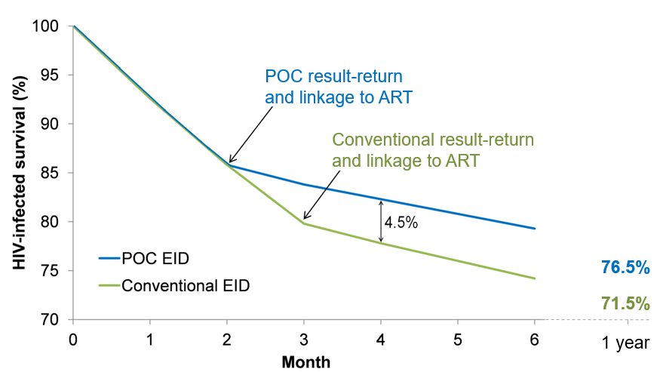
Clinical Impact and Cost-Effectiveness of
Incorporating POC Assays into EID
Frank SC et al. 9th IAS Conference, Paris, 2017 Abs.WEAD0105
  Survival for HIV-Infected Infants
Lifetime projections (undiscounted)
Strategy | HIV-infected life expectancy (years) | Birth cohort life expectancy (years) | Lifetime costs (2014 USD per person)
Conventional | 23.8 | 60.1 | $860
POC | 25.5 | 60.2 | $930

Slide 23
Clinical Impact and Cost-Effectiveness of
Incorporating POC Assays into EID
Frank SC et al. 9th IAS Conference, Paris, 2017 Abs.WEAD0105
Using birth cohort costs & life expectancy values discounted at 3%/yr, ICER of POC EID vs. Conventional EID was $750/YLS
ICER <1x Zimbabwe per-capita GDP ($930), thus POC considered cost-effective compared to Conventional EID
POC EID was no longer cost-effective if:
  <75% of infants undergoing POC testing or >96% undergoing conventional testing received test results
  <80% of infants linked to ART after receiving POC results
  POC assay sensitivity: <85%
  POC assay specificity: <92%
  POC assay cost: >$40

Slide 24
Optimization of HIV Testing Yield in Children
Models of HIV Testing, Uganda
Bitimwine H et al. 9th IAS Conference, Paris, 2017 Abs.MOAB0201
Baylor-Uganda implemented targeted HIV Testing Services (HTS) models for children and adolescents (18mos -19yrs) from Mar-June 2016, and evaluated testing yield:
  HTS Outreach: Targeting Orphans & Vulnerable Children (OVC) at dwelling homes, remand homes and orphanages
  Know Your Child Status (KYCS) Campaigns: Targeting children of index clients
  Targeted HTS Outreach: Targeting children of Female Sex Workers (FSWs), Fisher Folks (FFs) and Tea Plantation Workers
  Evening HTS: Targeting youth by offering Health Facility- based HTS within Outpatient Department between 5-7pm

Slide 25
Optimization of HIV Testing Yield in Children
Uganda
Bitimwine H et al. 9th IAS Conference, Paris, 2017 Abs.MOAB0201
4,091 children and adolescents tested, 52% females
  <5 years: 827, 20%
  5-<10 years: 1,234, 30%
  10-19 years: 2,030, 50%
Overall # Tested, All Ages, by HTS Model
Adolescent Testing by HTS Model
90% of those
tested with
evening testing
were adolescents

Slide 26
Optimization of HIV Testing Yield in Children
Uganda
Bitimwine H et al. 9th IAS Conference, Paris, 2017 Abs.MOAB0201
Reaching adolescents: proportion of testing among adolescents by HTS Model
HIV Testing yield: overall yield and by age
Adolescent testing through models:
Overall HIV Yield by Age

Slide 27
HTS Yield by Model Overall and by Sex
Bitimwine H et al. 9th IAS Conference, Paris, 2017 Abs.MOAB0201
Overall Testing Yield by Model
Testing Yield by Sex and Model

Slide 28

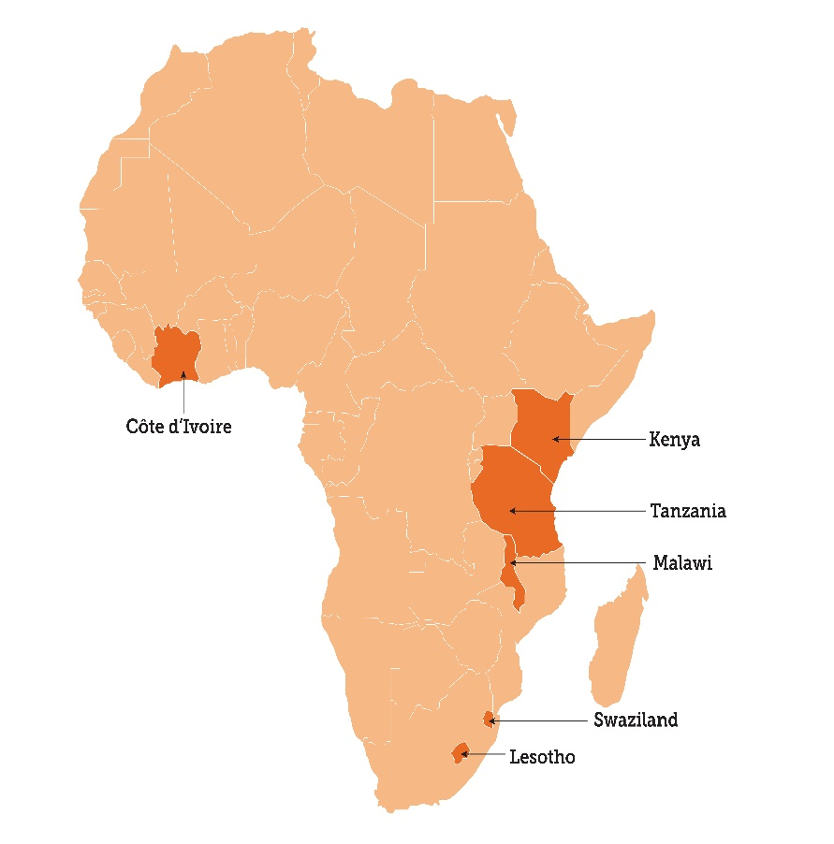
Trends in Pediatric HIV Testing in 6 African Countries
Wolters T et al. 9th IAS Conference, Paris, 2017 Abs. WEAD0101
From 7/2015 to 9/2016, EGPAF supported expansion of pediatric HIV provider-initiated pediatric testing and counseling
Range of facility- and community-based service points:
  Door-to-door testing, community campaigns, home-based index case contact testing
  Facility-based outpatient; inpatient; TB; maternal, child, and newborn health (MNCH); under five; and nutrition services
  791,851 children (0-14 years) tested

Slide 29

Trends in Pediatric HIV Testing in 6 African Countries
Wolters T et al. 9th IAS Conference, Paris, 2017 Abs. WEAD0101
274% ↑ HIV testing & 60% ↑ in HIV diagnoses
HIV-positivity ↓ in all countries over the 5 Qs
9,688/791,851 (1.2%) tested HIV+
Lowest HIV+ rate in children <4 years (effective PMTCT)
Highest rates in 10-14 year olds

Slide 30
Trends in Pediatric HIV Testing in 6 African Countries
Wolters T et al. 9th IAS Conference, Paris, 2017 Abs. WEAD0101
While HIV+ rates should be factor in determining effectiveness of testing points, absolute # of HIV+ children is also critical, particularly as high HIV + rates may not translate into high # of children identified.
Kenya – HIV+ by age and testing point
Proportion of children testing + by testing point
TB:
9.2%-20.6% HIV+
40 children identified
Out-Patient
0.8-1.4% HIV+
968 children identified

Slide 31

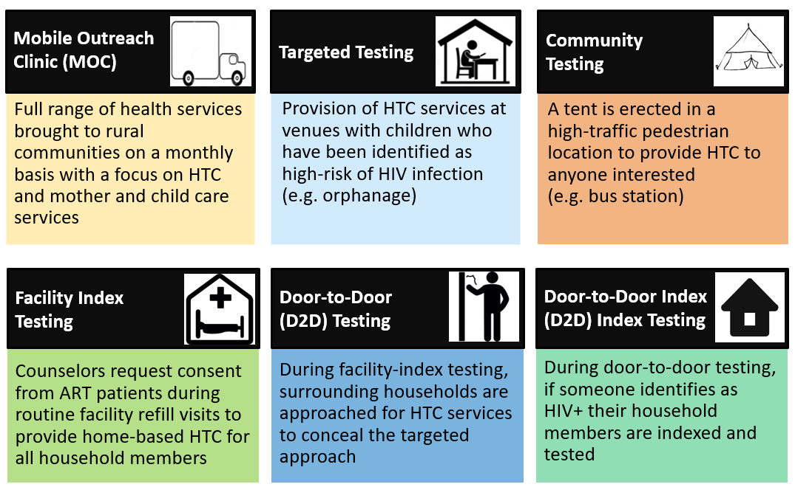
Community-Based Testing of Children, Lesotho
Sindelar K et al. 9th IAS Conference, Paris, 2017 Abs. WEAD0104
‘M-HIT’ project operating in 2 districts with highest HIV prevalence, goal to rapidly identify undiagnosed/lost children & pregnant/breastfeeding women; started Oct 2015; data from Nov 2015-Ap 2017.
Identified 6 testing strategies to target children:

Slide 32
Community-Based Testing of Children,Lesotho
Sindelar K et al. 9th IAS Conference, Paris, 2017 Abs. WEAD0104
Overall Results
47,823 children tested
206 tested positive
0.43% positivity yield
152 were enrolled in FU
Yield at routine testing facilities
In the same district routine facilities between January 2016 and March 2017, yields were only slightly higher at 0.85%
Mobile outreach clinics (MOC) account highest number (48%) of all HIV+ identifications
Yields were highest with index testing, either facility or D2D testing strategies
Targeted (‘high risk’) strategies did not result in higher yields

Slide 33
Community-Based Testing of Children,Lesotho
Sindelar K et al. 9th IAS Conference, Paris, 2017 Abs. WEAD0104
Mobile outreach clinic (MOC) were effective at identifying children of all ages
  Unexpected given MOCs only operate during school hours
Door-2-door (D2D) index testing strategies were successful at finding older children, 5 – 14 years
Overall identifications were 48.7% female to 51.3% male
  Near even ratios among all age groups

Slide 34
Community-Based Testing of Children, Lesotho
Sindelar K et al. 9th IAS Conference, Paris, 2017 Abs. WEAD0104
Prior testing coverage decreases as age increases.
Most HIV+ children >5 years were never tested before.
Community-based HTC was effective at finding HIV+ children who had never been tested before, particularly older children.
Linkage to care support included optional counselor accompanying pt to the facility for all strategies except MOCs
Retention in care was highest for children 2 – 5 years old, followed closely by 10 – 14 year olds
Retention was lowest among children 0 – 1 years

Slide 35
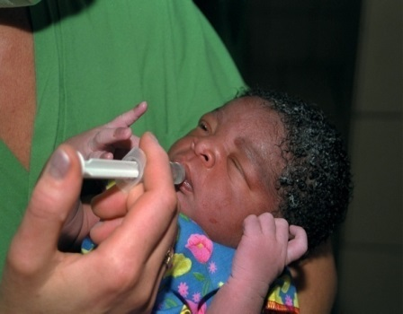


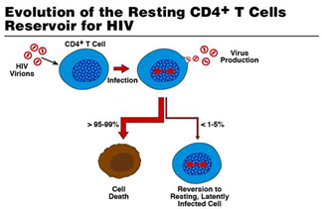

Pedatric Treatment
and
Viral Remission

Slide 36

Multi-Month ART Prescription (MMP) in Children- Baylor International Pediatric AIDS Initiative, 6 Countries
Kim M et al. 9th IAS Conference, Paris, 2017 Abs. MOAD0105
Switch from monthly (MP) to MMP made on an individual patient basis and varied by provider and facility.
Patients transitioned to MMP when deemed to be clinically stable and ART adherent, typically after 6-9 months of MP.
Conducted retrospective review of 20,472 electronic medical records (26% MP and 74% MMP); 74% 0-9 yrs, 26% 10-19 yrs at ART initiation.
Comparison somewhat problematic as those on MP stayed because felt to have adherence or clinical issues - but no adverse effect MMP seen: MMP patients had ↓ mortality and LTFU and ↑ adherence and response to ART by CD4+ and VL measurements (seen all countries & age groups).
Clinical outcome | MP | MMP | P-value
Mortality – deaths/100 P-Y | 2.08 | 0.45 | p < 0.0001
Loss to follow-up | 5245 (13.5%) | 15,227 (2.6%) | p < 0.0001
Adherence (pill count 95-105%) | 4681 (59.5%) | 4969 (78.2%) | p < 0.0001
CD4+ (> 350 or > 25 %) | 4969 (77.1%) | 15,170 (92.3%) | p < 0.0001
VL (% undetectable <400 c/ml) | 2455 (67.9%) | 12,397 (84.3%) | p < 0.0001

Slide 37

Pediatric Treatment South Africa 2008-2013:
Children Starting ART Earlier, When Less Sick, Higher CD4
Iyun V et al. 9th IAS Conference, Paris, 2017 Abs. TUPD0206LB
In children starting ART at <12 wk/o, evaluated temporal trends in infant characteristics and 6-month outcomes after ART start in South Africa IeDEA, 2006-2016.
 | 2006-2009 (n=411) Rec “ART all <1 yr” | 2010-2012 (n=470) Rec “ART all <2 yr” | ≥ 2013 (n=499) Rec “ART all <5 yr”
Age (days) | 61 (46-75) | 60 (39-76) | 34 (1-66)
Female | 51% (208) | 62% (289) | 52% (257)
CD4 | 888 (380-1703) | 1271 (463-2069) | 1526 (659-2231)
Log RNA | 5.9 (5.4-6.4) | 6.0 (5.2-6.7) | 5.4 (3.9-6.3)
WHO stage 3/4 | 84% (250) | 53% (153) | 39% (109)
WAZ ≤ -2 | 70% (173) | 55% (116) | 41% (79)
Young infants starting ART most recently were younger with higher CD4 & lower RNA and better clinical stage/nutrition at time ART was started

Slide 38
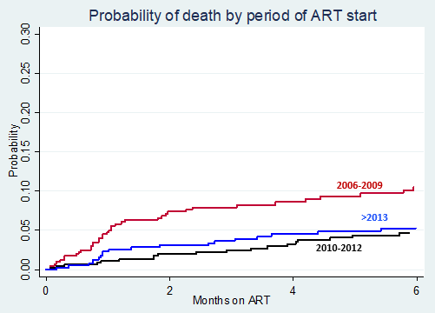
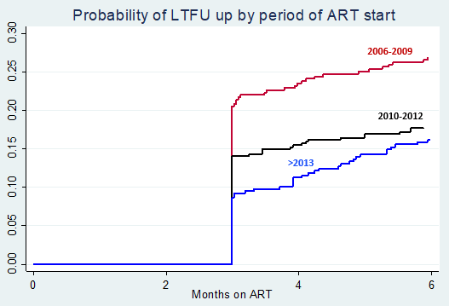
Children Starting ART in More Recent Years
Have Lower Rates of Mortality and LTFU
Iyun V et al. 9th IAS Conference, Paris, 2017 Abs. TUPD0206LB
p<0.001
p=0.004
Mortality
Overall | 2006-2009 | 2010-2012 | ≥ 2013
78 (5.7%) | 40 (9.7%) | 19 (4.0%) | 19 (4.8%)
LTFU
Overall | 2006-2009 | 2010-2012 | ≥ 2013
225 (17.6%) | 92 (22.4%) | 76 (16.2%) | 57 (14.4%)
Among LTFU, 72% had no FU after ART while 28% were LTFU after >1 visit on ART

Slide 39
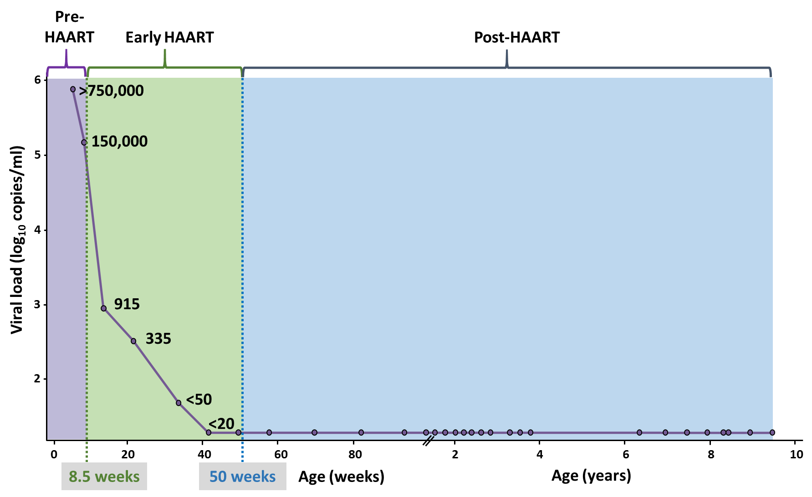
Viral Remission for 8 Years Off ART in Early-Treated HIV+ Child Randomized to D/C ART at 1 Year in CHER Trial
Violari A et al. 9th IAS Conference, Paris, 2017 Abs. TUPEB0106LB
DNA PCR+
32 d/o
Enrolled CHER;
start AZT/3TC/LPV-r
@ 8.5 wk/o
Clinical and CD4 q 3 mo to age 4 yr CHER
FU q 3 mo PEPFAR/CHANGES study
Undetectable VL with standard assays on stored and current specimen to 8.75 yr off ART
5 copies HIV DNA/million CD4 T cells
Weak CD4 and CD8 response
Low CCR5 expression and immune activation
Interrupt ART @
1 yr/o per CHER randomization
ASx
CD4 802

Slide 40



Adolescents and HIV

Slide 41

Primary Care Algorithm ↑ Testing Yield of HIV+ Young Adolescents HPTN 071 (PopART), Zambia
Chaila MJ et al. 9th IAS Conference, Paris, 2017 Abs. TUPED1341
Adolescents contacted at home as part of surveys were offered participation in the PopART intervention. Data were recorded electronically by CHiPs during household visits.
For participants aged 10-14 years, a screening tool developed and validated in clinical settings elsewhere was used to identify those at risk of being HIV infected.
Screening questions were:
  History of hospital admission
  Recurring skin problems
  Poor health in last 3 months
  Death of one or both natural parents
A “yes” response to ≥1 question was considered as an HIV infection suspect (“at risk”).

Slide 42
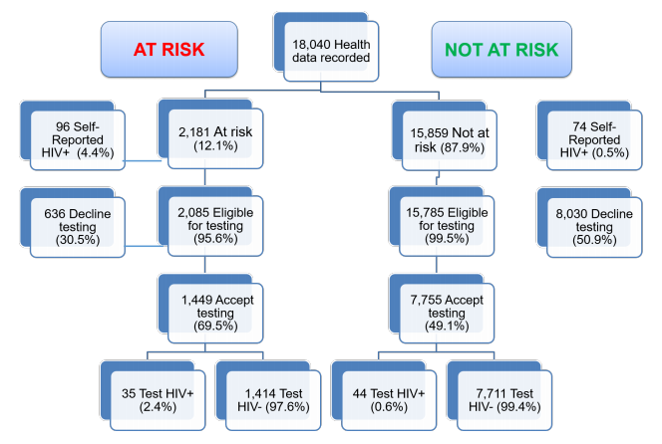
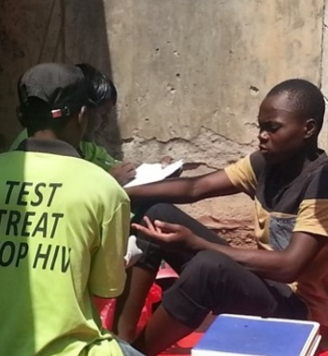
Primary Care Algorithm ↑ Testing Yield of HIV+ Young Adolescents - HPTN 071 (PopART), Zambia
Chaila MJ et al. 9th IAS Conference, Paris, 2017 Abs. TUPED1341
The screening tool identified youth in the general population who were at relatively high risk of being HIV-infected.
Screened “at risk”
Screened “not at risk”

Slide 43
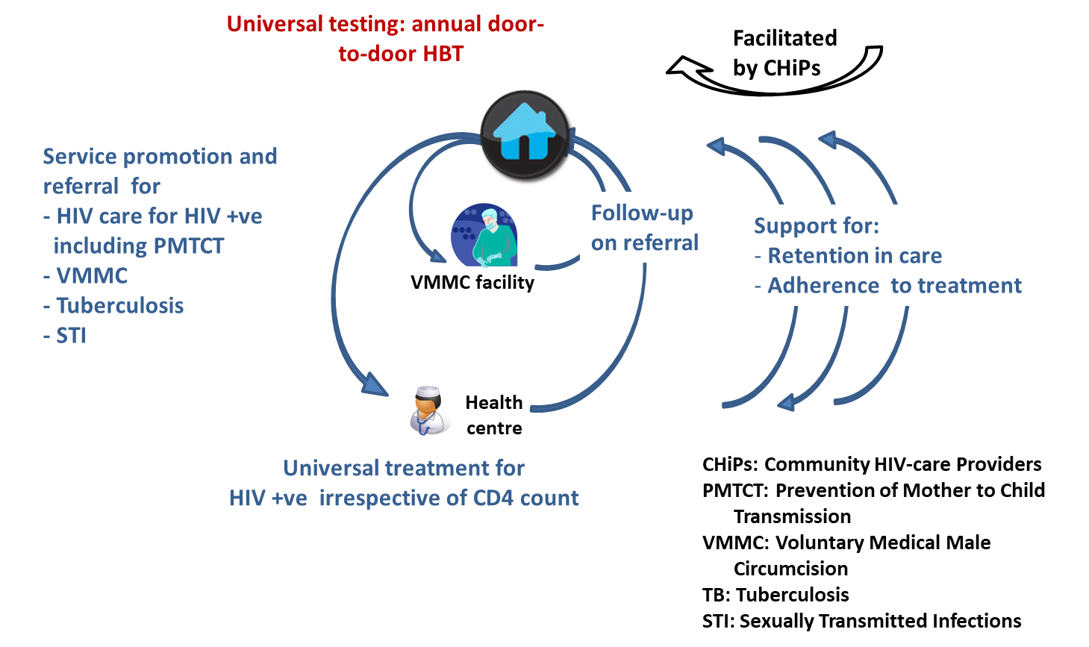
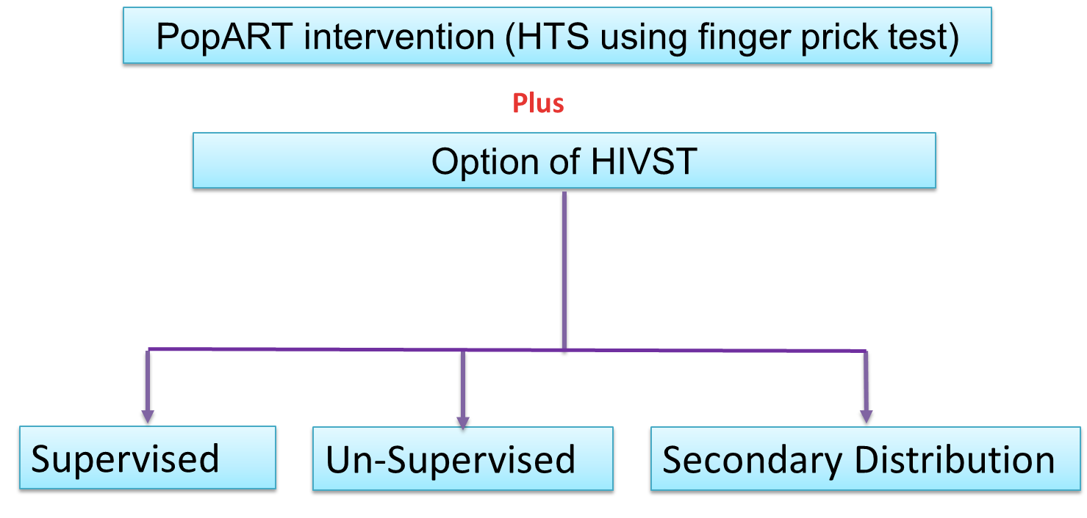
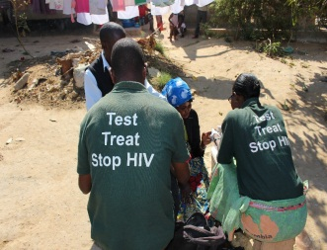
Self-Testing Increased Knowledge HIV Status
Among Men & Young Adults, HPTN 071 Zambia
Ayles H et al. 9th IAS Conference, Paris, 2017 Abs. TUAC0406LB
Two-arm cluster RCT in 4 HPTN 071 intervention communities in Zambia – allocated to continue with standard PopART intervention or to offer a choice of HIV testing include oral HIV self-test.
Standard of care arm
Intervention arm

Slide 44
Self-Testing Increased Knowledge HIV Status
Among Men & Young Adults, HPTN 071 Zambia
Ayles H et al. 9th IAS Conference, Paris, 2017 Abs. TUAC0406LB
HIV self-testing increased knowledge HIV status in men, younger adults, & those previously not tested in round 1 & 2 of HPTN 071.
Was acceptable and no self harm. Secondary distribution feasible and led to increased couple testing.
 | Standard of Care % (n/N) | HIV-ST % (n/N) | Adjusted OR (95% CI) | P-value
Overall | 65.3 (8,952/13,706) | 68.0 (9,027/13,267) | 1.30 (1.03, 1.65) | 0.03
Males | 55.1 (3,571/6,486) | 60.4 (3,843/6,368) | 1.31 (1.07, 1.60) | 0.009
Females | 74.5 (5,381/7,220) | 75.1 (5,184/6,899) | 1.05 (0.86, 1.30) | 0.62
Young adults (16-29) | 70.2 (4,917/7,002) | 73.5 (4,972/6,769) | 1.31 (1.05, 1.63) | 0.02
Older adults (30+) | 60.2 (4,035/6,704) | 62.4 (4,055/6,498) | 1.22 (0.98, 1.52) | 0.07
Resident in R1 and R2, and not previously tested in R1 or R2 | 20.6 (117/567) | 29.7 (173/583) | 1.76 (1.25,2.48) | 0.001

Slide 45

Effectiveness of Community-Based Support for Youth on ART
Fatti G et al. 9th IAS Conference, Paris, 2017 Abs. MOPDD0105
Aim: Measure effectiveness and cost-effectiveness of a large community-based support (CBS) program for adolescents and youth receiving ART in South Africa.
Study design: Cohort study including 6,706 adolescents & youth initiating ART at 47 facilities, followed for 9,215 PY.
Loss to follow-up Mortality
aHR: 0.60 (95% CI: 0.51-0.71); p<0.0001
aHR: 0.52 (95% CI: 0.37-0.73); P<0.0001

Slide 46
Effectiveness of Community-Based Support for Youth on ART
Fatti G et al. 9th IAS Conference, Paris, 2017 Abs. MOPDD0105
Cost
Cost-Effectiveness
Item | Average costs per patient-year supported, US$ (%)
Human Resources | $41.83 (84.4%)
Training | $5.97 (12.1%)
Infrastructure and equipment | $0.02 (0.05%)
Clothing for CBS-workers | $0.15 (0.3%)
Management and administration | $0.48 (1.0%)
Monitoring and evaluation | $0.10 (0.2%)
Overhead costs | $0.99 (2.0%)
Total cost per patient supported/ year | $49.50 (100.0%)
Duration of ART (years) | Effectiveness of intervention in reducing patient attrition (%) | Cost-effectiveness ratio (US$/patient-loss averted)
1 | 42.2% | $600.7
2 | 40.3% | $776.3
3 | 38.7% | $892.1
4 | 37% | $1007.7
5 | 35.9% | $1149.1
Community-based adherence support was associated with substantially improved patient retention.
CBAS is a low-cost intervention, with reasonable cost-effectiveness.
Cost–effectiveness was maximal during first two years of treatment.

Slide 47
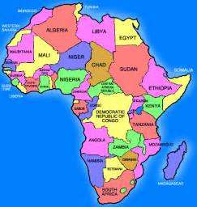

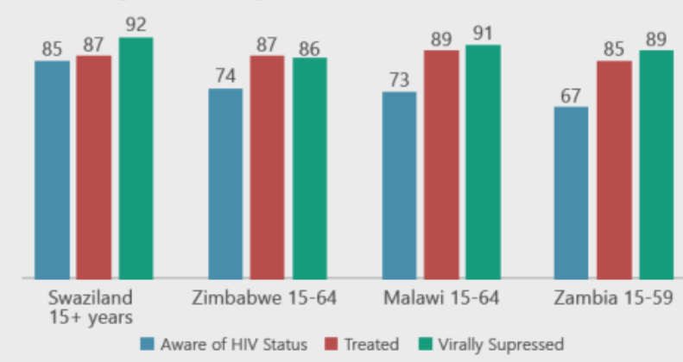

Population- Based HIV
Impact Assessment (PHIA)
Household Surveys
90-90-90 in Four PHIA Countries

Slide 48
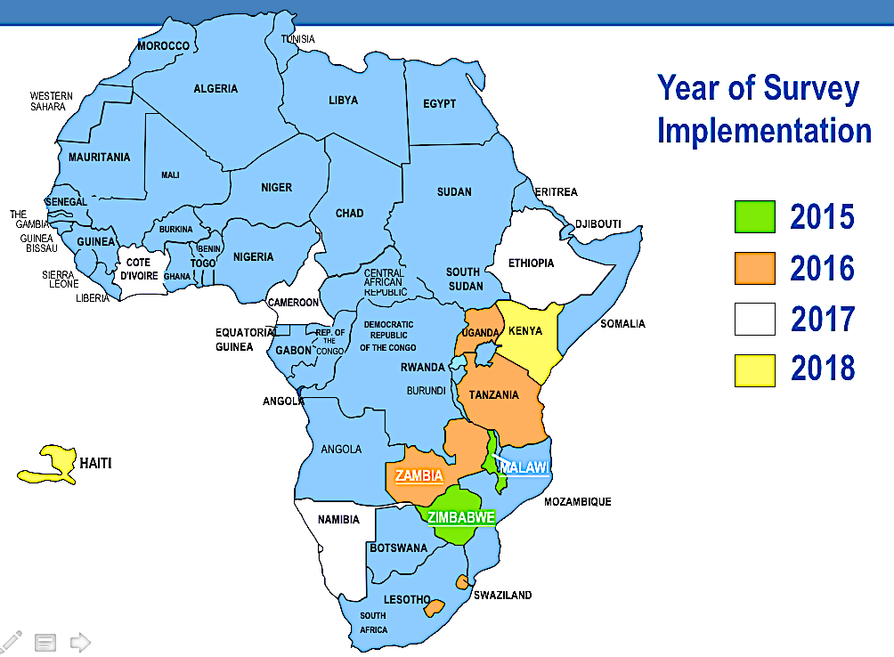


To Better Understand Current State of the Epidemic, PEPFAR is Funding Population-Based HIV Impact Assessment
(PHIA) Surveys
Population-based household HIV sero-surveys completed in 3 countries in 2015-2016: Malawi, Zambia and Zimbabwe

Slide 49
PHIA: 90-90-90 Four Countries Summary

Slide 50


Some Take-Aways
All countries: HIV prevalence higher in women once >14 years
Malawi:
  Women doing better than men, younger women (<24 years) lag significantly behind older women
  Lowest 90-90-90 rates in youth (59%, 77%, 79%)
  Pediatic prevalence lowest among childen 0-4 years (1.1% vs 2.1% 10-14 yr)
  Lowest rates viral suppression 0-4 years (only 19%!)
Zambia:
  Overall pediatric prevalence 0.9% (lowest 0-4 years, >1% >5 years)
  Lowest rates viral suppression 0-14 and 15-24 years

Slide 51


Some Take-Aways
Zimbabwe:
  Correlates not knowing HIV status: younger age, male gender, never married, no condom use last 12 mos
  Correlates not being on ART: younger age, >2 sexual partners last 12 mos, no condom use last 12 mo
  Correlates not having viral suppression: younger age, male gender
Swaziland:
  Comparing 2011 PHIA survey to 2016, 44% decrease HIV incidence and >100% increase viral suppression

Slide 52
90-90-90 HIV+ Women, Malawi – MPHIA
Wadonda-Kabondo N et al. 9th IAS Conference, Paris, 2017 Abs. TUAC0303
Awareness of HIV Status by Age in Women
Self-Reported ART Use by Age in Women
No age group met 90% goal;
younger women (15-24 yrs) lag behind
Overall, 69.5% of women reported being on ART; younger women (15-24 yrs) lag behind
Viral Suppression by Age in Women
Overall, 73.1% of women were
suppressed; younger women (15-24 yrs) lag behind

Slide 53
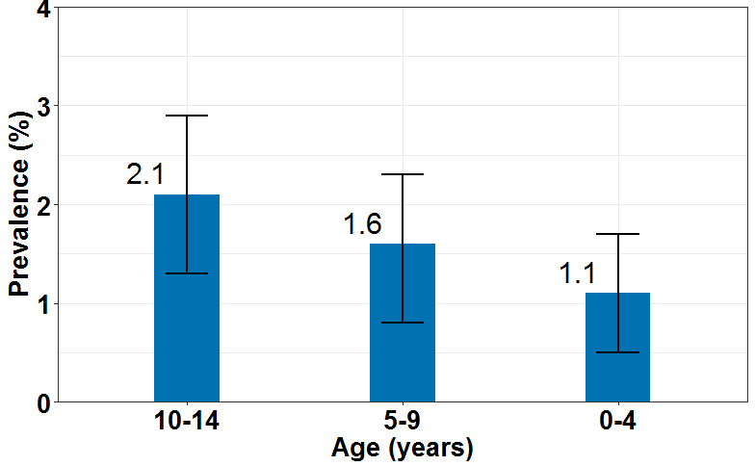
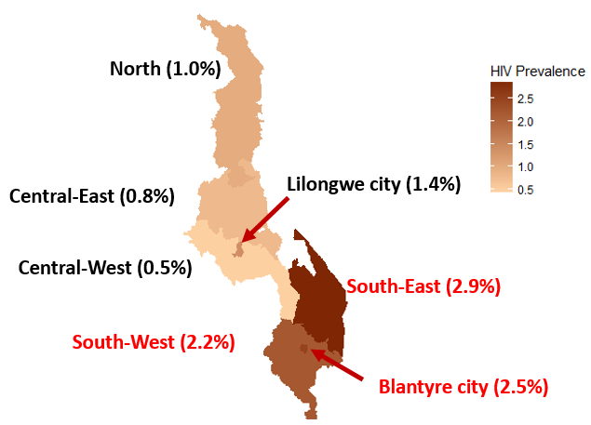
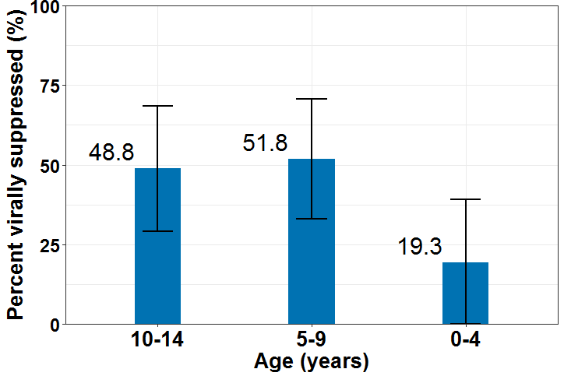
Pediatric HIV Prevalence, Malawi
Jonnalagadda S et al. 9th IAS Conference, Paris, 2017 Abs. TUAC0304
Pediatric HIV Prevalence by Age
Overall: 1.5% (1.1-1.9%)
Birth cohort 2002-2006
AZT from 28 weeks +
sdNVP mom/child birth
Birth cohort 2007-2011
Birth cohort 2012-2016
Option B+ era
2011 Option B+
Lifelong ART
Viral Suppression HIV Children, by Age
Overall: only 41% (28.9-54.0%) suppressed
Geographic Variation Pediatric HIV Prevalence
70% of 120,000 CLHIV live in the southern zone (~84,000)
Notes:
HIV prevalence varied by age group. 2.1% prevalence in the 10-14 year olds and 1.1% in children 4 and under.
This difference in prevalence across birth cohorts might closely track the evolution of the PMTCT program in Malawi.

Slide 54
VL Suppression and 90-90-90, Zambia
Barradas DT et al. 9th IAS Conference, Paris, 2017 Abs. TUAC0301
Viral Load Suppression by Sex and Age
Overall adult VLS: 59.1%
Lower viral suppression in children/youth
90-90-90 Status by Gender, Zambia 2016
Preliminary findings point toward the need to increase HIV testing, treatment, retention and adherence for both young men and young women.

Slide 55
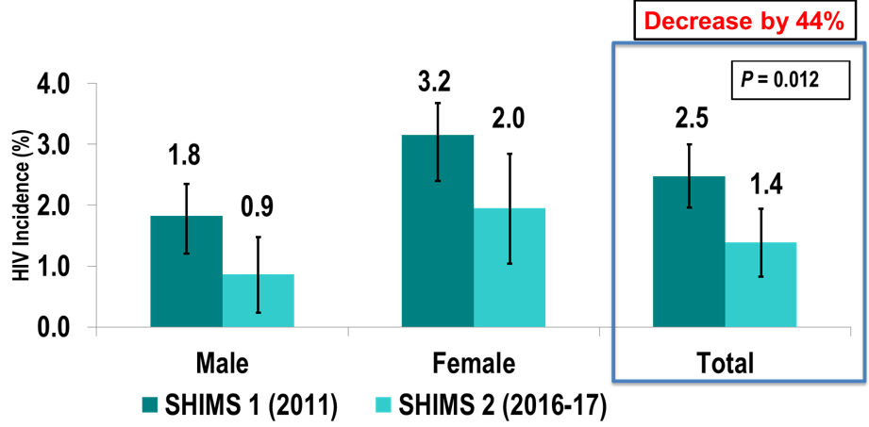
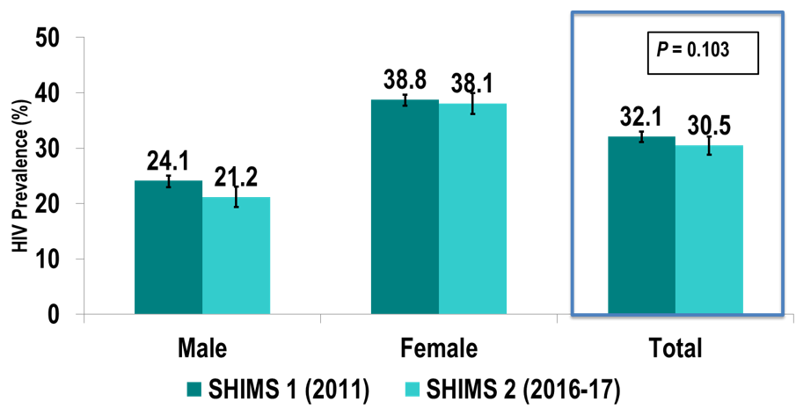
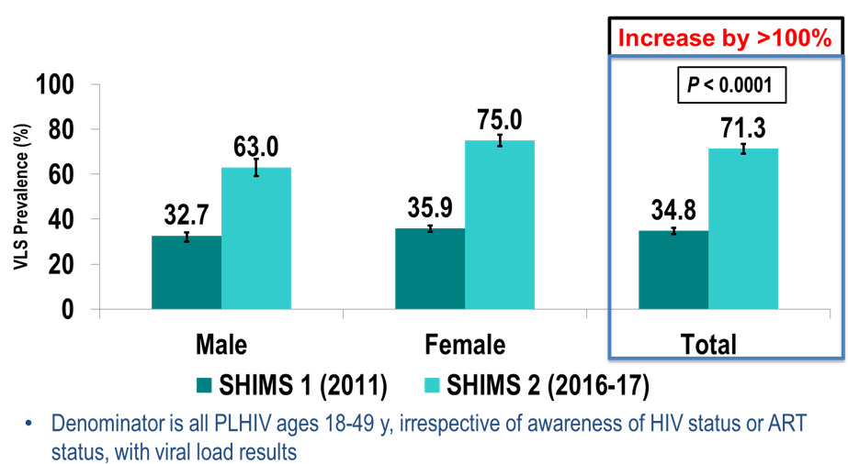
Swaziland Second HIV Incidence Measurement Survey (PHIA) – Adults 18-29 Years
Nkambule R et al. 9th IAS Conference, Paris, 2017 Abs. MOAZ0204LB
Comparing 1st PHIA (2011) to 2nd (2016-17 – universal ART)
Change in HIV Prevalence
Change in HIV Incidence
38% ↓
50% ↓
Change in Viral Suppression
Between 2011-2016:
  Decrease by nearly half in HIV incidence
  Doubling of VL suppression regardless of awareness of HIV status and ART use
  Evidence for ‘TasP’ at national level
Good progress towards global 90/90/90 targets (85/87/92)
Importance of continued efforts to reach and engage men and young women in order to fully achieve the 90/90/90 targets for all populations
1.9-fold↑
2.1-fold↑

