Slide 1
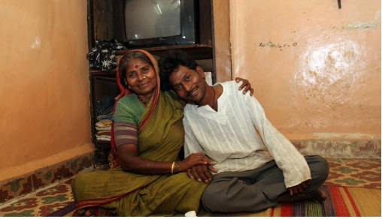

The role of DTG based regimens in first- and second-line HIV treatment and PEP – Updated WHO recommendations
Prof. Elaine Abrams
September 13th 2018
ICAP at Columbia University
Notes:
All-Russian Festival of colors in the park "Kyrlay“ – 2017 music festival

Slide 2
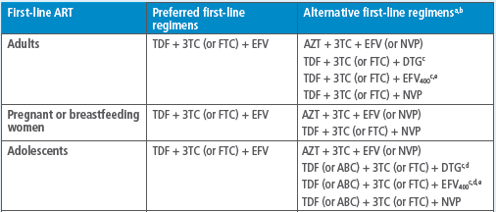
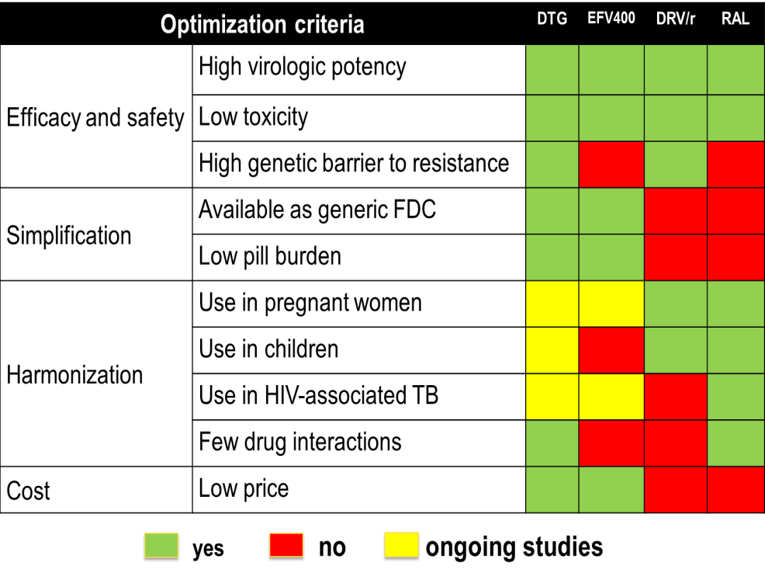
2016 WHO recommendations for 1st Line ART in Adults and Adolescents
In 2017 WHO Recommendations:
1) Countries with national pretreatment HIVDR to EFV or NVP ≥10% should consider a RAPID transition to non-NNRTI for all new ART starters:
2) ART starters with reported prior exposure to ARVs: start a non-NNRTI (i.e. DTG), regardless of level of PDR
WHO Consolidated ARV Guidelines , 2016

Slide 3

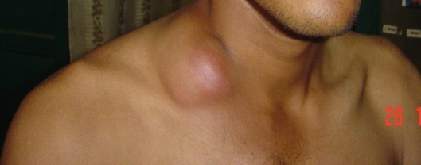
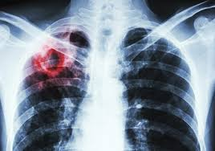
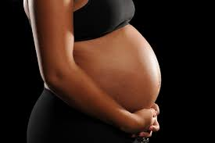
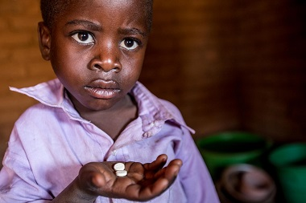
Gaps on clinical use of dolutegravir
CNS side effects: higher than expected rate of DTG discontinuation due to insomnia in some cohort studies (higher rates compared with RCTs) but very low occurrence of other side effects.
IRIS in PLHIV with advanced HIV disease: increased risk observed in some cohort studies but not detected in RCTs with other INSTIs (REALITY trial).
HIV-associated TB: need to double dose if rifampin is used (INSPIRING – 50 mg BID)
Pregnant/BF women: limited safety data, very high DTG concentrations in blood cord at birth (clinical studies ongoing)
Infants and children: safety and dose finding trial underway.
Very limited clinical experience

Slide 4
New findings informed DTG safety profile among women of child bearing potential
NIH‐funded study identified a potential safety concern; these findings were reported to the World Health Organization (WHO) and ViiV Healthcare.
Observational study in Botswana, found 4 cases of neural tube defects out of 426 women who became pregnant while taking DTG.
This rate of approximately 0.9% compares to a 0.1% risk of neural tube defects in infants born to women taking other antiretroviral medicines at the time of conception.

Slide 5
Drug Safety Alert vs. Policy Guidelines
DOCUMENT | CHARACTERISTICS | EXAMPLES
DRUG SAFETY ALERTS | Drug centered, more restrictive, consider major clinical scenarios | WHO (EMP), FDA, EMA, PEPFAR, SAHCS, ViiV, Brazilian MoH
GUIDELINES | Patient centered, consider clinical and programmatic aspects in addition to scientific evidence in decision making | WHO (HIV), DHHS, BHIVA

Slide 6
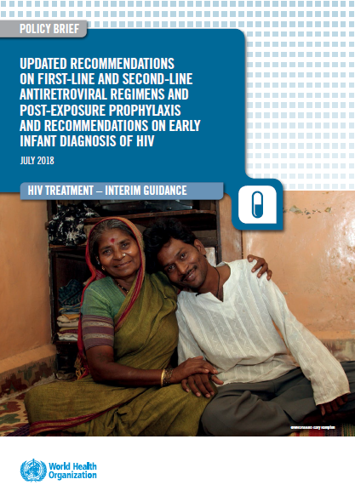
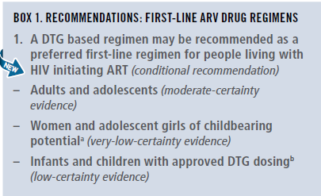
2018 WHO recommendations first-line ARV regimens

Slide 7
Safety and Efficacy of DTG and EFV600 in 1st line ART
(summary 2018 WHO Sys Review & NMA)
major outcomes | DTG vs EFV₆₀₀ | _{QUALITY OF EVIDENCE}
Viral suppression (96 weeks) | DTG better | moderate
Treatment discontinuation | DTG better | high
CD4 recovery (96 weeks) | DTG better | moderate
Mortality | comparable | low
AIDS progression | comparable | low
SAE | comparable | low
Reference: Steve Kanters, For WHO ARV GDG, 16-18 May 2018
WHO, 2018
Notes:
Evidence: The NMA showed that DTG, was superior to EFV in terms of viral suppression, CD4 recovery and treatment discontinuation. EFV400 was better than EFV 600 in terms of CD4 recovery and treatment discontinuation, but comparable in terms of viral supression. DTG was betetr than EFV400 in terms of viral suppression and treatment discontinuation. All regimens were comparable in terms of mortality, disease progression and occurrence of SAE. The quality for this evidence was rated according GRADE methodology.
Research gaps: There are concerns on NTD potential risk with DTG if used in the early pregnancy and during the preconception period.

Slide 8

WHO 2018 recommendations for first-line
Population | Preferred | Alternatives | Special situations
Adult men and adolescent boys | TLDª | TLE600 TLE400 | AZT+3TC+ EFV600^{b} TDF+3TC (or FTC)+PI/r^{c}
Pregnant (from eight weeks after conception) and breastfeeding women and adolescent girls
Women and adolescent girls with effective contraception or not of childbearing potential
Women and adolescent girls of childbearing potential who want to become pregnant and have no effective contraception | TLE600 | TLE400 TDF+3TC (or FTC)+PI/r^{c} | AZT+3TC+ EFV600^{b} TDF+3TC (or FTC)+ RAL
In PLHIV with TB using rifampicin, the dose of DTG needs to be increased to 50 mg twice daily.
NVP may be used in special circumstances where alternative options are not available.
If national prevalence of EFV pretreatment drug resistance exceeds 10% or if no other alternatives are available.
TLD = TDF + 3TC + DTG
TLE = TDF + 3TC (or FTC) + EFV
Notes:
TDF & XTC are currently recommended as the preferred NRTI backbone for ART initiation
Large clinical evidence and programmatic advantages support the use of DTG as preferred 1st line option for all adults and adolescents with HIV , including women and adolescents girls using consistent and reliable contraception.
Concerns regarding safety of DTG use during periconception period were recently identified, but are based on limited data and has been closely investigated by WHO and other partners.

Slide 9
Risk and Benefits
Available clinical evidence as well as assessment of the risk and benefits support the use of DTG as a preferred 3rd agent in all lines of antiretroviral treatment and post-exposure prophylaxis in adults and adolescents, including women and adolescents girls using consistent and reliable contraception.
Concerns around the safety of DTG use during periconception period were acknowledged resulting in specific qualifications on the use of DTG in women and adolescents girls of childbearing potential

Slide 10
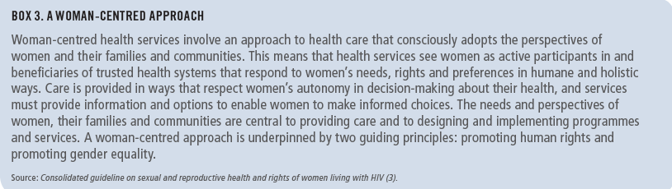
Note of caution for using DTG in women and adolescent girls of childbearing potential
Exposure to DTG at the time of conception may be associated with NTD risk among infants.
DTG appears to be safe when started after the period of risk of neural tube defects (ie, up to 8 weeks after conception).
Adolescent girls and women of childbearing potential who do not currently want to become pregnant can receive DTG together with consistent contraception (hormonal contraception and DTG have no reported or expected drug–drug interactions).
An EFV-based regimen is a safe and effective first-line regimen and can be used among women of childbearing potential during the period of potential risk for developing NTDs.
National programmes should consider the balance of benefits and risks when selecting the optimal ARV regimen for women and adolescent girls of childbearing potential (fertility levels, contraceptive availability and coverage, pretreatment resistance to NNRTIs at the population level, drug availability and the maternal and infant toxicity profile).

Slide 11
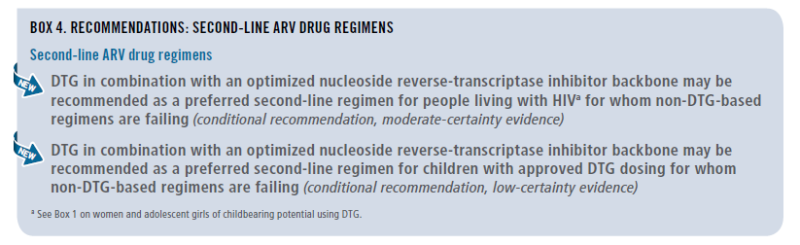
2018 WHO recommendations for second-line ARV drug regimens

Slide 12
Comparative Safety and Efficacy of DTG and LPV/r in 2nd line ART (DAWNING Study – NMA)
MAJOR OUTCOMES | NUMBER OF STUDIES | INTERPRETATION | EFFECT |  | QUALITY OF EVIDENCE
 |  |  | Relative (95% CI) | Absolute ( 95% CI)
Emergent adverse events | 1 | DTG better | 0.63 (0.45 to 0.89) | 103 fewer per 1,000 (from 187 fewer to 25 fewer) | HIGH
Viral suppression (48 weeks) | 1 | DTG better | 2.11 (1.45 to 3.21) | 109 more per 1,000 (from 54 more to 154 more) | MODERATE
Treatment discontinuation (overall) | 1 | DTG better | 0.76 (0.44 to 1.3) | 26 fewer per 1,000 (from 45 fewer to 2 fewer) | MODERATE
Treatment related adverse events | 1 | DTG better | 0.31 (0.21 to 0.45 | 47 fewer per 1,000 (from 66 fewer to 31 fewer) | LOW
Reference: Steve Kanters, For WHO ARV GDG, 16-18 May 2018

Slide 13
Preferred and alternative second-line ART regimens for adults, and adolescents (including pregnant / breastfeeding women)
Population | Failing first-line regimen | Preferred second-line regimen | Alternative second-line regimens
Adults and adolescents | 2 NRTIs + DTGª | 2 NRTIs^{b} + (ATV/r or LPV/r) | 2 NRTIs^{b} + DRV/r^{b,c}
 | 2 NRTIs^{b} + EFV (or NVP) | 2 NRTIs^{b} + DTG ^{a,b} | 2 NRTIs^{b} + (ATV/r or LPV/r or DRV/r^{c,d})
ª DTG can be offered to women receiving reliable contraception and who are fully informed of the benefits and risks, including the potential risk of neural tube defects (see Box 1 and the section on safety concern about DTG for women and adolescent girls of childbearing potential).
^{b} If ABC + 3TC or TDF + 3TC (or FTC) was used in the failing first-line regimen, AZT + 3TC should be used in second-line ART and vice versa.
^{c} RAL + LPV/r can be used as an alternative second-line regimen for adults and adolescents.
^{d} DRV/r can be used as an alternative PI option.

Slide 14
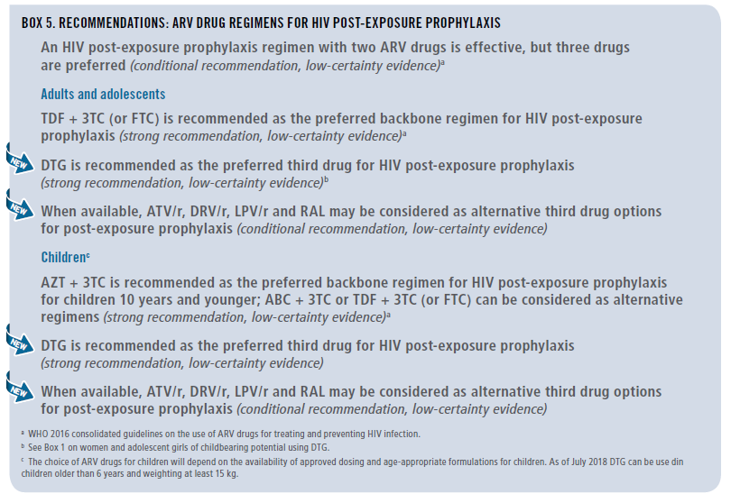
PEP recommendation

Slide 15
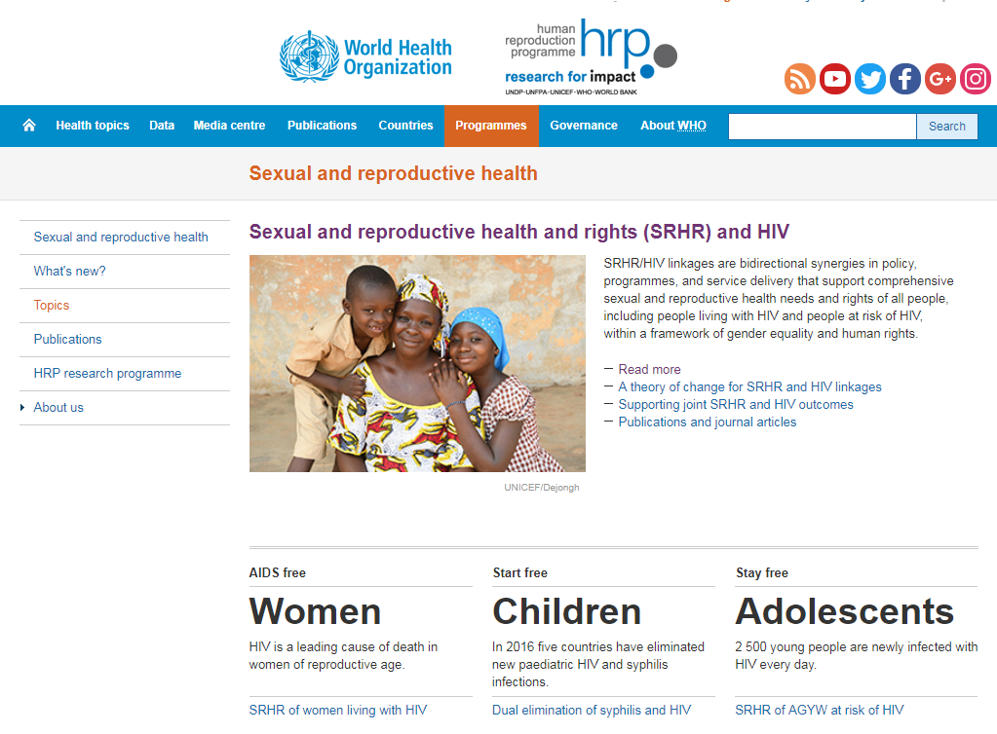
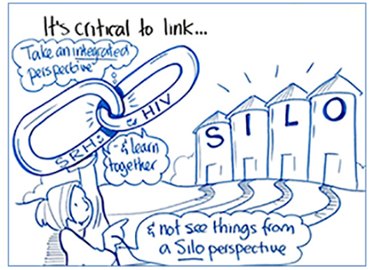
Programs should strengthen the integration of sexual and reproductive health services within HIV treatment programs to ensure reliable and consistent access to contraception for women and adolescent girls living with HIV.

Slide 16
Conclusions
Faced with an unexpected signal of risk in a high value and much anticipated ARV
WHO along with other regulatory agencies issued drug safety warnings
2018 WHO guidelines identify DTG-based ART as the preferred ARV regimen including for women and adolescents of child bearing potential using consistent and reliable contraception. EFV-based ART is preferred for women desiring pregnancy.
WHO emphasizes that women and adolescents of child bearing potential will need informed choices
Communities need to be at the table to discuss policy translation at country level.
Silver lining is an opportunity for integration and real linkages between HIV and SHR; FP choices need to be available in HIV clinics (and vice -versa)

Slide 17
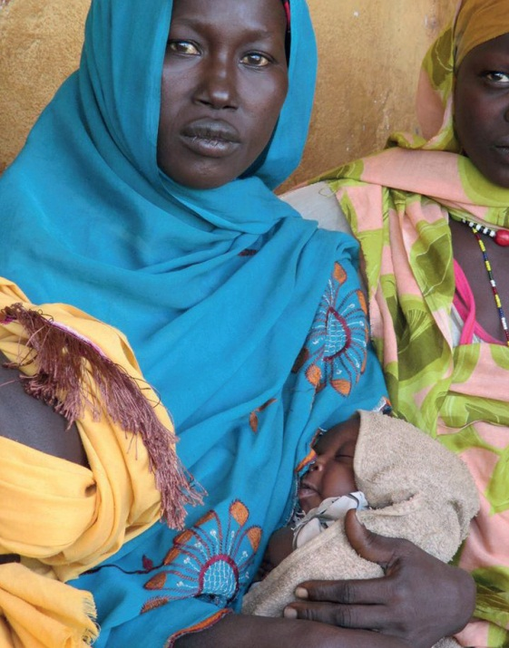
Acknowledgements
Guidelines Development Group members
Lynne Mofenson
Rebecca Zash
WHO Treatment and Care team
Marco Vitoria
Martina Penazzato
Serena Brusamento
Chantal Migone
Nathan Ford
Lara Vojnov
Silvia Bertagnolio
Vindi Singh
Ajay Rangaraj
Anisa Ghadrshenasa
Systematic Review Teams
External Review Group
PEPFAR, Global Fund, Gates, CDC, USAID
ICW, GPN+, APN+, ITPC

