Slide 1
Sample Collection for POC EID
Supplementary Content 1: Sample Collection and Handling
POC EID Training Toolkit
v. May 2019

Slide 2
Agenda
1
  Learning Objectives
2
  Specimen Management
3
  Sample Collection: Capillary Blood
4
  Sample handling, storage and transport

Slide 3

Learning Objectives
1
At the end of this topic participants should be able to:
Know and understand the steps of specimen management
Learn procedures for collecting capillary blood by heel prick
Collect Dried Blood Spot (DBS) samples for infants
Discuss proper handling of samples to maintain specimen integrity during storage and transport
3

Slide 4
Agenda
1
  Learning Objectives
2
  Specimen Management
3
  Sample Collection: Capillary Blood
4
  Sample handling, storage and transport

Slide 5
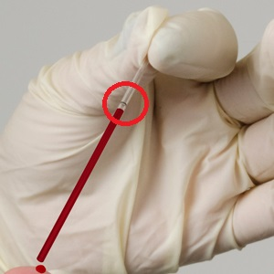
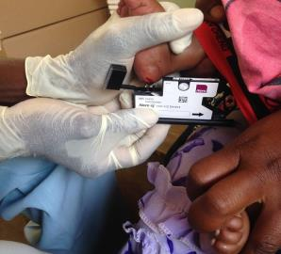
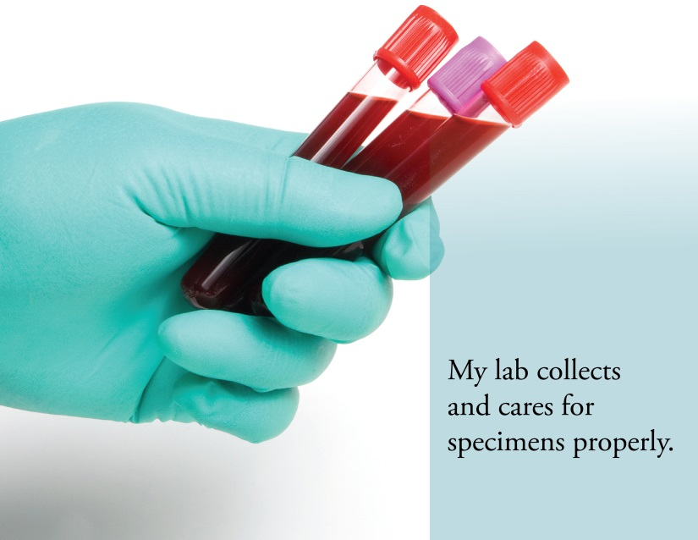
Specimen management
2
The quality of the specimen obtained in the pre-analytical phase of testing is crucial to the output of accurate and reliable results
Steps in specimen management:
  Specimen collection
  Specimen rejection
  Specimen handling
  Specimen referral
  Specimen storage
  Specimen transport

Slide 6
Agenda
1
  Learning Objectives
2
  Specimen Management
3
  Sample Collection: Capillary Blood
4
  Sample handling, storage and transport

Slide 7
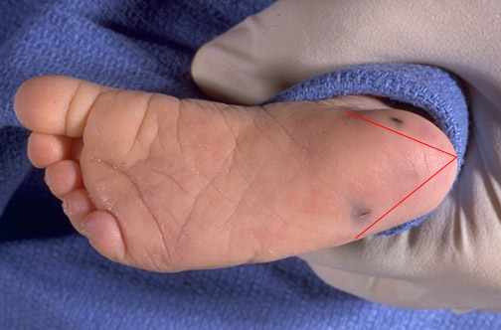
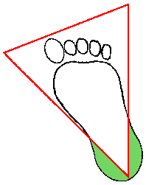
Best location to collect capillary blood samples
3
The recommended location for blood collection on a newborn baby or infant (< 4 months) is the edge of the heel. The diagram below indicates in green the proper area to use for heel punctures for blood collection.
Two heel-sticks have been performed on this baby. One of them has been performed correctly. One was performed improperly.

Slide 8
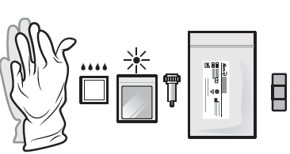
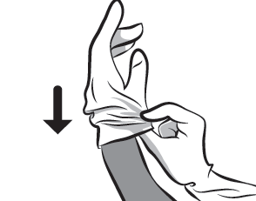
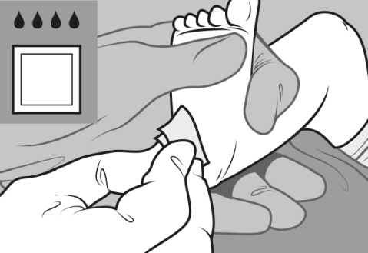
Sample collection: capillary blood
3
A. Collecting Heel-prick capillary blood direct to cartridge
❶Prepare workstation: Gather necessary materials to perform the test
❷Always wear a new pair of gloves for every patient!
❸Select a site for heel prick. Wipe the heel with an alcohol swab and allow the alcohol to air dry.
Source: Alere Technologies GmbH, Loebstedter Strasse 103-105, 07749 Jena, Germany, April 2015

Slide 9
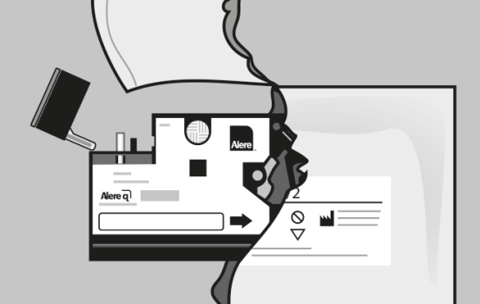
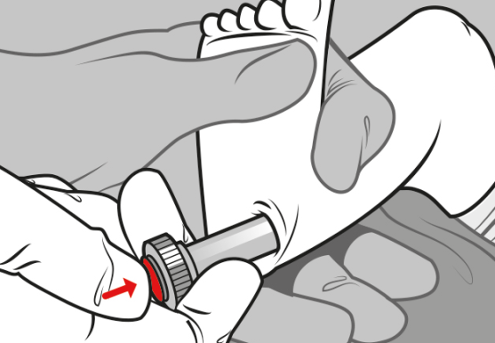
Sample collection: capillary blood
3
A. Collecting Heel-prick capillary blood direct to cartridge
❹Remove a test cartridge from its pouch and completely flip open the cartridge cap. Only open the foil pouch when ready to load sample on the cartridge and process within 10 minutes. Write patient ID on cartridge.
❺Perform heel prick: Use sterile lancets to make a skin puncture. It is important to press lancet firmly onto the heel and maintain contact while ejecting the lancet.
Source: Alere Technologies GmbH, Loebstedter Strasse 103-105, 07749 Jena, Germany, April 2015

Slide 10
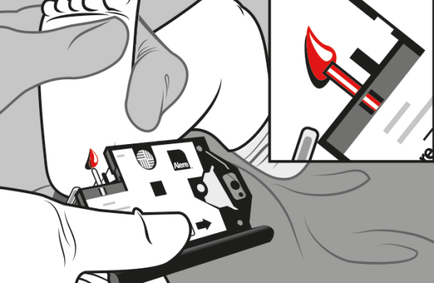
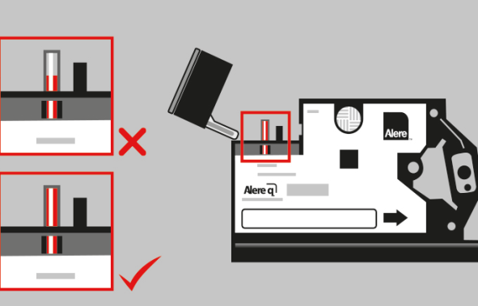
Sample collection: capillary blood
3
A. Collecting Heel-prick capillary blood direct to cartridge
❻Collect specimen:
If necessary, massage gently the heel to ensure steady blood flow. Wipe away the first drop of blood with a dry and sterile gauze pad. If necessary, wipe off another drop, until blood flows freely.
❼Hold cartridge in a firm grip and ensure visibility of the control window. Position sample capillary directly in contact with the blood drop. The capillary should be filled swiftly and completely. After collection, apply gauze with gentle pressure to stop bleeding.
Source: Alere Technologies GmbH, Loebstedter Strasse 103-105, 07749 Jena, Germany, April 2015

Slide 11
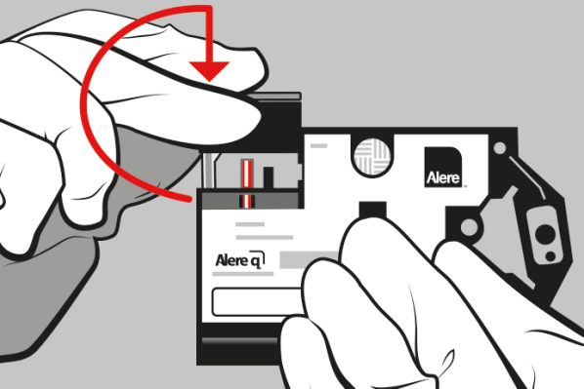
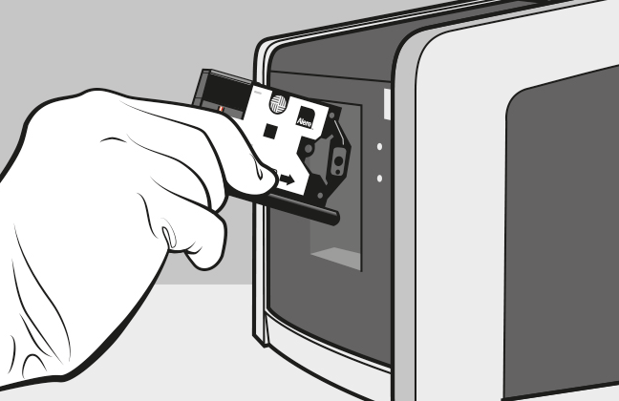
Sample collection: capillary blood
3
A. Collecting Heel-prick capillary blood direct to cartridge
❽Stop filling when the sample capillary is full, confirmed by observing the control window.
Completely close the cartridge cap
❾Select «Run Test».
The «Insert new cartridge» screen appears.
Open the Alere q door.
Insert loaded cartridge into the Alere q in the direction
indicated by the arrow on the cartridge label and manually close the door.
Source: Alere Technologies GmbH, Loebstedter Strasse 103-105, 07749 Jena, Germany, April 2015

Slide 12
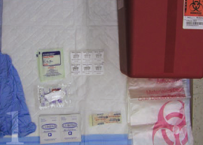
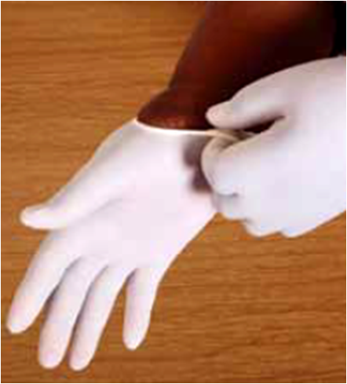
Sample collection: capillary blood
3
B. Collecting Heel-prick capillary blood using a microtainer
❶Prepare workstation: Gather necessary materials to perform the test. Label microtainer tube with patient ID, date and time of sample collection.
❷Always wear a new pair of gloves for every patient!
❸Turn patient’s heel upward. Massage patient’s heel to increase blood flow.

Slide 13
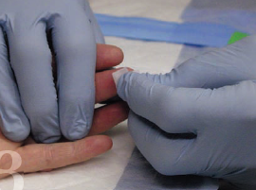
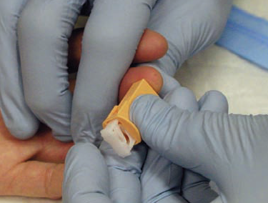
Sample collection: capillary blood
3
B. Collecting Heel-prick capillary blood using a microtainer
❹Scrub the patient’s feel with an alcohol swab. Dry with gauze
❺Hold the heel in an upward position and lance the side of the heel with proper auto lancet.

Slide 14
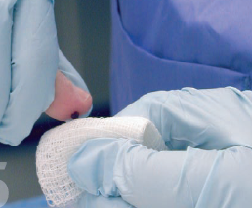
Sample collection: capillary blood
3
B. Collecting Heel-prick capillary blood using a microtainer
❻Apply slight pressure to start blood flow. Wipe the first drop of blood on a guaze pad and discard pad in appropriate biohazard container
❼Keep the heel in the downward position and gently massage it to maintain blood flow. Hold the microtainer at an angle of 30 degrees below the collection site and use the scoop or funnel on the microtainer to fill it to the 250-500 ul level

Slide 15
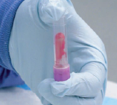
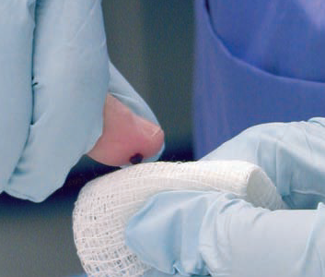
Sample collection: capillary blood
3
B. Collecting Heel-prick capillary blood using a microtainer
❽Cap the microtainer and gently invert it 10 times to prevent clots from forming. Properly discard all used materials and refrigerate the sample until shipment or analysis
❾Apply gauze with gentle pressure to stop bleeding

Slide 16
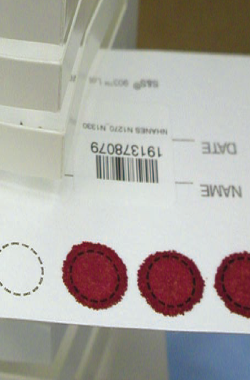
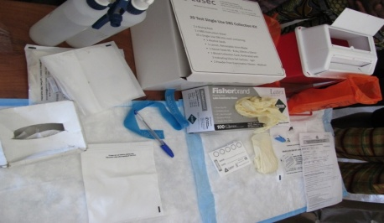
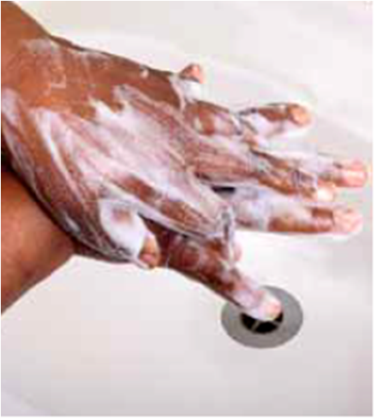
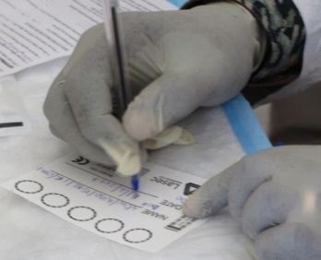
Sample collection: capillary blood
3
C. Collecting Heel-prick capillary blood direct to DBS card
❶Get all the materials ready and available within reach
❷Always use Universal Safety Precautions: Wash hands and dry thoroughly and put on powder-free gloves
❸Clearly label each card with Infant ID number and date sample collected. Completely fill out and cross-check necessary forms and samples.

Slide 17
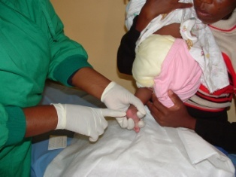
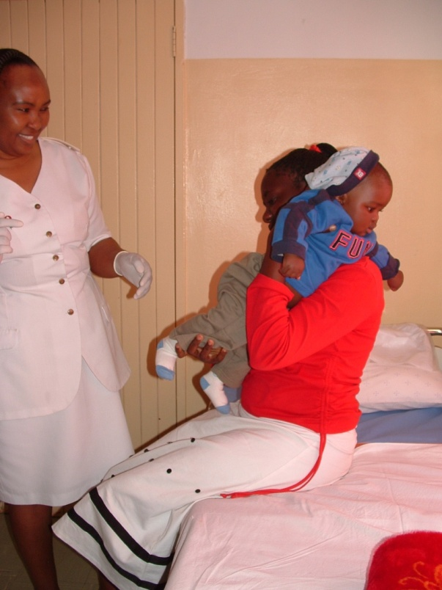
Sample collection: capillary blood
3
C. Collecting Heel-prick capillary blood direct to DBS card
Newborn infants 1-4 months (<5kg) - puncture the heel
Infants 4-12 months (>5kg) - puncture the lateral side of big toe
Infants 12-15 months (>10kg) - puncture the 3rd or 4th finger of the hand the baby uses less
❹ For Infants, keep the foot down to help the blood flow more easily. Warm site with soft cloth moistened with warm water up to 40C for 3 to 5 minutes or by gentle massage.

Slide 18
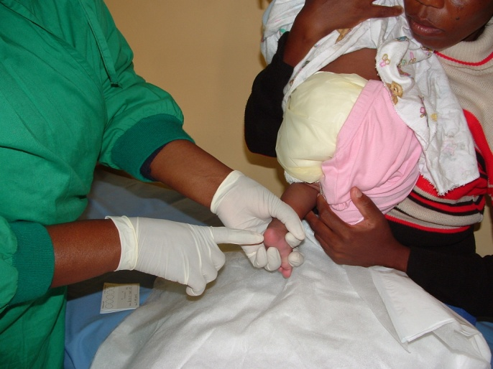
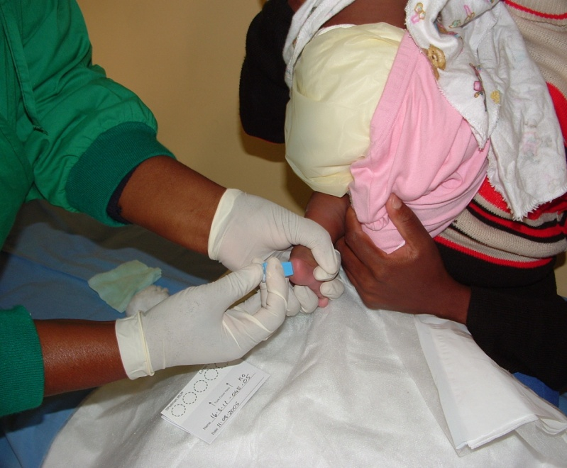
Sample collection: capillary blood
3
C. Collecting Heel-prick capillary blood direct to DBS card
❺Use alcohol swab to clean the site. Start in the middle and work outward to prevent contaminating the area. Allow the area to dry
Note: Failure to allow alcohol to dry may dilute the specimen
❻Hold the heel and firmly place a new sterile lancet off-center on the edge of the heel, toe or finger.
Firmly press the lancet to puncture the fingertip or edge of the heel

Slide 19
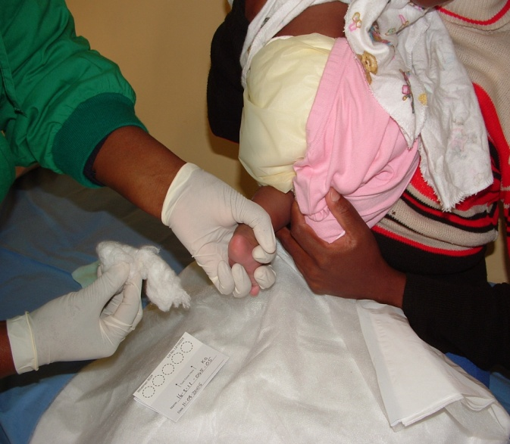
Sample collection: capillary blood
3
C. Collecting Heel-prick capillary blood direct to DBS card
❼Wipe the first drop of blood. The initial drop contains tissue fluid that may dilute the specimen.
Allow another large blood drop to form before starting collection.
❽Fill the entire circle of the DBS card. Allow to soak through and completely fill the circle. Complete all 5 spots (minimum of 3 circles).

Slide 20
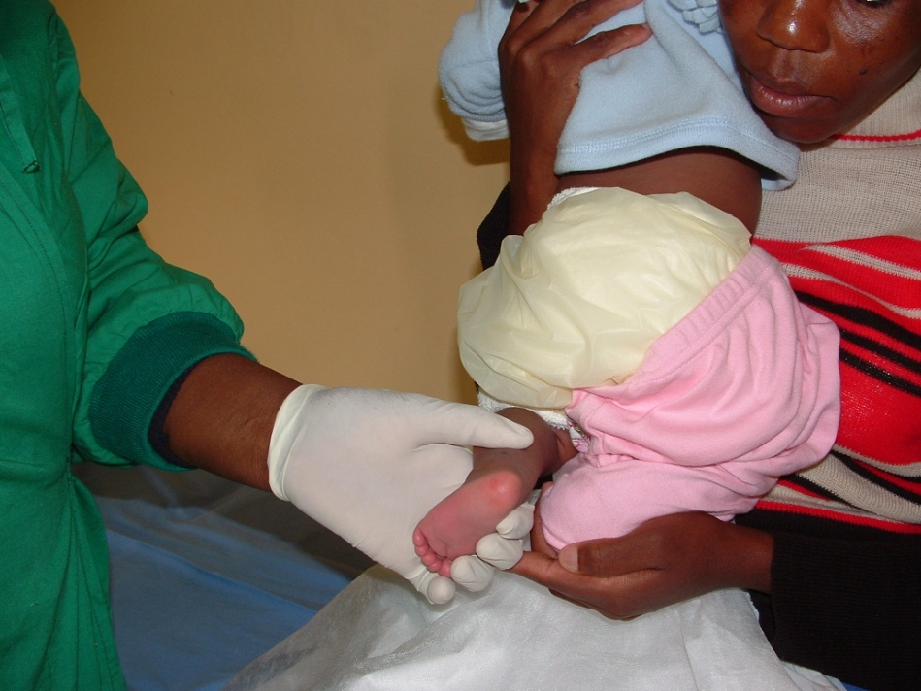
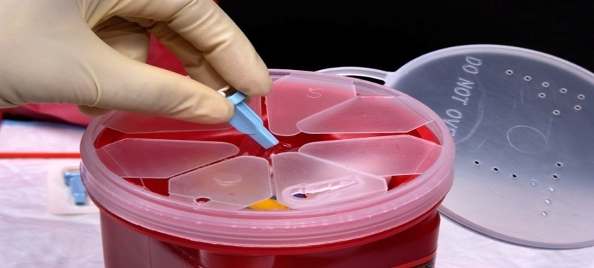
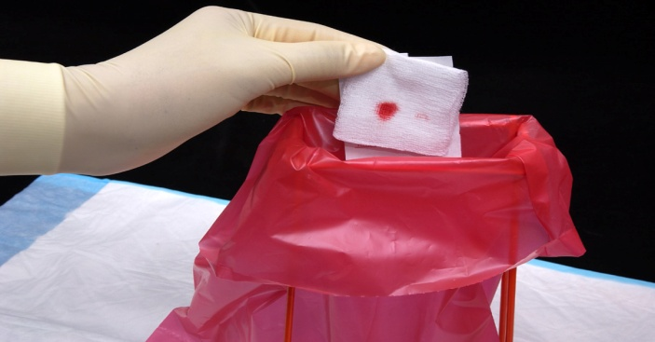
Sample collection: capillary blood
3
C. Collecting Heel-prick capillary blood direct to DBS card
❾Stop the bleeding by applying gentle pressure. Wipe and clean the area (wipe out excess blood). Leave with no bandage
❿Properly dispose of all contaminated supplies.

Slide 21
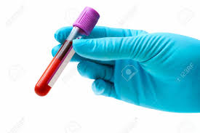
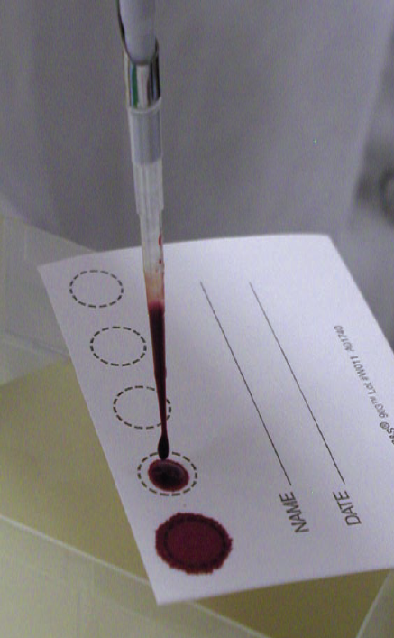
Preparing DBS from blood collection tube using calibrated precision pipette
3
Perform phlebotomy to collect venous blood or Finger/Heel-Prick to collect blood in microtainer tube.
Mix blood sample 10 times by inversion to prevent clot from forming and to equilibrate before performing the test.
Using the precision pipette calibrated to 70ul, fill entire circle of the DBS card.
Allow to soak through and completely fill the circle.
Complete all 5 spots.

Slide 22
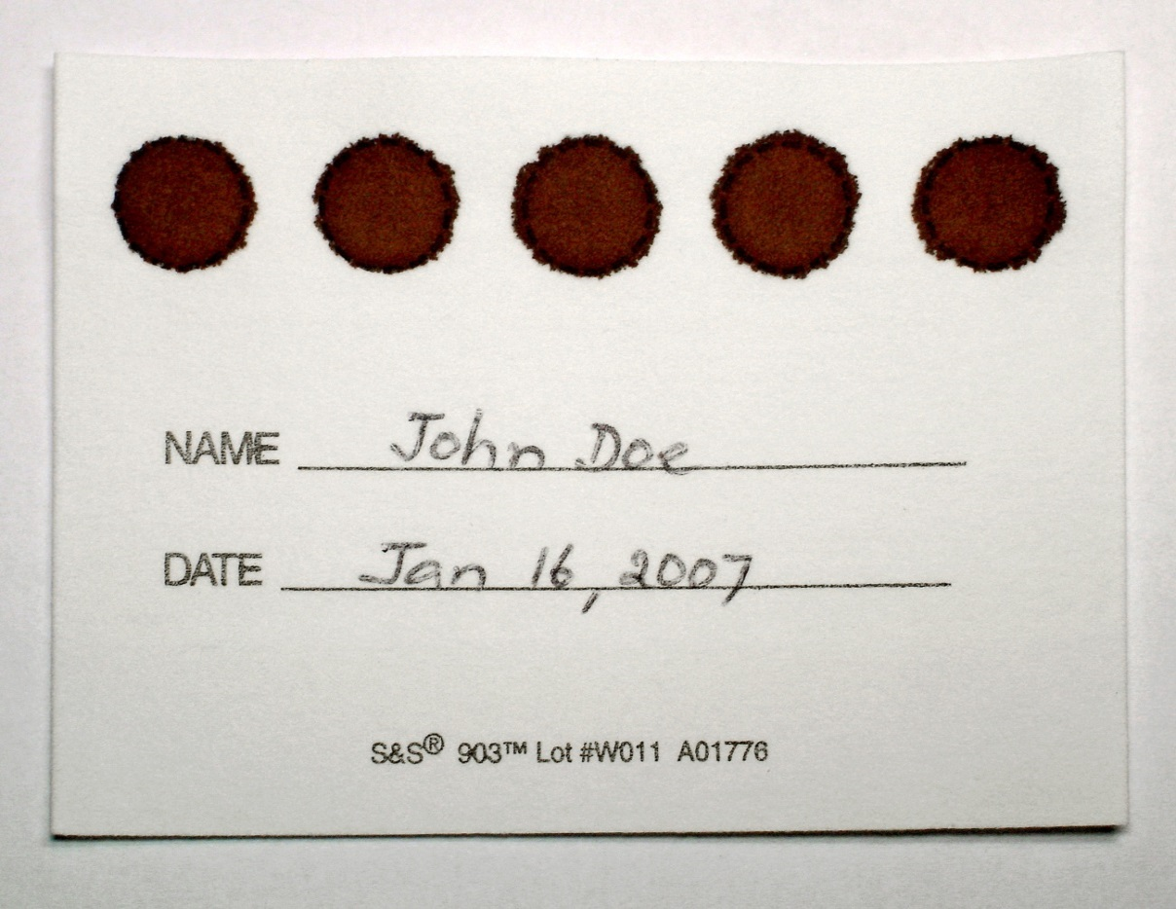
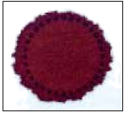
Validate DBS specimen
3
Inspect card to ensure you have collected enough blood, and the specimen is valid
Minimum of 3 completely filled circle is better than 5 insufficient samples
Note: A test result is as good as the sample collected
EID No. 02-07-17-0010
August 15, 2017

Slide 23
Criteria for validating a DBS sample
3
The samples should be properly labeled.
All the 5 circles should be properly filled, or at least 3 spots
The spots on a DBS sample should not be in contact with anything or any other sample
The DBS sample should not be heat-fixed; it should be air-dried away from the sun.

Slide 24
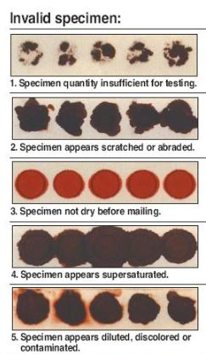
Criteria for rejecting a DBS sample
Insufficient quantity of blood
The spots are discolored, contaminated or diluted.
Blood spots appear coagulated.
Blood spots appear layered, abraded or scratched.
Blood spots presents serum rings
Dirty DBS
DBS/ filter paper not properly dried.
Poor labeling or no label

Slide 25
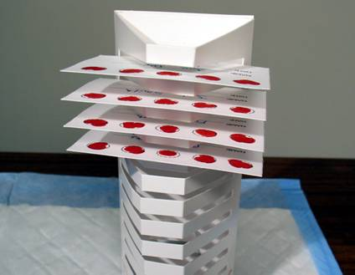
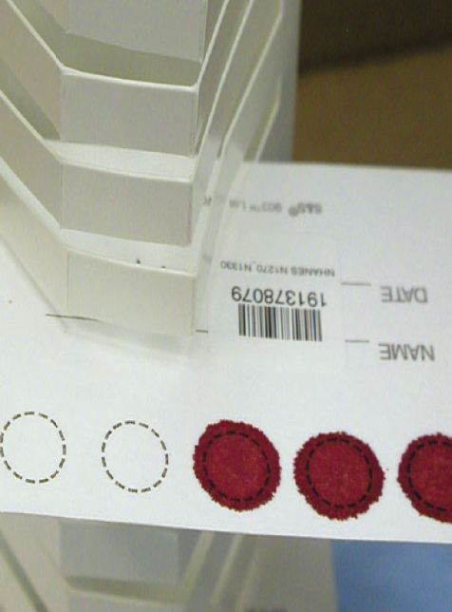
Drying the DBS cards
3
⓫ Place filter paper horizontally with the spots at the exterior on a clean drying rack to AIR DRY for at least 4 hours or overnight
Do not heat-dry DBS samples
Keep away from direct sunlight, dust, and bugs
Do not allow blood spots to come into contact with any surface or with each other.

Slide 26
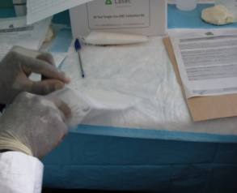
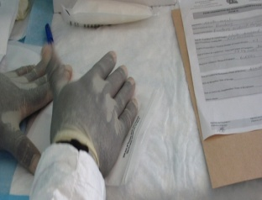
Packaging DBS samples
3
⓬ Pack each DBS card with desiccants and humidity indicator cards into a small Ziploc bag
Press out the air completely and seal.

Slide 27
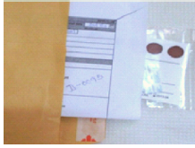
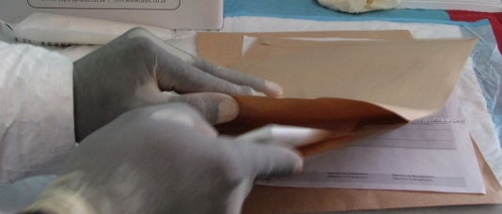
Packaging and handling DBS samples
3
⓭ Place bag into envelope
Add lab requisition form and specimen delivery check list
⓮ Keep packaged DBS (in sealable ziploc bags) in a dry, cool and airy area of the lab free from dust, heat, insects and sun (preferably in a drawer) until transported to reference laboratory
Avoid leaving in vehicle, as sun and heat will deteriorate DBS

Slide 28
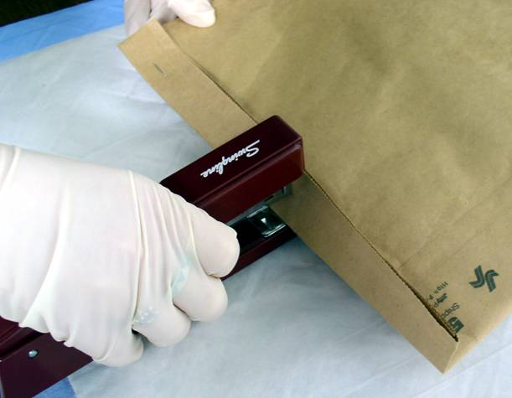
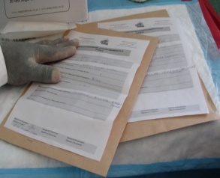
Transportation
3
⓯ Clearly label outside of the envelope
Fill up any Sample referral logs ( HF staff & courier/transporter)
Transport to designated reference laboratory for processing
Register all the samples you send to the reference Lab in your integrated Lab register
Avoid leaving in vehicle, as sun and heat will deteriorate DBS
Notes:
Click the highlighted Fiche/forms to directly link to forms

Slide 29
Agenda
1
  Learning Objectives
2
  Specimen Management
3
  Sample Collection: Capillary Blood
4
  Sample handling, storage and transport

Slide 30
Sample Handling
4
A summary of the sample handling recommendations for EID testing as per assay device requirements:
GeneXpert: Sample storage and transport Requirements
Whole blood Sample in EDTA microtainer tube Temperature and storage time +31 to +35˚C → 8 hours (EID only) +15 to +30˚C → 24 hours (EID) +2 to +8˚C → 72 hours ( EID) | DBS Sample (EID) Temperature and storage time +2 to +25˚C → 12 weeks +31 to +35˚C → 8 weeks
Alere q EID: Sample storage | Cartridge Storage
If testing is not possible right after collection, capillary blood can be stored at 18-28 ˚C for up to 24 hours after draw and before testing. | Should be stored between 4 -30˚C

Slide 31

Questions?
Thank You!
31

Slide 32




Acknowledgments
The development of the POC EID Training Package was made possible
thanks to Unitaid’s support.
Unitaid accelerates access to innovation so that critical health products
can reach the people who need them.

