Slide 1
Point-of-Care EID and VL Products: What’s in the Pipeline?
June 2016

Slide 2
Point-of-Care EID and VL Products
Background
POC EID and VL product pipeline
Preliminary evidence
Regulatory approval
EID Consortium for technical evaluations
Patient impact of POC EID technologies – pilot indications

Slide 3
Pediatric ART coverage rates by region
Less than 35% of HIV-positive infants are on ART globally

Slide 4
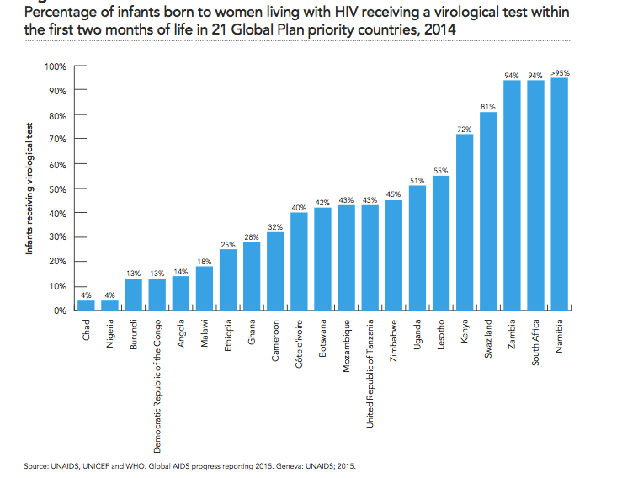
Infant HIV diagnosis: Access to early infant diagnosis and ART for infants remain low
49%
Notes:
Gap of treatment is more significant at 31%. Compared to 66% of pregnant women.

Slide 5
POC will transform the way that HIV care and treatment are provided
Continuum of Care
Same day EID to ART initiation
HIV Diagnosis
Enrollment in HIV care
Blood draw
Test performed
Result received
1
2
3
4
5
POC EID
POC EID
Clinical consultation
ART initiation
2nd line (when necessary
Monitoring
6
7
8
9
POC EID
Point of care will expand access to actionable results, reduce loss and improve patient outcomes.

Slide 6
Viral load testing is expanding quickly, but significant need remains

Slide 7
POC will transform the way that HIV care and treatment are provided
Continuum of Care
Same day viral load results for faster clinical decision-making
HIV Diagnosis
Enrollment in HIV care
Blood draw
Test performed
Result received
1
2
3
4
5
Clinical consultation
ART initiation
2nd line (when necessary
Monitoring
6
7
8
9
POC VL
Point of care will expand access to actionable results, reduce loss and improve patient outcomes.

Slide 8
Point-of-Care EID and VL Products
Background
POC EID and VL product pipeline
Preliminary evidence
Regulatory approval
EID Consortium for technical evaluations
Patient impact of POC EID technologies – pilot indications

Slide 9












Viral load and early infant diagnosis POC technology pipeline
SlipChip
NWGHF
2015
2016
2017
Post 2017

Slide 10
Alere q Qual/Quant
Tests: EID, VL
Limit of detection: 1,000 copies/ml
Sample types: plasma, whole blood
Input sample volume for plasma: 25ul or 500ul
Input sample volume for whole blood: 25ul
HIV-1 Group M, N, O; HIV-2
50 minutes per test
8-hour throughput of 8 tests
Automated/semi-automated
Requires consistent electricity
Regulatory approval (device and EID cartridge): CE-IVD, WHO-PQ
Regulatory approval (VL cartridge): still in development

Slide 11
Diagnostics for the Real World SAMBA II
Tests: EID, VL
Limit of detection: 1,000 copies/ml
VL is semi-quantitative
Sample types: plasma, whole blood
Input sample volume for plasma: 200 ul
Input sample volume for whole blood: 120 ul
60-90 minutes per test
8-hour throughput of 4-8 tests
Semi-automated
Requires constant electricity
Regulatory approval (device and cartridge): CE-IVD

Slide 12
Cepheid GeneXpert Qual/Quant
Tests: EID, VL
Limit of detection: 40 copies/ml
Sample types (VL): plasma
Sample types (EID): whole blood, DBS
Input volume for plasma (VL): 1 ml
Input volume for DBS (EID): 1 spot
Input volume for WB (EID): 100 ul
HIV-1 Group M, N, O
95 minutes per test
8-hour throughput for 4-module: 20 tests
Requires computer skills, constant electricity, AC
Semi-automated: plasma separation (VL) or DBS sample preparation (EID, if DBS is used)
Regulatory status (VL plasma): CE-IVD
Regulatory status (EID): CE-IVD, WHO-PQ

Slide 13
Cepheid Omni
Tests: TB, EID, VL, HCV, MTB (2017)
Limit of detection: 20 copies/ml
Sample types (VL): plasma
Sample types (EID): whole blood, DBS
Input volume for plasma (VL): 1 ml
Input volume for DBS (EID): 1 spot
Input volume for WB (EID): 100 ul
HIV-1 Group M, N, O
95 minutes per test
8-hour throughput: 6 tests
Semi-automated: plasma separation (VL) or DBS sample preparation (EID, if DBS is used)
Regulatory status (VL plasma): CE-IVD
Regulatory status (EID): CE-IVD
Regulatory status (device): none
Price: $2,895/device

Slide 14
Cepheid HIV quant plasma assay sample preparation

Slide 15
Cepheid HIV qual assay whole blood sample preparation

Slide 16
Cepheid HIV qual assay dried blood spot sample preparation

Slide 17
UNITAID HIV/AIDS Diagnostics Technology Landscape Document

Slide 18
Point-of-Care EID and VL Products
Background
POC EID and VL product pipeline
Preliminary evidence
Regulatory approval
EID Consortium for technical evaluations
Patient impact of POC EID technologies – pilot indications

Slide 19
Alere q HIV-1/2 Detect preliminary test performance
AIDS 2016
Sensitivity: 98.5% (91.7 – 99.9)
Specificity: 99.9% (99.3 – 100)
PLoS One 2016
Sensitivity: 95.5% (91.7 – 97.9)
Specificity: 99.8% (99.1 – 100)

Slide 20
Cepheid GeneXpert qual assay preliminary test performance
JCV 2016
Sensitivity: 100% (92.7 – 100)
Specificity: 100% (92.6 – 100)
CROI 2016
Sensitivity: 97.0% (93.2 – 99.0)
Specificity: 100% (98.6 – 100)

Slide 21
Cepheid GeneXpert quant assay preliminary test performance

Slide 22
Point-of-Care EID and VL Products
Background
POC EID and VL product pipeline
Preliminary evidence
Regulatory approval
EID Consortium for technical evaluations
Patient impact of POC EID technologies – pilot indications

Slide 23
International Stringent Regulatory Pathways
HIV viral load and early infant diagnosis (molecular diagnostic assays) are typically considered high risk and thus go through a stringent evaluation process.
CE-IVD: European Union regulatory approval body; several notifying bodies across Europe of various quality. Primarily dossier review.
WHO-PQ: http://who.int/diagnostics_laboratory/en/
  Dossier review
  Laboratory evaluation: in collaboration with CDC and NHLS South Africa
  Site inspection
Expert Review Panel for Diagnostics (ERPD): panel of experts to assess the potential risks/benefits associated with diagnostic products lacking WHO-PQ or other stringent regulatory approval. Primarily dossier review.
http://www.theglobalfund.org/en/healthproducts/qualityassurance/diagnostic/

Slide 24
Global Fund Quality Policy for HIV virological assays (EID and viral load)
Manufactured at a site compliant with ISO 13485:2003 or an equivalent Quality Management System recognized by the Founding Members of GHTF;
AND
Recommended by WHO for use in HIV (WHO prequalification); OR
Authorized for use by one of the Regulatory Authorities of the Founding Member of GHTF (such as CE-IVD, US-FDA, etc.); OR
Acceptable for procurement based on the advice of an Expert Review Panel (ERPD) due to a public health need yet lacking WHO-prequalification of regulatory approval by a Founding Member of GHTF.
Global Fund Quality Assurance Policy For Diagnostics Products (Issued on 14 December 2010, amended on 5 February 2014)

Slide 25


Viral load and early infant diagnosis POC technology pipeline
SlipChip
NWGHF
2015
2016
2017
Post 2017

Slide 26
Point-of-Care EID and VL Products
Background
POC EID and VL product pipeline
Preliminary evidence
Regulatory approval
EID Consortium for technical evaluations
Patient impact of POC EID technologies – pilot indications

Slide 27
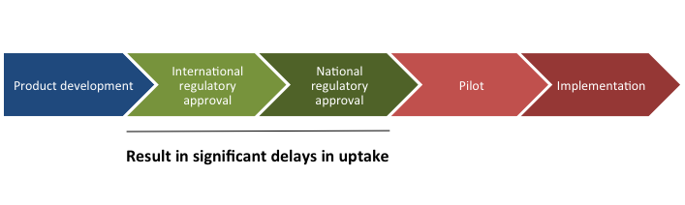
Once a technology is ready, significant barriers and delays remain
Product selection
Dossier review
Manufacturing site inspection
Analytical laboratory evaluation
Clinical field evaluation
Duplication of international regulatory processes
Notes:
Important to note that not all countries have this approval process. Some do (Tanzania, South Africa), but others only have pieces of these five steps in their regulatory approval process.

Slide 28
The Alere Pima Product Evaluation Story
http://alerehiv.com/studies-implementation-world-map/

Slide 29
The Alere Pima Product Evaluation Story
http://alerehiv.com/studies-implementation-world-map/
Notes:
To highlight this duplication further, CHAI in collaboration with NHLS, is in the final stages of preparing a meta-analysis of the majority of Pima technical evaluations. Touch on meta-analysis of Pima, no difference across populations.

Slide 30
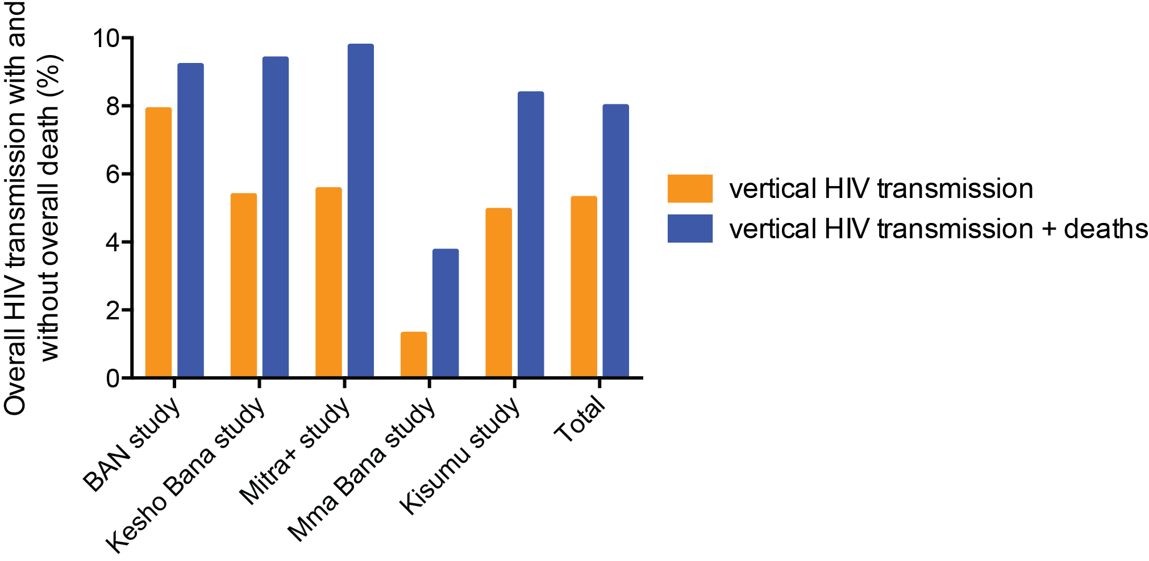
Option B+/ART for pregnant and breastfeeding women leads to low transmission rates

Slide 31
Performing EID evaluations or studies independently will significantly slow implementation
Number of Tests per Site per year
The majority of sites (>90%) would contribute 10 or less HIV-positive infants per year
Individual Sites (n=2,789)

Slide 32
Regulation and adoption of in vitro diagnostics through harmonization
Goal: To hasten market entry while ensuring the safety, quality, and effectiveness of new diagnostic technologies.
Challenges:
Regulatory landscape is highly variable.
Path to approval is not transparent in many countries.
Excessive duplication in clinical trials and inspection of manufacturing sites.
Approval process is often costly and lengthy, especially for imported tests.
Regulatory frameworks have not kept up with technological advances and have become a disincentive to innovation
Used and adapted with permission from Rosanna Peeling
Notes:
Many tests on the market are not regulated.
Evals up to $2 mill

Slide 33
National regulatory approval often requires technical evaluations
Alere q qualitative
Cepheid GeneXpert
Qualitative
Notes:
Beyond MOH/CHAI evaluations, there are many, many more evaluations planned or ongoing. This slide is meant to illustrate the significant number of evaluations and duplication.

Slide 34
EID Consortium
Led by Principal Investigators across East and Southern Africa, including ASLM Collaborating Centres of Excellence
Objective: Strengthen collaboration and form a consortium for multi-site technical evaluations and impact studies to hasten in-country regulatory approval
Initial focus: POC EID testing at 6 weeks (standard of care) and at birth testing
Key components:
Common protocols
High quality of comparator testing
Site monitoring visits
Willingness to share/consolidate interim and final data
Current status: Initial analysis of data from nine studies covering six countries has been completed and will be presented at AIDS 2016 in Durban. Additional data review, publication, and report to be completed in the coming months.

Slide 35
Point-of-Care EID and VL Products
Background
POC EID and VL product pipeline
Preliminary evidence
Regulatory approval
EID Consortium for technical evaluations
Patient impact of POC EID technologies – pilot indications

Slide 36

Mozambique and Malawi POC EID pilots
POC EID pilots initiated in September 2015
Mozambique
Malawi
1
Central
Hospital
District Hospital
Primary Health Centre
8 health centers using POC vs 8 health centers using conventional lab testing
2
3
Factors influencing POC EID placement include:
High burden: HIV prevalence among women >10% at each site
High volume: High EID volumes maximize patient impact based on 2014 LIMS data
Strong buy-in: Sites expressed interested in implementing POC EID
Patient / clinic flow: Facility-specific patient / clinic flow informed device placement strategies
Sofala
Maputo

Slide 37
Objectives and planned outcomes
EID algorithm and linkage to proceed per standard of care and national guidelines
Primary Objectives
Turnaround time across the cascade
LTFU/retention across the cascade
LTFU/retention three months post-ART initiation
Secondary Objectives
Operational considerations for national scale-up
Cost-effectiveness
Optimal site selection and deployment
Proposed training, certification, and QA model
Health care worker and patient acceptability

Slide 38
Significant peak of early infant mortality precedes current testing algorithm timing
DBS sample collected
Result returned to facility
Caregiver receives result
Results received
Results not received
50 days
Bourne AIDS 2009

Slide 39
POC EID technologies can reduce the time to result receipt
Sample collected/Result received
Rapid PCR vs conventional
ART initiation: 72.3% vs 47.8%
TAT to ART: 3.0 d versus 6.5 d
McCollum JAIDS 2014
Caregiver receives result
Bourne AIDS 2009

Slide 40
Thank you!
Questions?

