Slide 1
Tuberculosis Along The Life Cycle
Kenya IPT Experience in PMTCT settings
Dr. Kathure, Weyenga and Langat

Slide 2
Indication of IPT in Kenya
PLHIV aged > 1 year
  Including pregnant women
Children living with HIV < 1 year exposed
Children aged below 5 years exposed to Sm +ve TB
Prisoners
Health Care workers

Slide 3
Evolution of IPT Policy in Kenya
WHO 3 Is Guidelines
National IPT scale-up
IPT recommended for < fives Exposed to active TB throughout the guideline evolution cycle
Pilot Projects
2009
TB guidelines
2011
HIV Guidelines
2013
TB guidelines
2015
IPT SOP
IPT in PLHIV in restricted settings
TPT in PLHIV in wider settings
IPT in PLHIV

Slide 4

Data Collection Forms and Tools
Integrated IPT ICF record card developed in 2011
Register developed to track IPT outcomes support monthly reporting
  Patient socio demographic details
  Evaluation for preexisting hepatitis and peripheral neuropathy
  Anthropometric evaluation and dose of INH and B6
  Review of ADRs (rash, peripheral neuropathy, hepatitis)
  Review of Adherence – at every visit
Interim reporting tool
Data entered in DHIS 2
Notes:
We use standard data collection tools including an integrated IPT ICF to record card, an IPT register and an interim reporting tool to support documentation. Parameters in the IPT register include evaluation of pre existing hepatitis and peripheral neuropathy, review of ADRS among others

Slide 5
Burden of TB and HIVTB among Women, Kenya 2015
Females contribute a higher to HIVTB cases than their contribution to all cases
The proportion contributed by Women aged 15-45 years to HIVTB is higher than that contributed by this age group to all cases
Notes:
TB predominantly affects males However,
Women contribute a higher in proportion to HIVTB cases than the proportion contributed all cases
The proportion contributed by Women aged 15-45 years to HIVTB is higher than that contributed by this age group to all cases
PMTCT provides an opportunity for TB control among women of reproductive age group and their children

Slide 6
Package of TB services within PMTCT settings
BCG for infants
TB screening of all women and children
TB treatment for diagnosed cases
Tracing of contacts aged less than 5 years exposed to smear positive TB
IPT for the eligible asymptomatic cases
ART for HIV-positive families (Family approach)
TB infection prevention and control (IPC)

Slide 7
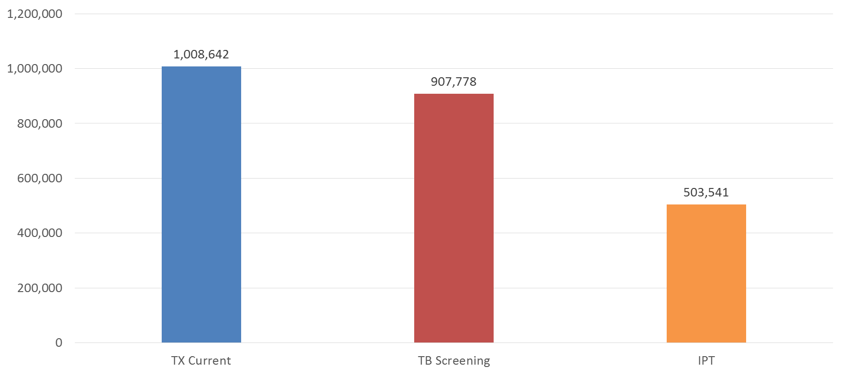
TB ICF/ IPT Kenya: Mar 2017
90% TB Screened
57% put on IPT
Data source: DHIS, DATIM, TIBU (*IPT data – April 2017)
Notes:
We estimate that about 60% of patients current on ART have ever been initiated on IPT based on DHIS reports/TIBU/DATIM
IPT coverage however differs by county

Slide 8
Scale-up of IPT Among PLHIVs, Kenya 2014-2016

Slide 9
Progress in IPT Uptake among HIV-positive Pregnant and Breast-feeding Women and Children in MNCH, Kenya, 2014-2017
Notes:
Progressive increase in IPT coverage among PMTCT mothers and children in PMTCT settings
Children include HIV positive children aged> than 12 months and HIV+ HEIs aged less than 1 year but exposed to smear positive TB
Efforts being made to improve data sharing for patients who had completed IPT prior to enrolment in MNCH clinic

Slide 10
IPT Uptake Among <5 Children Exposed to Smear +ve TB
Assumptions
Average house hold size= 5
One Smear +ve per House Hold
One child per household
Twenty-fold Increase in in IPT coverage
High Knowledge of HIV status
Half of children on IPT HIV positive
Notes:
Following the official launch in March 2015, all implementing partners were assigned targets based on current number of patients on ART
CDC supported development of performance tracking tools that are used to report IPT cumulative uptake, Quarterly IPT uptake and treatment outcomes for patients initiated on IPT same quarter last year
We hold quarterly performance review meetings with Implementing partners to review performance and national quarterly progress review meeting that brings together all stakeholders to assess progress

Slide 11
IPT Outcomes Among PMTCT Mothers Kenya 2014-2016
Over 96% IPT completion in 2016
Notes:
Following the official launch in March 2015, all implementing partners were assigned targets based on current number of patients on ART
CDC supported development of performance tracking tools that are used to report IPT cumulative uptake, Quarterly IPT uptake and treatment outcomes for patients initiated on IPT same quarter last year
We hold quarterly performance review meetings with Implementing partners to review performance and national quarterly progress review meeting that brings together all stakeholders to assess progress

Slide 12
IPT Outcomes Among Children, Kenya 2014-2016
Over 99% IPT completion in 2016
Notes:
Following the official launch in March 2015, all implementing partners were assigned targets based on current number of patients on ART
CDC supported development of performance tracking tools that are used to report IPT cumulative uptake, Quarterly IPT uptake and treatment outcomes for patients initiated on IPT same quarter last year
We hold quarterly performance review meetings with Implementing partners to review performance and national quarterly progress review meeting that brings together all stakeholders to assess progress

Slide 13
IPT Cascade among HIV-infected Children, Aged 12-24 months, Kenya 2014-2016
Over 91% IPT completion in 2016

Slide 14
Lessons learned
TB services can be integrated in PMTCT Settings
Scale up of IPT with good outcomes is possible in PMTCT settings
Multiple stakeholder involvement is essential for successful implementation
Integrating IPT in routine HIV service delivery and supply chain is critical for program support and commodity security
Ministry of Health leadership is critical in program success

Slide 15
Acknowledgements
PEPFAR
DGHT Kenya
Global Fund
Implementing Partners
Ministry of Health
Health Facility Staff

Slide 16
Thanks
Notes:
Our current reporting tools were last reviewed in 2014 before the official launch of IPT and hence do not provide detailed information on IPT
We hope that our next revision will take this into consideration.
We now share interim performance data based on different data sources

