Slide 1
EARLY IMPLEMENTATION OF OPTION B+
OCTOBER 2013 – FEBRUARY 2014
A webinar presentation

Slide 2
Content
Country profile
PMTCT in Tanzania
Option B+; Early implementation assessment findings
Actions from assessment findings
Recommendations

Slide 3
Country profile
Population 45 Million people¹
1.4m persons living with HIV (2013)³
98978 pregnant women living with HIV⁵
5.1% HIV prevalence among adults aged 15-49³
5.6% HIV prevalence among pregnant women⁴
Proportion of making at least one ANC visit 97%⁶
Proportion of making at least four ANC visits 43%⁶
Percentage of women with unmet need for family planning 25%⁶
Maternal Mortality Ratio 454/ 100,000
Infant Mortality Rates 51/1,000 live births⁶
Syphilis Prevalence among pregnant women 2.4%
1. National Population Census 2012, 2. National projections, 3. Tanzania HIV and Malaria survey 2010, 4. National ANC HIV Surveillance 2011/12, 5. Spectrum projections 2014, 6. Tanzania demographic and Health survey 2010

Slide 4
PMTCT in Tanzania
2000; Pilot
2002 – 2006 Sd NVP
2006 – 2010 AZT starting 28th week of GA
2010 – 2013 Option A
2013 -> Option B+
PMTCT is fully integrated in RMNCH
FP in HIV context in RMNCH
HTC in ANC, L&D and Postnatal
ART initiation in ANC, L&D and Postnatal
HEID in Postnatal

Slide 5
PMTCT in Tanzania
Rollout: By Dec 2014, ~5000 sites had started Option B+
Rollout started in 9 high burden region, in Oct 2013

Slide 6
PMTCT in Tanzania
A significant increase in # enrolled into ART
Notes:
Coverage of women receiving ART for their own health increased significantly in 2014 attributed to rollout of B+, there was ~ 40% increase in women receiving ART due to rollout of B+ in 2013 alone.

Slide 7
PMTCT in Tanzania

Slide 8
Early option b+ implementation assessment

Slide 9
Sample description
In 7 high burden regions, 1165(66%) of 1756 PMTCT sites started LLAPLA implementation by 4th quarter, 2013
Evaluated 26 sites in 13 districts
11 Hospitals, 9 health Centers, 6 Dispensaries
21 had CTC on site (only 2/6 dispensaries had CTC)

Slide 10
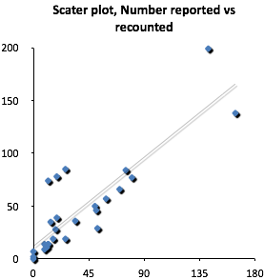
PMTCT DATA QUALITY
Data reported closely approximated actual site level performance, with tendency to under-report
Crosscheck revealed mean data recording accuracy of 68% (30%-100%)
VR=112%

Slide 11
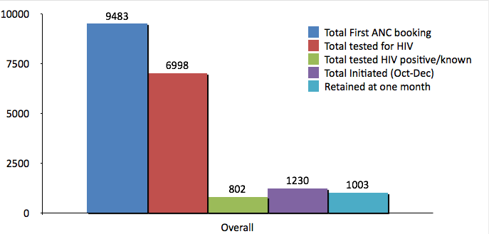
PMTCT cascade, October – December 2013, N=26 sites
74%
82%
Notes:
Retention is measured against everyone ART naïve or ART experienced, one month since registering at RCH clinic

Slide 12
HIV testing
Overall 74% testing coverage
11(42%) of sites reported test kits stock out within the quarter of Oct - Dec
In facilities with no stock out; overall testing was 92%, versus 60% in facilities with reported stock out (p<0.01)

Slide 13
ART initiation in RCH
Level | Total tested HIV positive/known | Total Initiated (Oct-Dec) | Retained at one month
Hospital | 547 | 779 | 627
Health center | 162 | 330 | 280
Dispensary | 93 | 121 | 96
Overall | 802 | 1230 | 1003
Total initiated includes
Newly Diagnosed women
Transitioning from AZT to TLE
Transfers of pregnant and breastfeeding women from CTC to RCH

Slide 14
ART initiation in RCH…
Large number of breastfeeding and pregnant women currently on ART transitioning to new TLE regimen
Unanticipated, leading to TLE stock shortage
Competition for TLE between RCH and ART clinics
Complete TLE stockout; switching to alternative regimens
4 (15%) sites reported TLE Stock out

Slide 15
Commodity Management
Facility staff asked to demonstrate how to order commodities and graded as correct or incorrect
77% correctly demonstrated ordering HIV test kits
88% for ARV ordering
Lower knowledge of protocol associated with reported stockout in past months
Sites with TK stockout, 73% vs. 81% demonstrated correct protocol
Sites with TLE stockout, 75% vs. 91% correct protocol

Slide 16
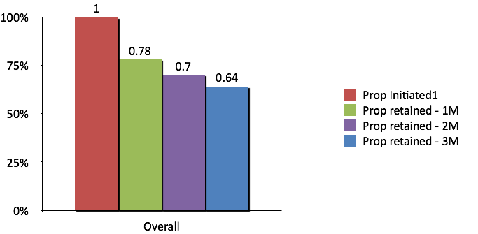
Retention
Notes:
Overall retention in the first first month is 78% which is what Malawi had at 3 months (ART naïve only) what we found really is that data are not updated regularly (data are updated in patient files but not in the registries)_ Data issues than true retention.
Retention at 3 months was noted to be at 64%
There was no association with between retention and health facility characteristics
Retention at 1m-62 cohorts
Retention at 2m-37 cohorts
Retention at 3m-14 cohorts

Slide 17
Site visits observations
Site staff were not aware of poor retention
There was little skills in chronic care clinic management, (no appointment and follow-up system)
Week community linkage (Home based care services is not integrated into RCH)
Some sites with good retention reported using cellphone reminder
Stock outs were not uncommon even before rollout of B+
RTKs
TLE, but other ARVs were available

Slide 18
Capacity and space
Observation
Limited space in RCH for confidential ART services
Fewer staffs against large service portfolio
ANC, Immunization, FP, PMTCT-LLAPLA
Untapped capacity and resources at ART clinics coexisting with RCHs
Limited space and high workload – domino effect
Inadequate adherence assessment, counseling and support
Shortage of current data tools
Many data errors noted, due to inadequate understanding of ART data and patient management
Notes:
In some facilities RCH staff were too few
Good examples in CTC/RCH collaboration where staff from one clinic rotates to the other (noted in lower health facilities) collaboration need to be emphasized in hospitals that also account for largest number of women initiating on ART in RCH

Slide 19
Key Findings
LLAPLA was successfully rolled-out as planned
Data issues threatens program’s ability to monitor performance
Retention
Accuracy of other metrics
HIV commodities Stock stability was promising
TLE stock levels were not optimum during rollout onset; Stabilized later
RTKs stock levels have ben in emergency levels, without drastic stockout
Staff capacity and space for quality care in RCH clinics remain desired
Retention issues related to skills, data and inadequate community linkage
Space and HR shortage compromise privacy, and quality time for care

Slide 20
Actions from Findings
Redistribution of TLE from overstocked, to under stocked/stocked out facilities
Emergency supply of RTKs
Addressing data issues and overall performance;
Starting scoring system, and incorporation of PMTCT indicators into RMNCH score card
PMTCT-RMNCH focused DQA
Designing Cohort monitoring for Mother-Baby pair
Developing response system focusing on
Commodity availability
Retention
HEID
Quality of HTC
Data quality
Adapting appointment and tracking systems for chronic care

Slide 21
Recommendations
Considering data requirement and appropriate adjustment to meet M&E needs (include continuous data quality improvement)
Data needs
Quality
Consider Logistic systems, anticipated and unanticipated events
Smart push for consumables
Proper Commodity management (chronic care needs)
Capacity and space
Tap into existing ART clinics staff skills in chronic care
Task shifting, Nurses focus on clinical care
Expand clinic space, and manage appointments
Enforce quality improvement

Slide 22
Recommendations
Develop/implement emergency response system especially in the early phase
Commodity stock stability
Data quality
Retention monitoring
Quality of HTC

Slide 23
Acknowledgement
Regional Teams in regions involved
USG and UNICEF Tanzania
IATT-UNICEF New York
MoHSW – PMTCT program staff

