Slide 1

Disclosure of HIV Status Toolkit for Pediatric and Adolescent Populations
Dr. Natella Rakhmanina & Dr. Judith Kose
June 19, 2019

Slide 2

Vision
A world in which young people living with HIV lead full and healthy lives, achieve their aspirations and reach their potential.
Through our collective effort, we will advance a holistic, integrated approach to high-quality and sustainable pediatric HIV care and treatment, with a specific focus on those in need of 2nd and 3rd-line medicines.
Mission

Slide 3
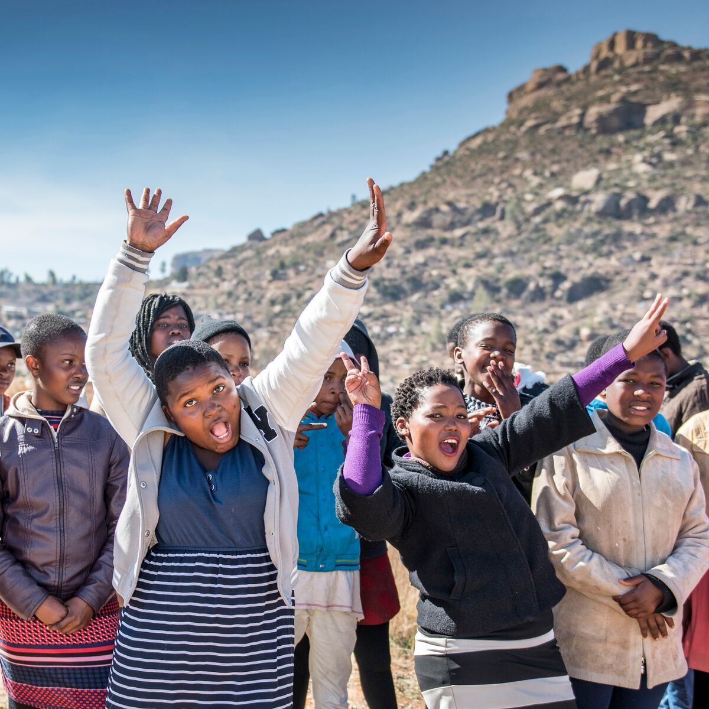
New Horizons Collaborative Goals
Contribute to UNAIDS 90-90-90 target
Ensure that the global HIV response addresses the critical unmet needs of children & adolescents
Promote treatment equity between adults & children
Link 5,000 pediatric patients to 2nd and 3rd-line care & access to J&J treatment by 2020
Notes:
New Horizons countries: Cameroon, Eswatini, Ethiopia, Kenya, Lesotho, Nigeria, Rwanda, Uganda, Zambia, Zimbabwe.

Slide 4
Disclosing HIV Status in Perinatal HIV
WHO guidelines recommend that children of school-going age (6-12 years) be told they are HIV-positive.
Disclosure prevalence from 16 studies in resource limited settings ranged from 0 to 69%.
Factors influencing disclosure:
  Child’s age.
  Perceived ability to understand HIV infection.
  Caregiver education level.
  Caregiver openness about their own HIV status.
Common barriers:
  Fear that the child would disclose HIV status to others.
  Fear of stigma.
  Concerns for children’s emotional or physical health.
Source: Vreeman RC, et al. J Int AIDS Soc, 2013.

Slide 5
Disclosure Practices
Varies between countries
  Partial disclosure: 4-6 years in Tanzania, 8-10 years in Rwanda.
  Full disclosure: 7 years and above in Zambia, 11-14 years in Rwanda.
Based on child’s maturity, needs, and understanding.
Engagement of caregivers:
  Joint disclosure with health care worker.
  Empowering caregivers to disclose.
  Assisted disclosure by caregiver: with health care worker support.
Notes:
Based on child’s maturity, needs, and understanding: Eswatini, Kenya, Malawi, Tanzania, Uganda, Zimbabwe
Engagement of caregivers
Joint disclosure with health care worker: Cameroon, Mozambique, Tanzania, Zimbabwe
Empowering caregivers to disclose: Malawi
Assisted disclosure by caregiver with health care worker support: Eswatini, Kenya

Slide 6
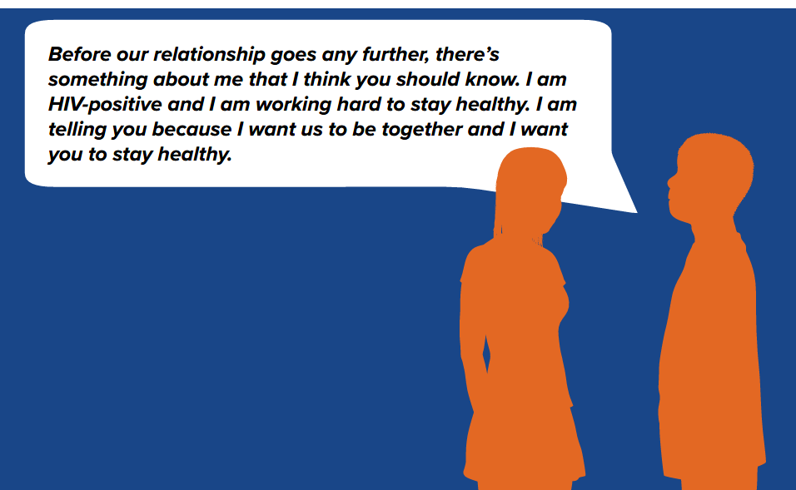
Toolkit Components
Evidence-informed.
Guidance and checklists for disclosure by:
  Health care workers
  Caregivers
  Horizontally-infected adolescents to caregivers
  Adolescents to social networks, community and partners
Job aids:
  Algorithms.
  Readiness assessment checklists.
  Role playing scenarios.
Available online at: http://www.pedaids.org/
wp-content/uploads/2019/01/NewHorizons
DisclosureToolkit_FINAL.pdf
Notes:
Background on the evidence base for disclosure, types of disclosure, and benefits and disadvantages of disclosure
Guidance and checklists for:
Health care workers on disclosing to a child or adolescent
Supporting caregivers to disclose
Supporting horizontally-infected adolescents to disclose to caregivers
Supporting adolescents to disclose to social networks, community, partners
Job aids
Algorithms
Readiness assessment checklist
Role playing scenarios

Slide 7
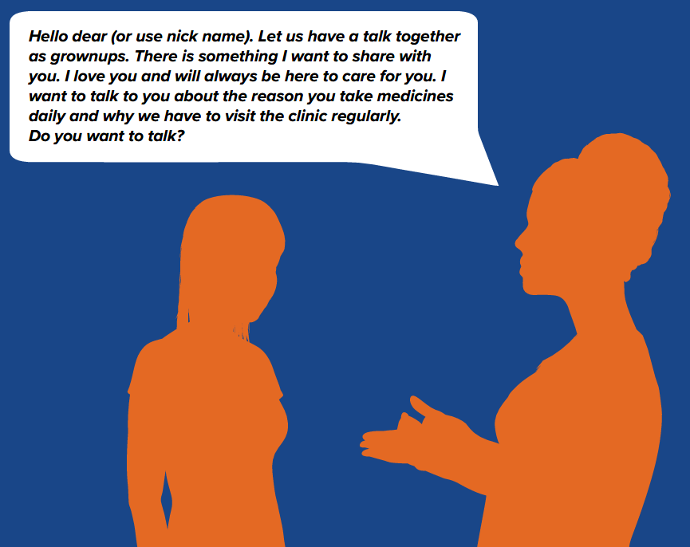
Structure of Modules
Benefits and barriers
Readiness assessment
Disclosure tips and key talking points
Post-disclosure evaluation and follow up
Notes:
PICTURE FUZZY

Slide 8
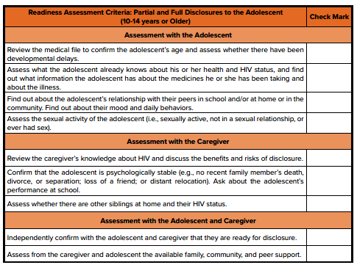

Slide 9
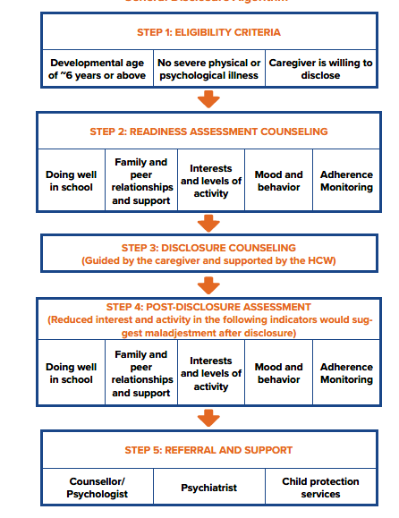
Disclosure Algorithm

Slide 10
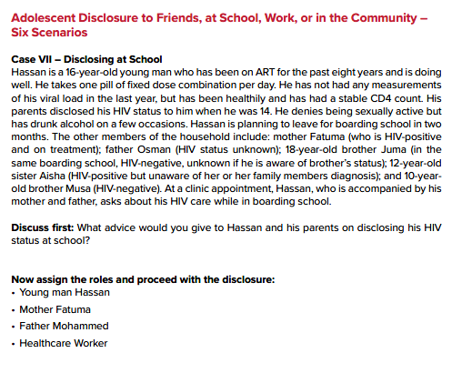
Role Playing Scenarios

Slide 11
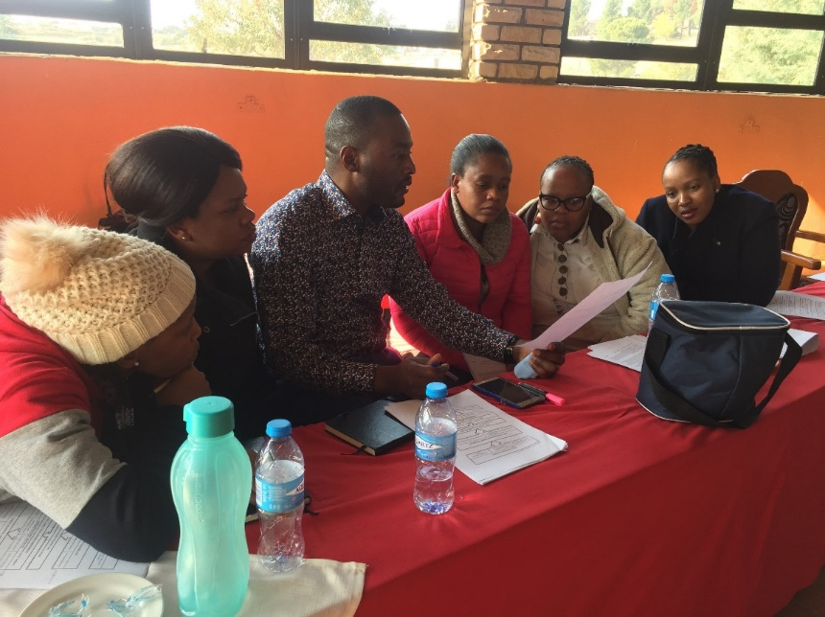
Toolkit Validation
Structured, small group discussion sessions and individual questionnaires used to gain feedback from health care workers who provide HIV care for children and adolescents.
Kenya: 36 participants from 5 facilities.
Lesotho: 38 participants from 8 facilities.
Health care worker cadres represented: clinicians, clinical officers, nurses, peer supporters, youth ambassadors, pharmacists, adherence counselors, peer educators, HIV testing services providers, social workers, and psychologists.

Slide 12
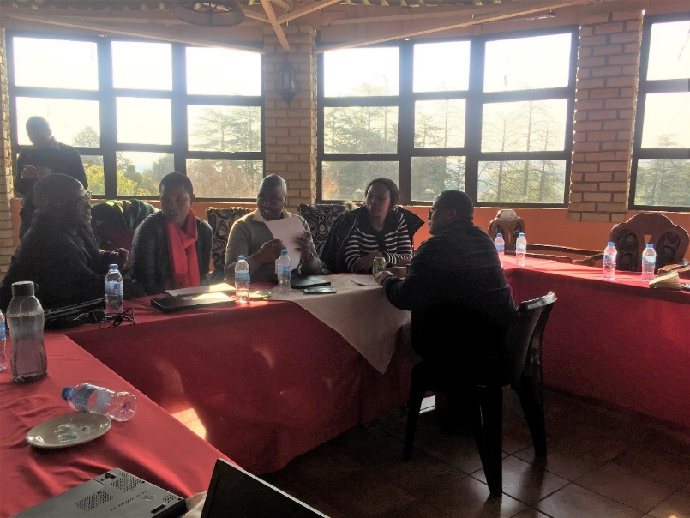
Validation: Main Findings
Majority of participants have worked in the HIV field for 5-10 years.
Tool found to be feasible and useful – complementing existing tools, as was the case in Kenya.
Background information on disclosure definitions and process was seen as beneficial.
Disclosure algorithm was viewed as the most useful component.
  Feedback to add additional elements, including adherence monitoring post disclosure.
Country-specific differences were observed:
  Role of HCW in disclosure.
  Existence of disclosure tools.
Notes:
PICTURE FUZZY

Slide 13
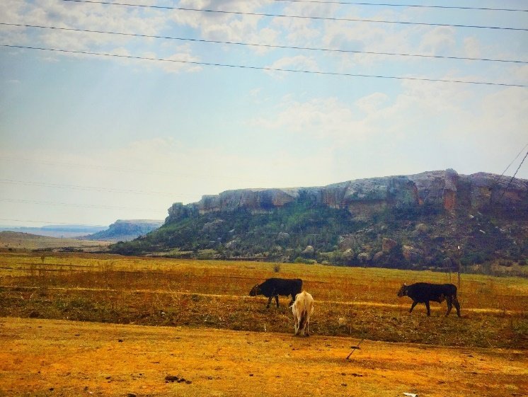
Validation: Main Themes
Add language/content on health care worker support in schools and community, faith settings.
Address accidental/unintentional disclosure.
Need for graphics/pictures.
Increase the amount of role plays and scenarios – practical guidance for health care workers and adolescents.
Notes:
PICTURE FUZZY

Slide 14
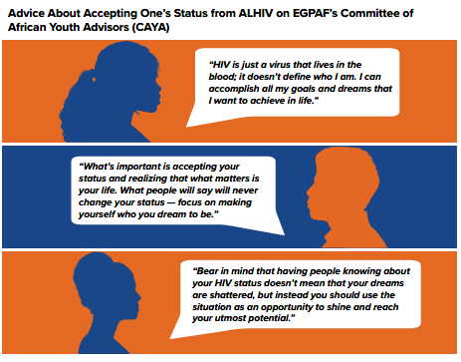

Slide 15

Next Steps
Currently available in French: http://www.pedaids.org/wp-content/uploads/2019/01/NewHorizonsDisclosureToolkit_FRFINAL.pdf
Portuguese version available soon.
Dissemination by EGPAF offices.
Notes:
Ugandaworking to get language integrated into MOH guidelines. Zimbabwe working to get the resource co-branded with MOH. Kenya county level capacity building activities using tool.

Slide 16


Slide 17
The Committee and African Youth Advisors (CAYA) –Youth Voices and Contribution to the Disclosure Toolkit
Joshua Ochieng |CAYA Member - Kenya

Slide 18
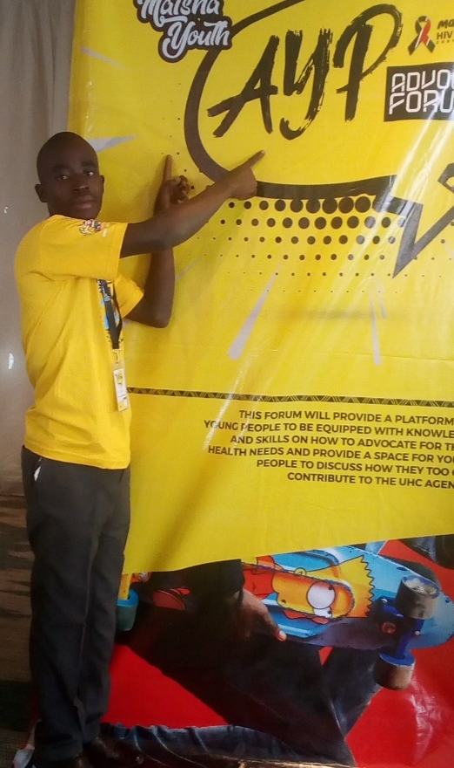
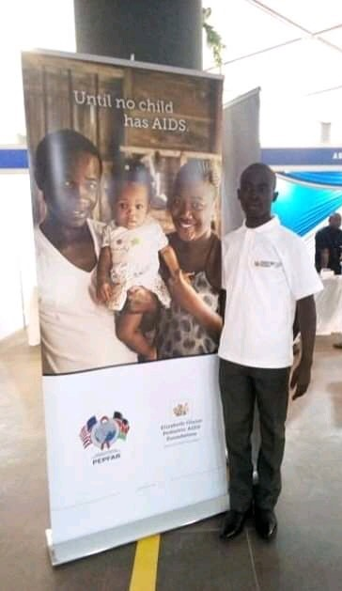
My Story
Joshua Ochieng
Kenya
21 years old
How I got to where I am today:
  Growing up
  Adolescent Champion; Adolescent Young People (AYP) Advisory Group member
  CAYA member
  Currently attending Maseno University
18

Slide 19
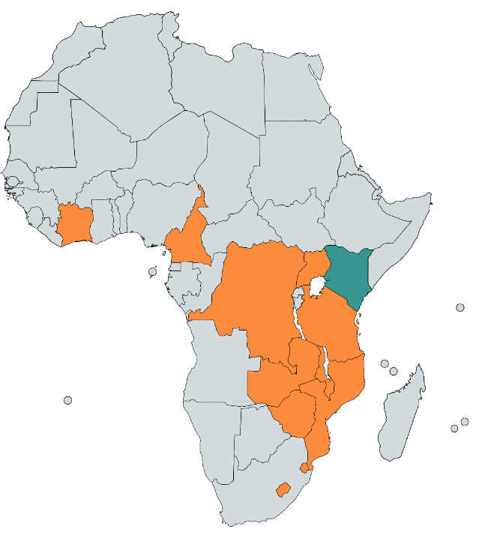
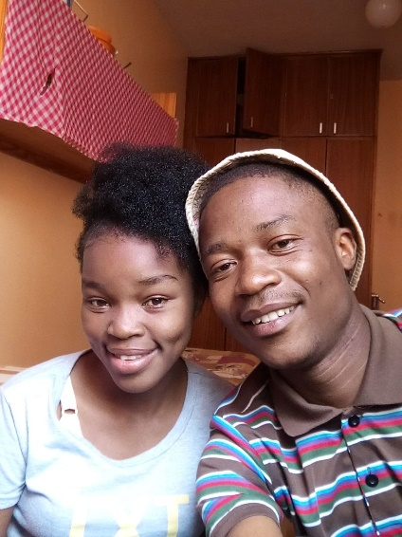
What CAYA is and How it Works
Virtual Meetings & Tasks
Members (2 youth per country)
Global Staff
Country Focal Point
EGPAF recognizes that meaningful participation of youth is integral to the future success of programs
A dynamic partnership with youth across EGPAF countries to better align global investments toward EGPAF’s mission, ending pediatric AIDS
20 CAYA Members from 11 EGPAF presence countries
Tema and Mthobisi – CAYA Members in Eswatini
19

Slide 20
CAYA’s Review and Feedback Role
Focus on supporting ALHIV to disclose status outside the clinic, to their:
    Caregiver / family
    Friends, social networks, school, and place of work
    Partner
Provided views regarding:
How HCWs should approach the disclosure process with adolescents
The benefits/challenges of disclosure, from a client perspective
Practical / realistic advice for unintentional/accidental disclosure and what to do after negative disclosure experiences
CAYA feedback incorporated into the tool:
Added new content for disclosure in the community
Provided a youth perspective on provider language and technique
Examples and quotes from CAYA lives
20

Slide 21
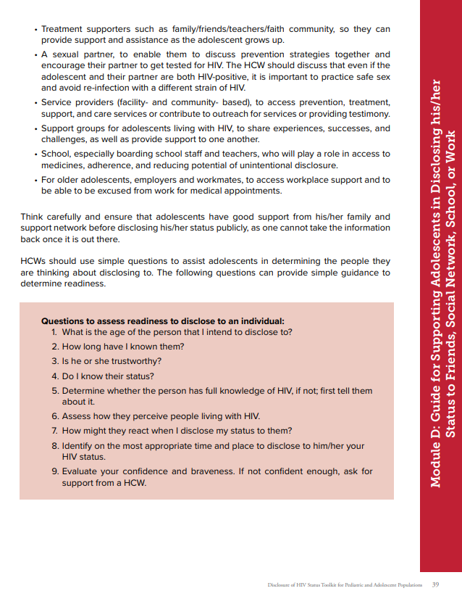
CAYA Contributions: 7 countries
CAYA:
Offered real time disclosure over WhatsApp, using emoji's and hashtags
Suggested using visuals (i.e. cartoons) to communicate disclosure
Gave advice on accepting one’s status, to motivate peers
In Kenya:
the CAYA team suggested HCWs can discuss key questions that assess ALHIV readiness to disclose to their social networks
21

Slide 22
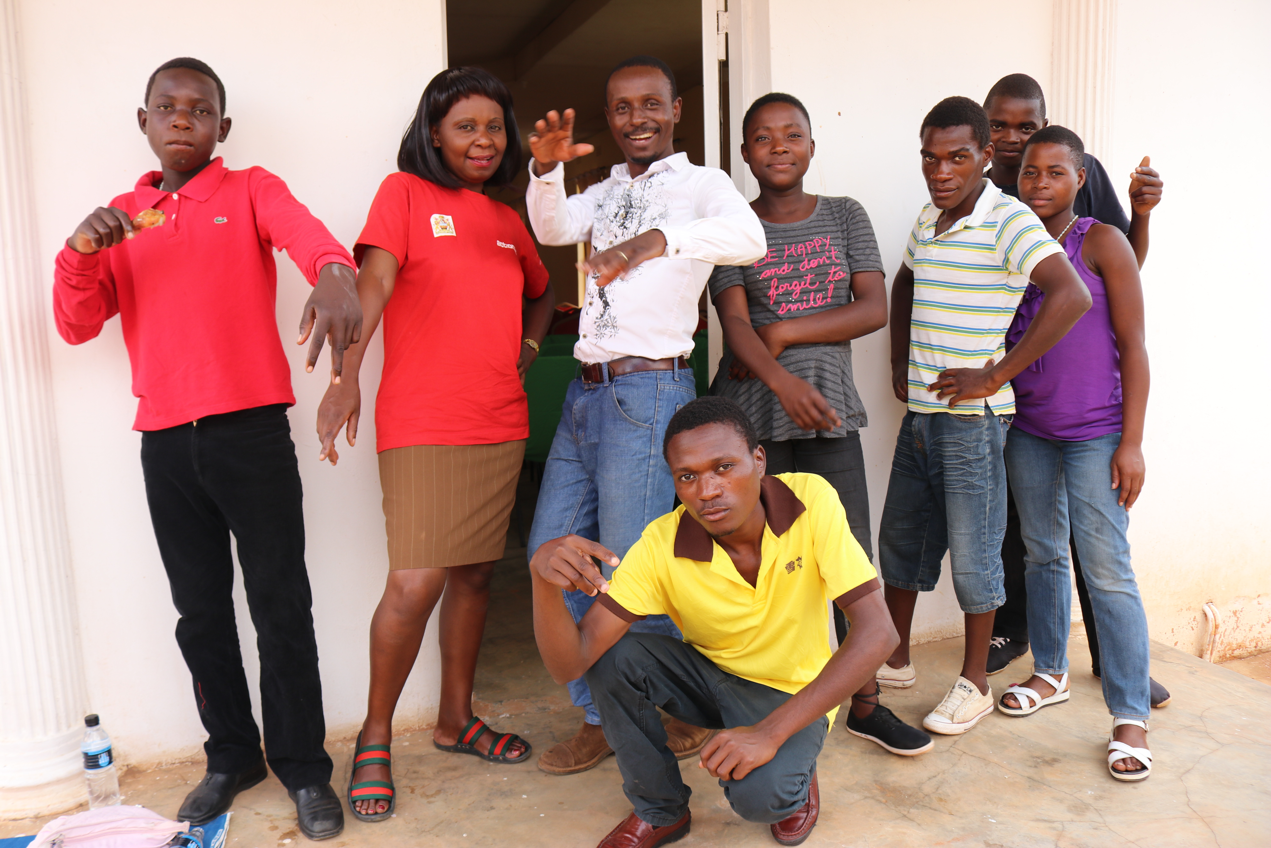


Results of the Disclosure Toolkit
Fast uptake and ownership of the Disclosure Toolkit from teams who developed the tool
  Project use in Malawi – Clinical / CAYA Focal Point and members began using it within teen clubs to help with partner disclosure
  Advocacy in Zimbabwe – CAYA members and Technical Director presenting the toolkit to the Ministry of Health; recommending national adoption
Identified need for new resources to address disclosure stigma, shame, and myths
  CAYA Cartoons developed for use by YPLHIV in support groups
Vincent (Center), Linkage Nurse and CAYA Focal Point, with young people in Malawi
Tanya and Rosa, CAYA Members from Zimbabwe
22

Slide 24
Download the toolkit in English and French: www.pedaids.org/resource/disclosure-of-hiv-status-toolkit-for-pediatric-and-adolescent-populations/
The webinar recording and presentation download will soon be available on www.childrenandaids.org
Thank you for joining!
Please type your questions into the chat box for the Q&A session.
Please contact Rikke Le Kirkegaard (rlekirkegaard@unicef.org) for any additional questions for the speakers or to learn more about the Children and AIDS Learning Collaborative.

