Slide 1
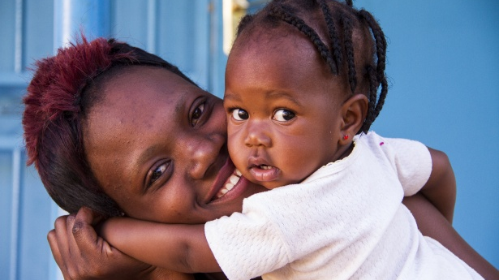
WHO Guidelines to achieve VL suppression in children
Dr Martina Penazzato
Paediatric HIV lead
HIV Hepatitis and STI programme
WHO Geneva

Slide 2
53% of children living with HIV are receiving treatment compared to 68% of adults
Only 950,000 children receiving treatment in 2019
Children living with HIV is declining with reduction in new infections and as children age into adulthood
Most recent data suggest lower numbers in mid-2020
Source: UNAIDS 2020 Estimates

Slide 3
Treatment optimization
Starting
children on preferred regimens in optimal formulations
Changing
formulations as children grown and can take more optimal formulations
Transitioning
to better regimens and formulations as improved regimens are available
Switching
to appropriate 2nd or 3rd line regimens in optimal formulations when VL failure
For the benefit of the individual and the programme!

Slide 4
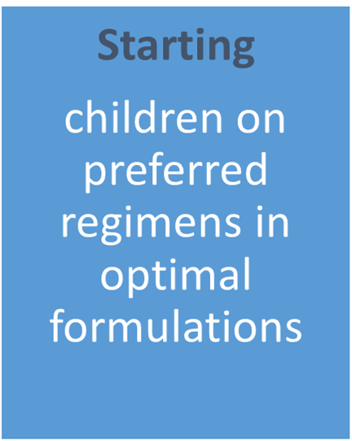
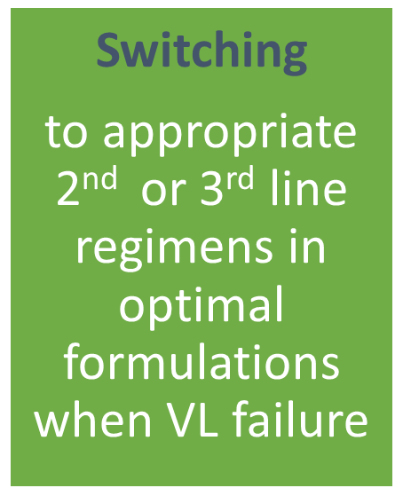
Additional evidence in support of WHO guidelines
Presented @CROI!
WHO Guidelines ALREADY recommend DTG for ALL children in need of 1st or 2nd line ART

Slide 5
Per protocol analysis over 96 weeks
Estimated risk difference
(DTG-SOC)
[95% CI] p-value:
Primary: Total
-8.0% [-13.5%,-2.6%] p=0.004
Per-protocol: Total
-6.8% [-12.2%,-1.4%] p=0.01
No significant difference in treatment effects by sex, weight, age, stratification factors, baseline VL or baseline CD4
A/B NI margin
Primary: ODYSSEY A
Total NI margin
-12.5% [-20.6%,-4.3%] p=0.003
Per-protocol: ODYSSEY A
-12.6% [-21.1%,-4.1%] p=0.004
Primary: ODYSSEY B
-4.6% [-11.8%,2.7%] p=0.22
Per-protocol: ODYSSEY B
-2.3% [-9.5%,4.9%] p=0.53
-24
-20
-16
-12
-8
-4
0
4
8
12
Difference in proportion with failure
DTG better SOC better
Turkova et al. CROI 2021
$ Excluding all patients who did not meet eligibility criteria & censoring follow-up in both arms for switch to 3rd agent for protocol deviation, toxicity or pregnancy, or stop of ART for >31 days

Slide 6
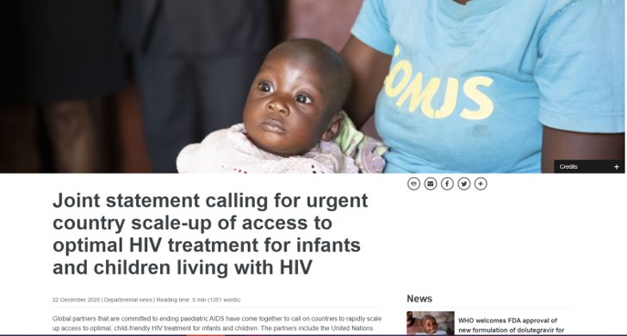
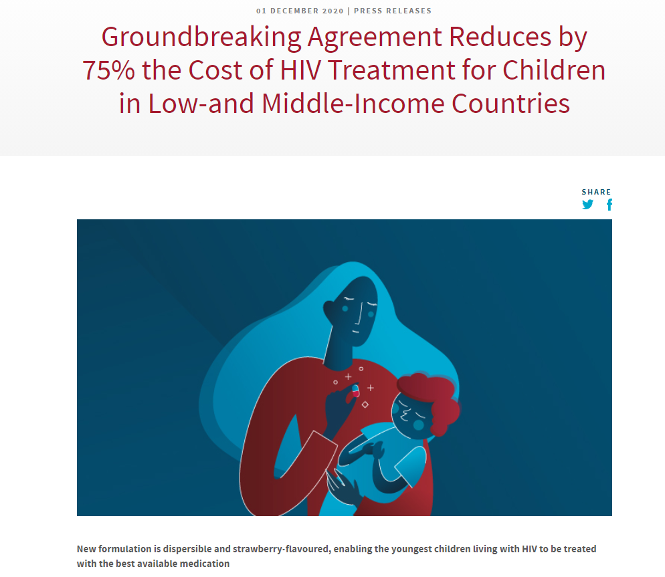
Accelerated development of a DTG 10 mg dispersible scored tablet will provide scalable access to a generic pediatric DTG formulation for children under 20kg
It would be possible to take advantage of TxD and associated health benefits and cost savings within a new tender to commence in April 2018
DTG 10mg Dispersible
Suppliers | Dosage
Mylan MacLeods | 10mg
Courtesy of CHAI

Slide 7
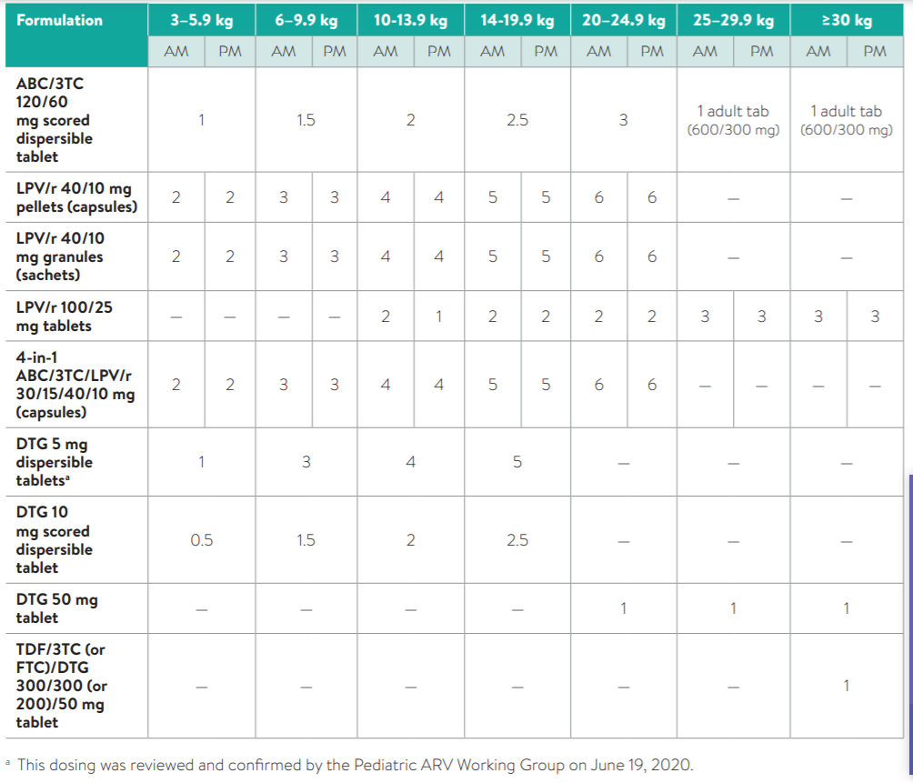
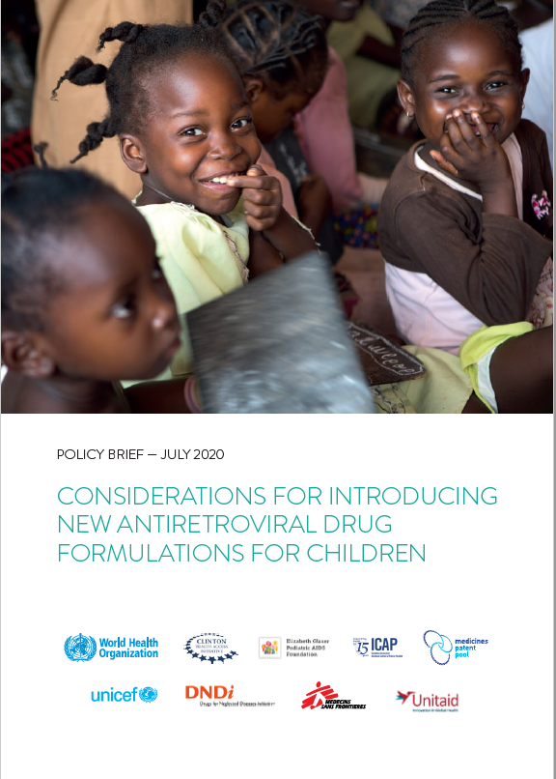
Dosing of DTG below 20 kg is now available and NO FURTHER guidance is needed on the formulations (including BD for children on TB Tx)

Slide 8
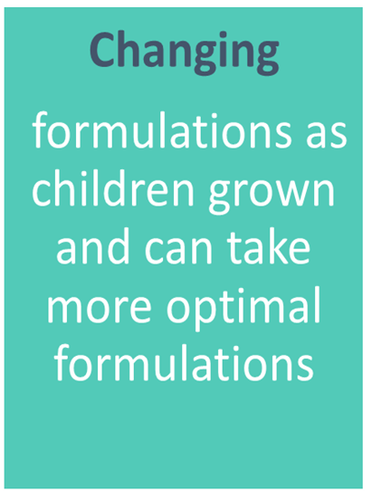
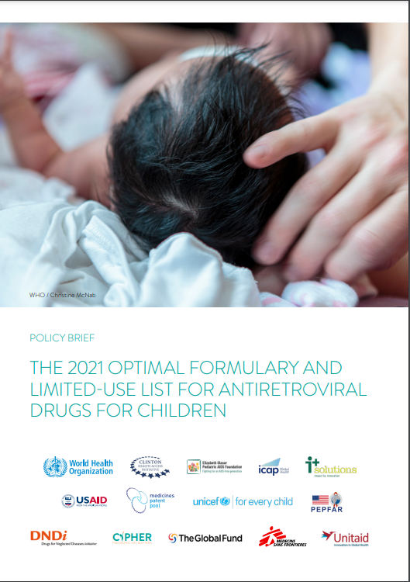
New ARV Optimal Formulary and Limited Use List
Since 2011, the publication of the Optimal Formulary and Limited-use List has provided clear guidance to country programmes, procurement entities and funding agencies on the essential antiretroviral therapy (ART) dosage forms for children needed to deliver WHO-recommended ART regimens for all lines of treatment.
The products included are regularly reviewed against a specific list of criteria that considers current WHO recommendations, supply constraints and programmatic realities to support programmes in taking a pragmatic approach to implementing WHO guidelines
This sixth edition of the Optimal Formulary and Limited-use List is intended to support the transition and implementation of preferred and alternative ART regimens recommended for infants and children across all lines of treatment.
2021 Optimal formulary Launched today!

Slide 9
2021 Paediatric ARV Optimal Formulary and Limited-use List
2021
DRUG | FORMULATION | DOSE
2021 Limited-use List
DRUG | FORMULATION | DOSE
DTG
Tablet, disp, scored
10 mg
NVP
Tablet, disp, scored
50 mg
ABC/3TC
Tablet, disp, scored
120/60 mg
3TC
Oral liquid
50 mg/5mL
AZT
Oral liquid
50 mg/5 mL, 240 mL
RAL
100 mg
Granules for suspension
NVP
Oral liquid
50 mg/5 mL, 100 mL
LPV/r
Oral pellets
40/10 mg
LPV/r
Tablet, heat-stable
100 mg/25 mg
DRV
Tablet
75 mg, 150 mg
LPV/r
Oral granules
40/10 mg
RTV
Tablet
25 mg
AZT/3TC
Tablet, disp, scored
60/30 mg
DTG 50 mg for children ≥ 20 kg

Slide 10
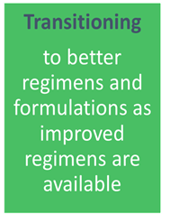
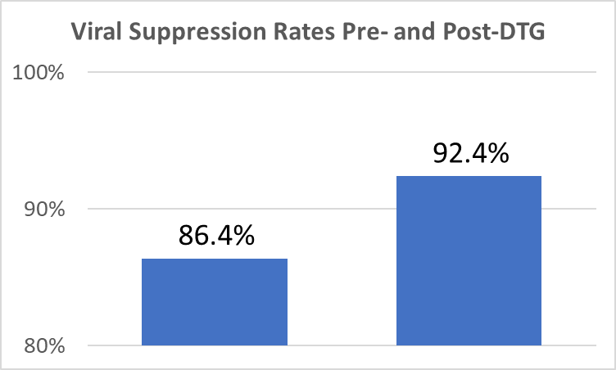
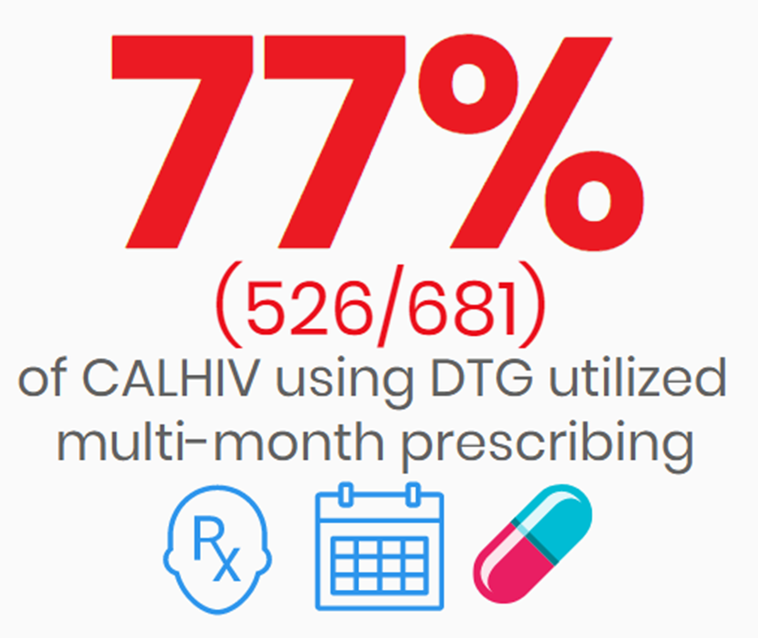
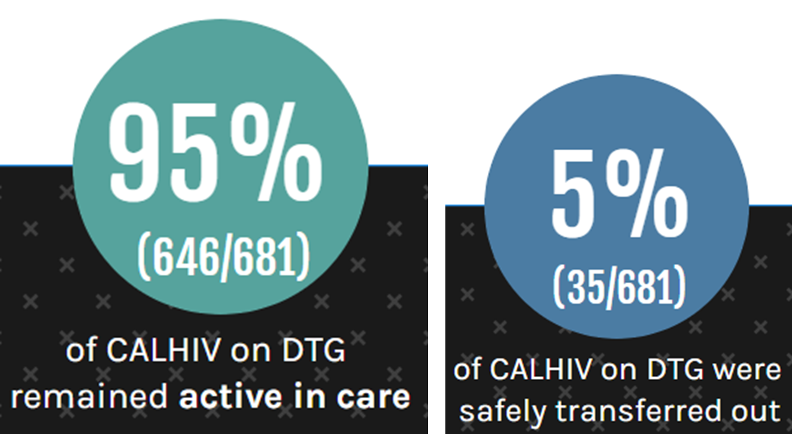
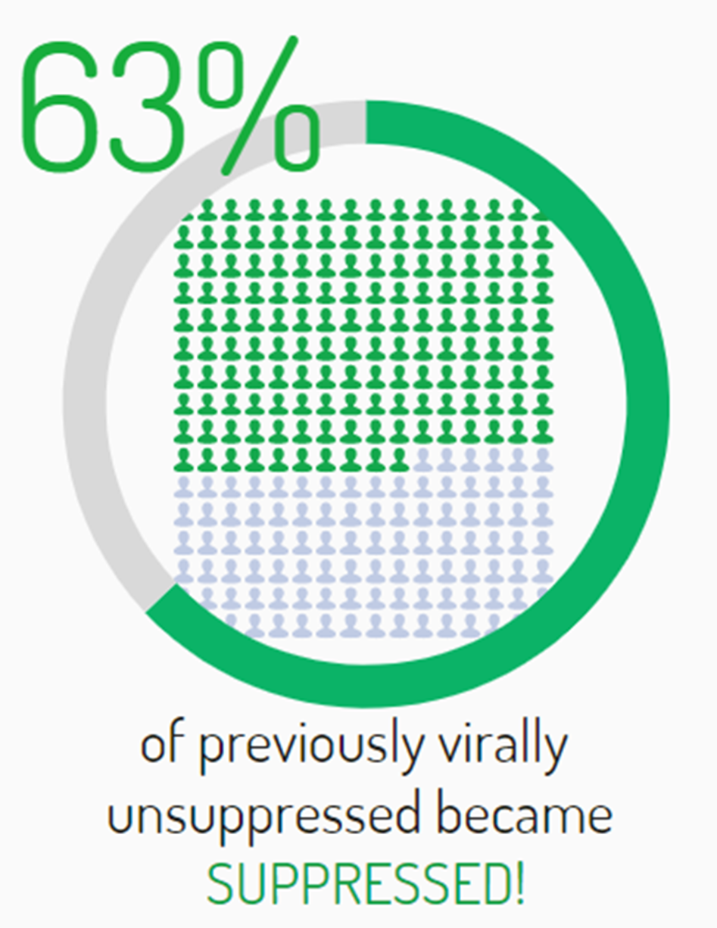
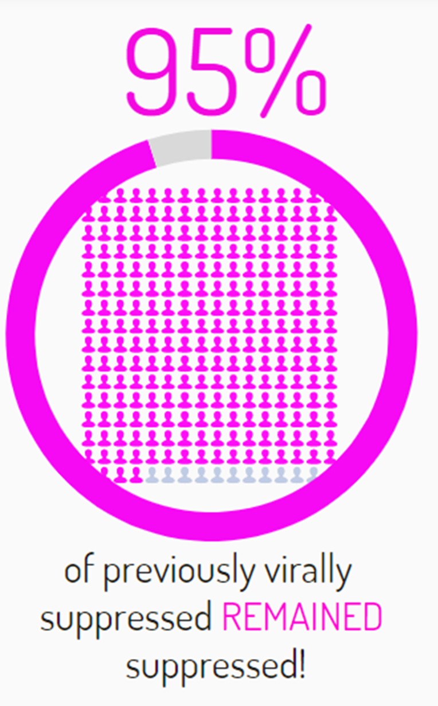
Bacha J et al. HIV Paediatrics Workshop Nov 2020
74%
(1254/1703)
1002/1084
1257/1455
86%
98%
(1674/1703)
2%
(29/1703)
(149/174)
(694/734)

Slide 11
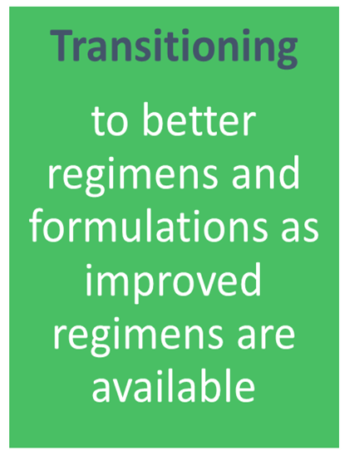
PAWG advice on transition to DTG for children established on 1st or 2nd line ART
The PAWG encourages rapid transition to DTG-based regimens for ALL infants and children (older than 4 weeks and weighting at least 3 kg) established on 1st and 2nd line ART irrespective of their current regimen. Timing of transition to DTG-based regimens for these infants and children should account for:
Availability and anticipated supply of paeds DTG and, in case of inadequate supplies to provide DTG to all children, the need to prioritize children who most need DTG considering:
The urgency to transition children off NNRTI-based regimens
The importance of transitioning children who need to start TB treatment
The anticipated benefits to transitioning children on LPVr solid formulations, particularly where those continue to present challenges in administration and/or challenges with attaining optimal VL suppression
Viral load testing is not be considered a precondition to undertaking programmatic or individual transition to DTG-based regimens. While viral load monitoring remains a good practice to deliver appropriate care to children living with HIV, infants and children should not have their transition to DTG delayed due to lack of documented viral load.
Fully endorsed by PAWG in March 2021 and to be included in 2021 WHO ARV Consolidated Guidelines

Slide 12
Treatment monitoring in children and adolescents is critical to preserve future treatment options
Less likely to be virologically suppressed
Less treatment options
Life-long treatment
More likely to acquire HIVDR from their mother
More likely to fail with multi-drug resistance
Timely identification of virological failure and switch to appropriate 2nd line can minimize selection of drug resistance and optimize future treatment optiojn improving overall clinical outcomes in children and adolescents

Slide 13
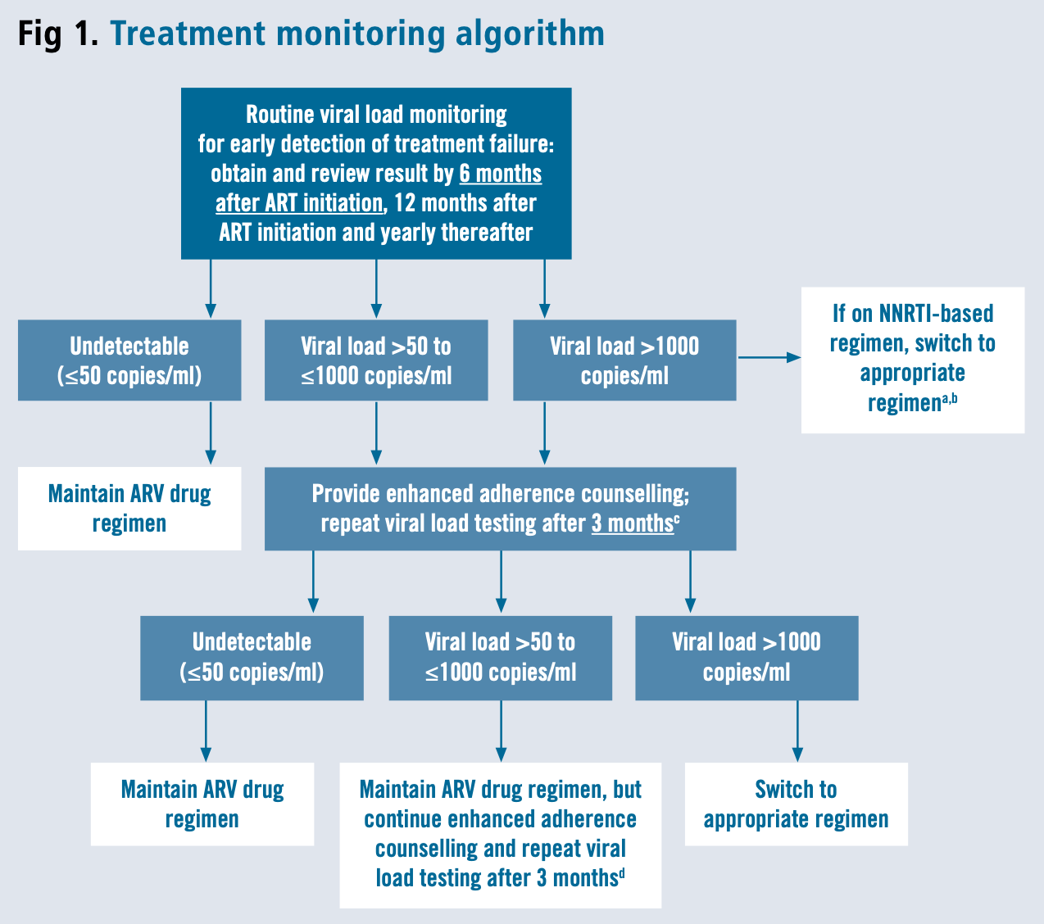
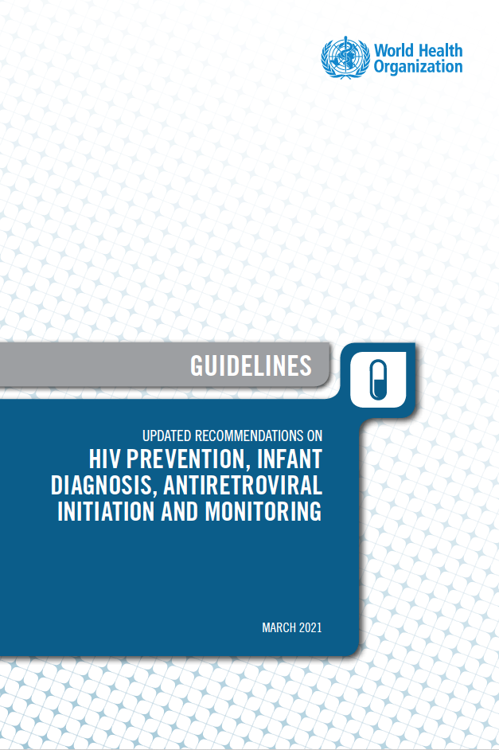
2021 Updated treatment monitoring algorithm
https://apps.who.int/iris/handle/10665/340190

Slide 14
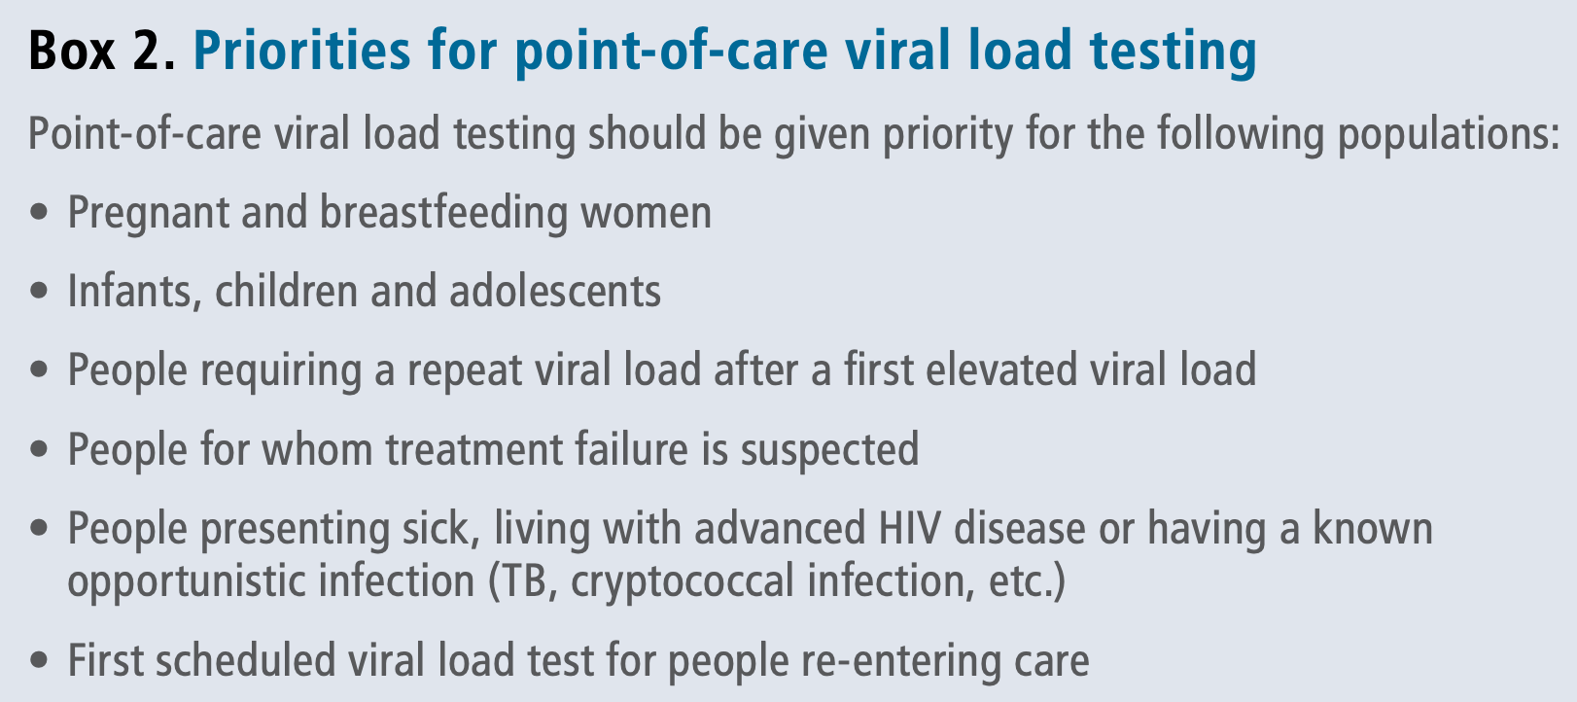
2021 Point-of-care viral load recommendations
https://apps.who.int/iris/handle/10665/340190

Slide 15
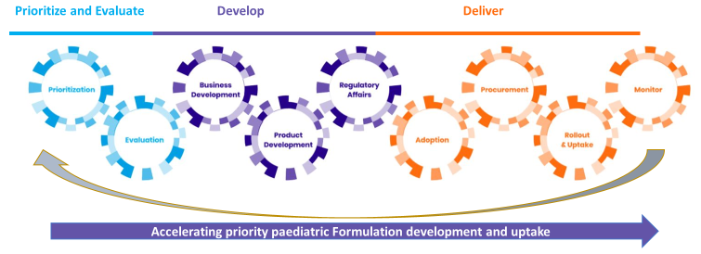
Collaboration and Political are needed to move the needle
GAP-f network set up as a collaboration platform to accelerate investigation, development and introduction of better medicines for children with pDTG as a proof of concept of “what we can do together” when we are aligned and join forces
The “Vatican Platform” generated political momentum and elevated the technical work of many stakeholders generating acceleration or strengthening to develop and roll out pediatric HIV testing and treatment. The initiative’s robust monitoring and reporting system promote transparency and mutual accountability

Slide 16
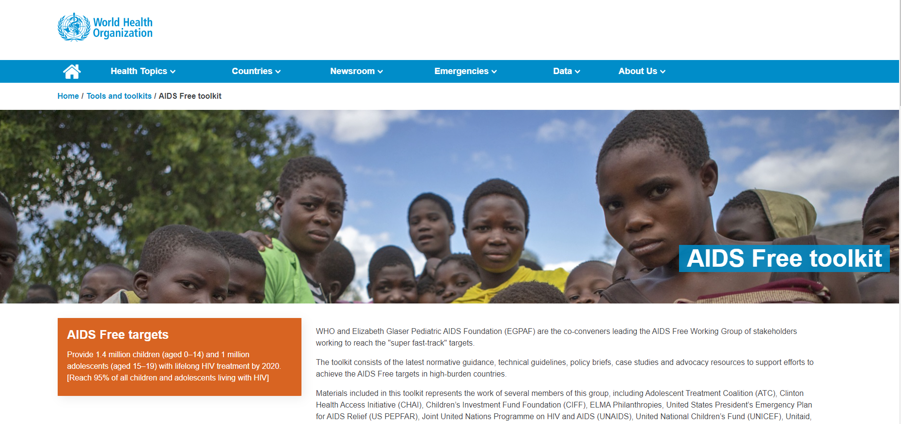

Slide 17
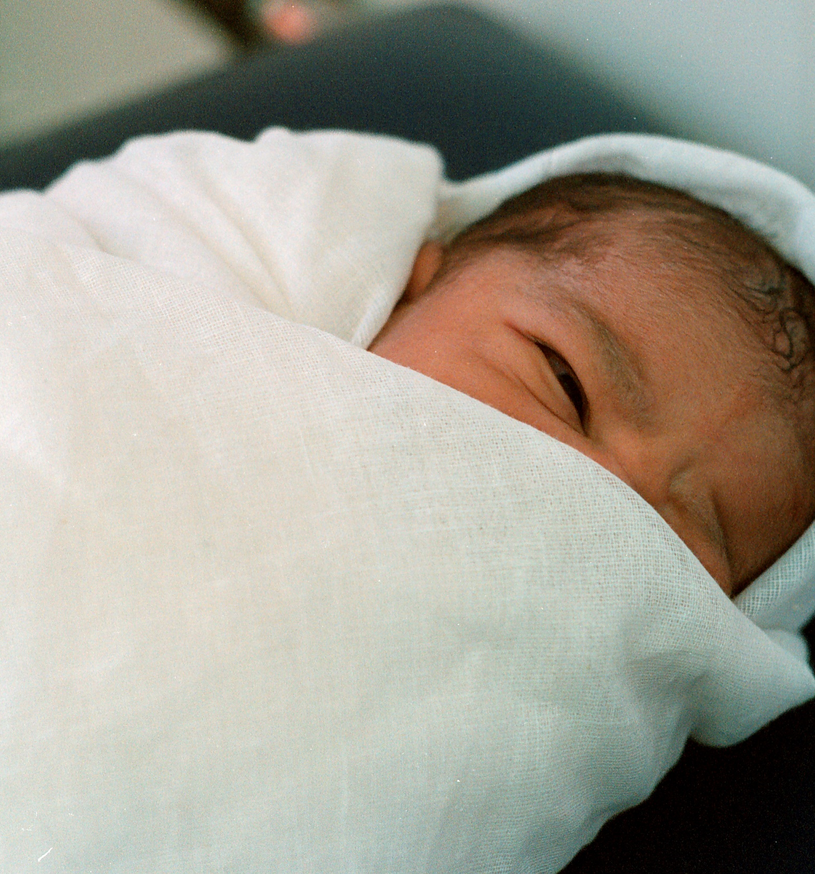
Thank you
WHO
20, Avenue Appia 1211 Geneva
Switzerland
www.who.int
www.gap-f.org/
www.who.int/hiv/pub/paediatric/aids-free-toolkit/en/
www.who.int/hiv/pub/research-dev-toolkit-paediatric-arv-drug-formulation/en/

